Slide 1
STh-01
MODERN ADVANCES IN COMPUTATIONAL IMAGING AT MICROWAVE AND MILLIMETRE-WAVE FREQUENCIES
Okan Yurduseven^{#1}, Thomas Fromentèze^{#2}
^{#1}Queen’s University Belfast, UK
^{#2}Xlim Research Institute, University of Limoges, France
¹okan.yurduseven@qub.ac.uk, ²thomas.fromenteze@unilim.fr

Slide 2
STh-01
New advances in computational imaging:
Polarimetric imaging, phaseless imaging, and recent advances in antenna systems and k-space reconstruction techniques
Okan Yurduseven^{#1}, Thomas Fromenteze^{#2}
^{#1}Queen’s University Belfast, UK
^{#2}Xlim Research Institute, University of Limoges, France
¹okan.yurduseven@qub.ac.uk, ²thomas.fromenteze@unilim.fr

Slide 3
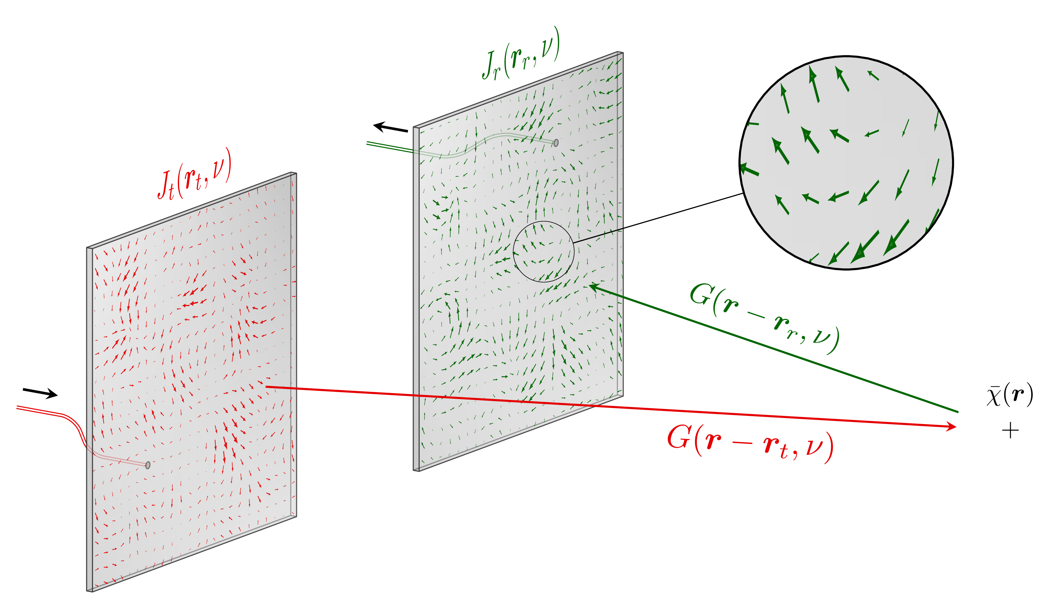
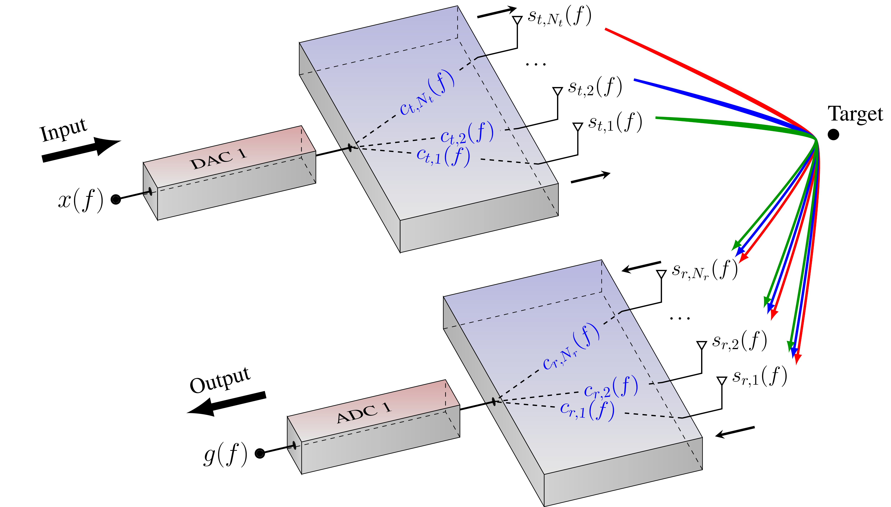
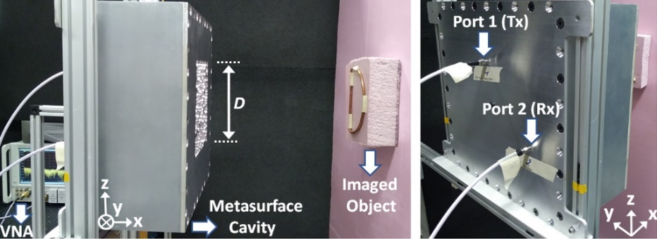
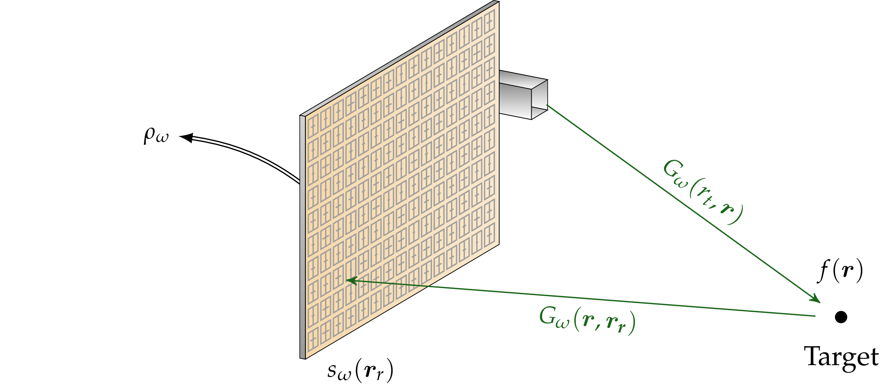
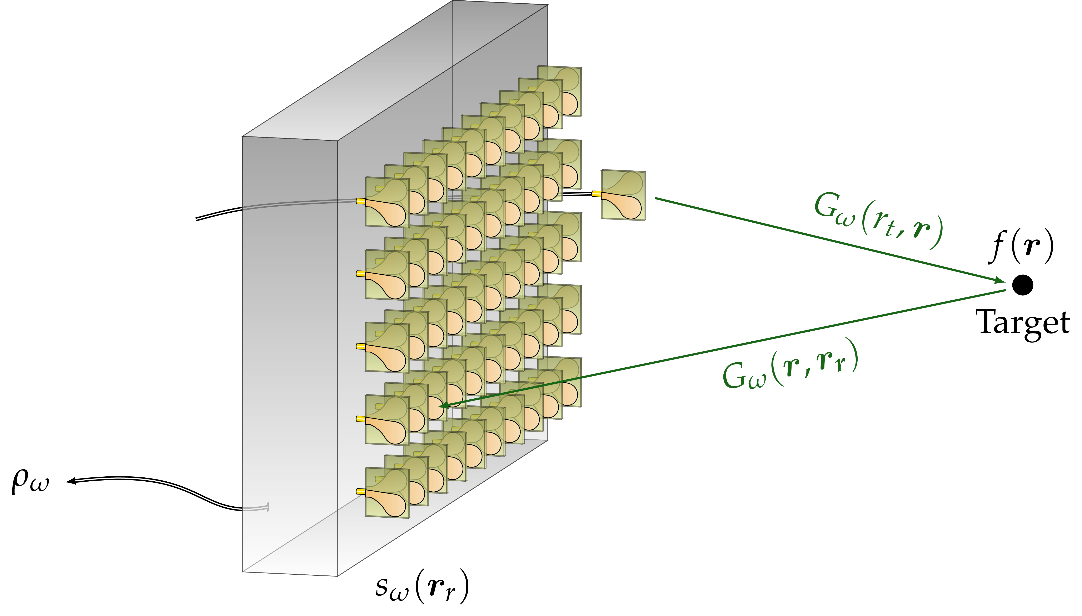
Outlines of the second part
Acceleration of image reconstruction: k-space and Fourier processing
Computational polarimetric imaging
Computational phaseless imaging
STh-01

Slide 4
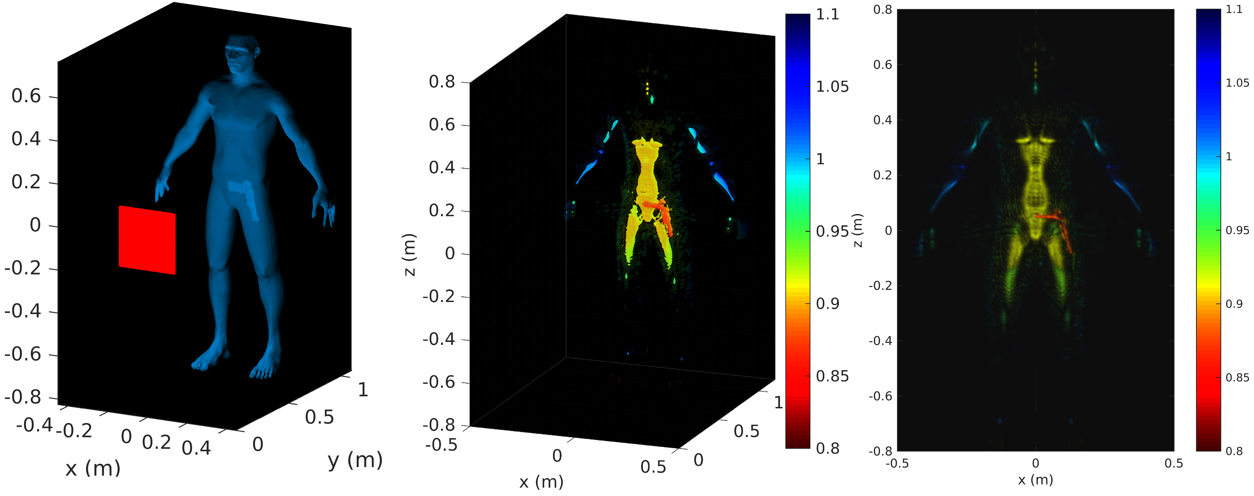
Accelerating computational imaging with Fourier processing
Some problems require the estimation of millions of voxels
Sensing matrix
Transmitters × Receivers × Frequency samples
M
nbx × nby × nbz
Example
Transmitters : 40 × 40
Receivers : 40 × 40
Frequency points : 20
nbx : 300
nby : 200
nbz : 300
Using MIMO apertures, the number of measured samples can also reach very large numbers
size(H) = 51.10⁶× 18.10⁶
Raw memory consumption ~2200 Tb (single precision)
Fromenteze, T., Yurduseven, O., Berland, F., Decroze, C., Smith, D. R., & Yarovoy, A. G. (2019). A Transverse Spectrum Deconvolution Technique for MIMO Short-Range Fourier Imaging.
IEEE Transactions on Geoscience and Remote Sensing.
STh-01

Slide 5
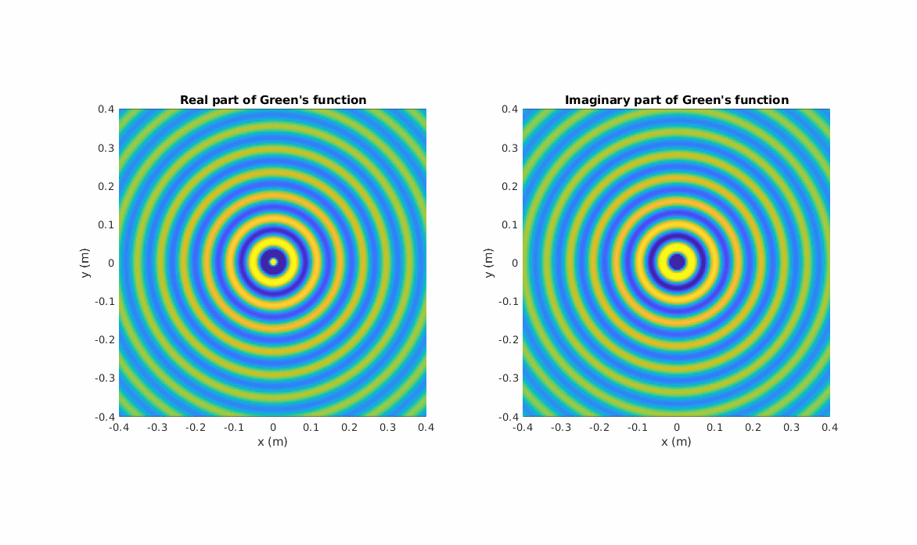
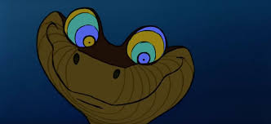
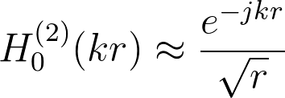
What makes Fourier processing so efficient?
Propagation is modelled within a scalar model: waves progress from source points in a spherical manner.
Note: Explanations are given for a set of 2D examples. For the sake of simplicity, we use an asymptotic form of Hankel's functions:
© Walt Disney pictures
STh-01
Notes:
H_0^{(2)}(k r) \approx \frac{e^{-jkr}}{\sqrt{r}}
G(r,r_a) = \frac{e^{-jk\lvert r - r_a \lvert }}{\lvert r- r_a \lvert}

Slide 6
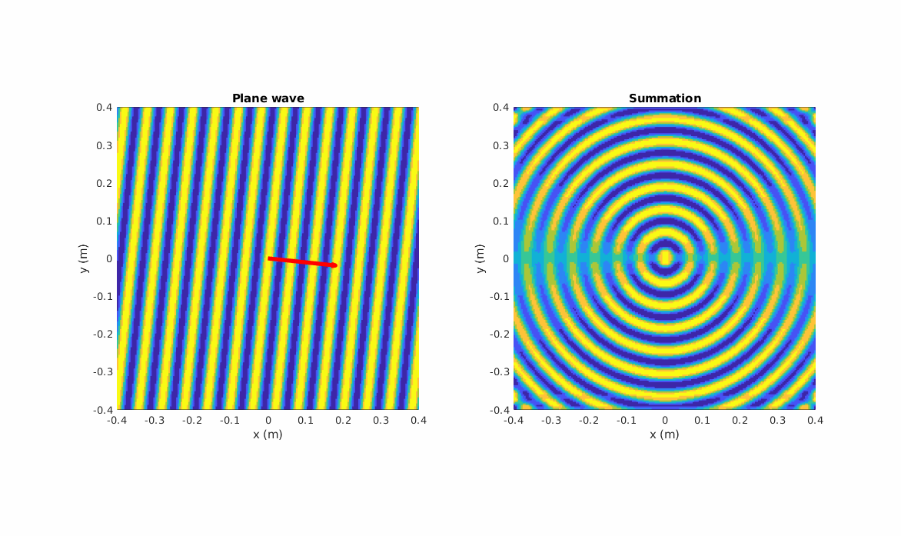
What makes Fourier processing so efficient?
Following an angular spectrum decomposition, a spherical wave is analogous to a sum of plane waves
Weyl's expansion:
with:
STh-01
Notes:
\frac{e^{-jkr}}{r} = \frac{j}{2\pi} \iint e^{-j(k_x x + k_z z + \lvert k_y \lvert y)}\, dk_x dk_z
k_y = \sqrt{k^2 - k_x^2 - k_z^2}

Slide 7
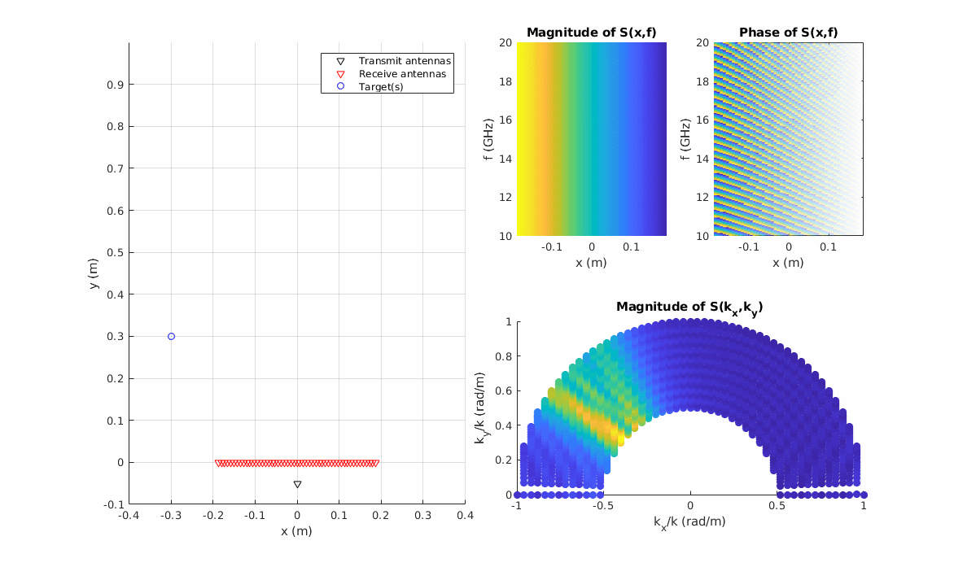
What makes Fourier processing so efficient?
Impact of a spatial Fourier transform on measurements:
The transformation helps to identify a set of angles of arrival
STh-01
Notes:
Left right

Slide 8
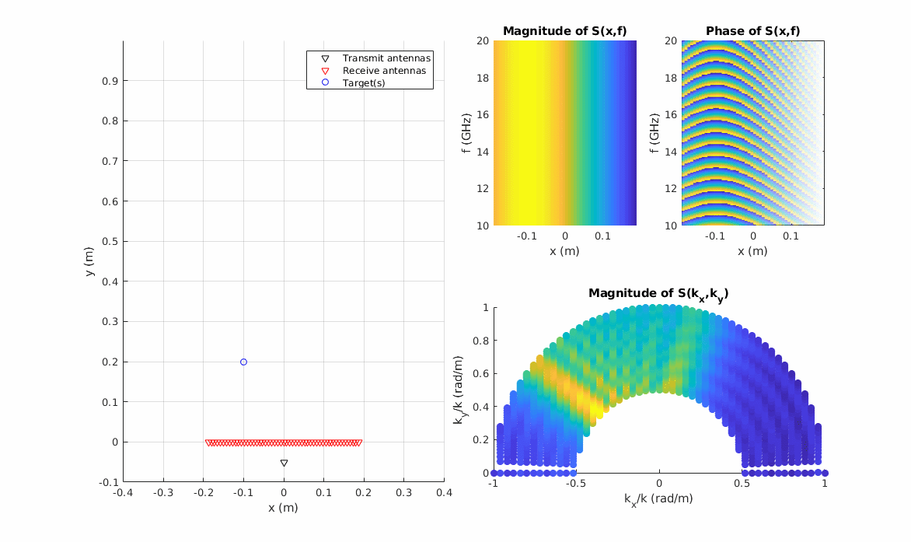
What makes Fourier processing so efficient?
Impact of a spatial Fourier transform on measurements:
The transformation helps to identify a set of angles of arrival
STh-01
Notes:
Up down

Slide 9
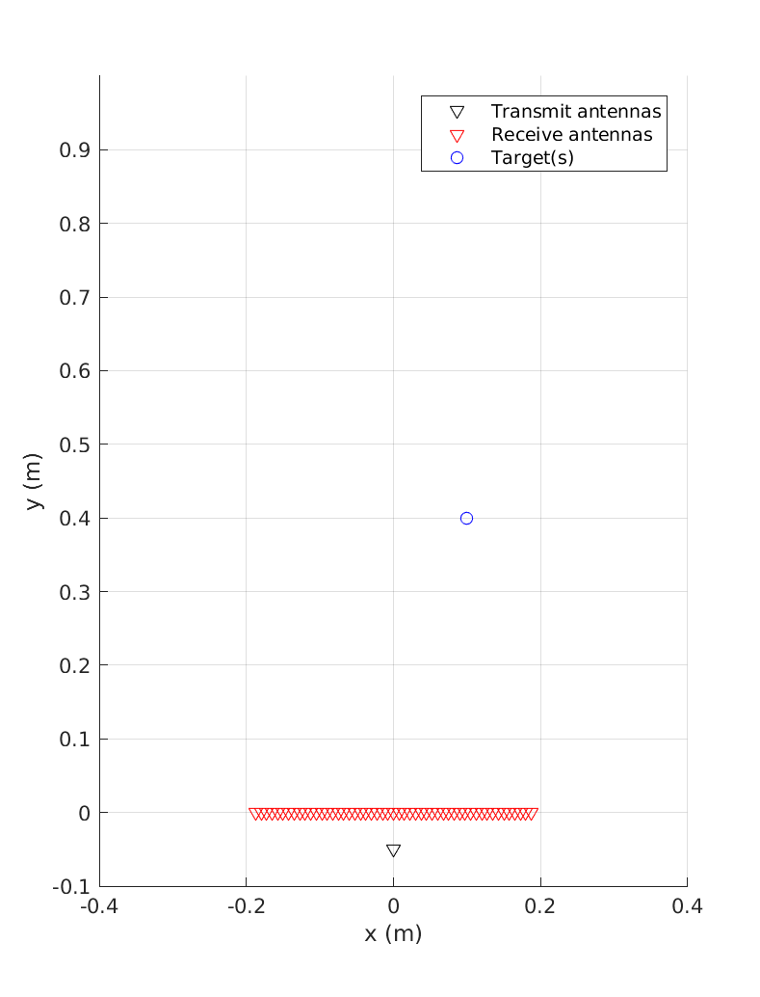
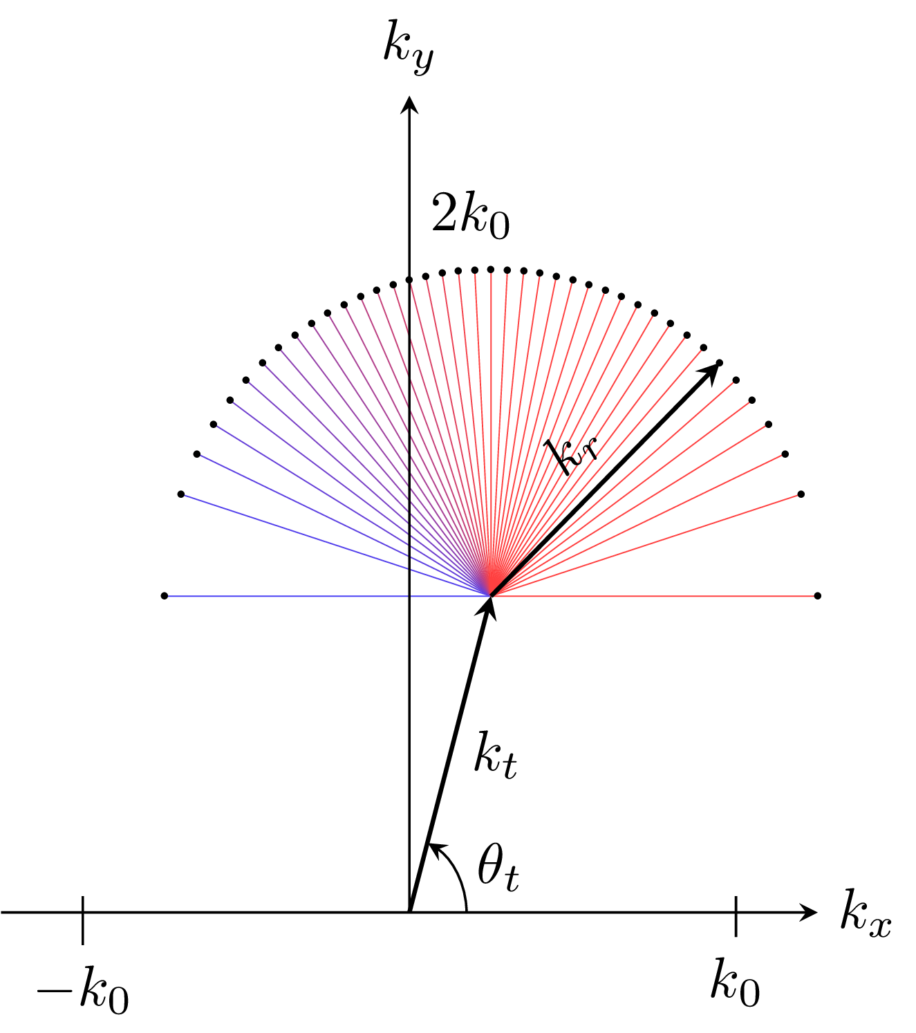
What makes Fourier processing so efficient?
A fundamental concept for short-range Fourier imaging: the definition of a dispersion relation
An association of transmitted and received plane waves are considered:
In the SIMO case:
A single Tx plane wave interacts with a set of Rx plane waves
We choose an area to image whose center is called the stationary phase point.
Product of Tx and Rx Green's functions: sum of the arguments of their exponential functions
(the rigorous demonstration is not that straightforward)
STh-01
Notes:
k_y = k \sin(\theta_t) + \sqrt{k^2 - k_x^2}

Slide 10
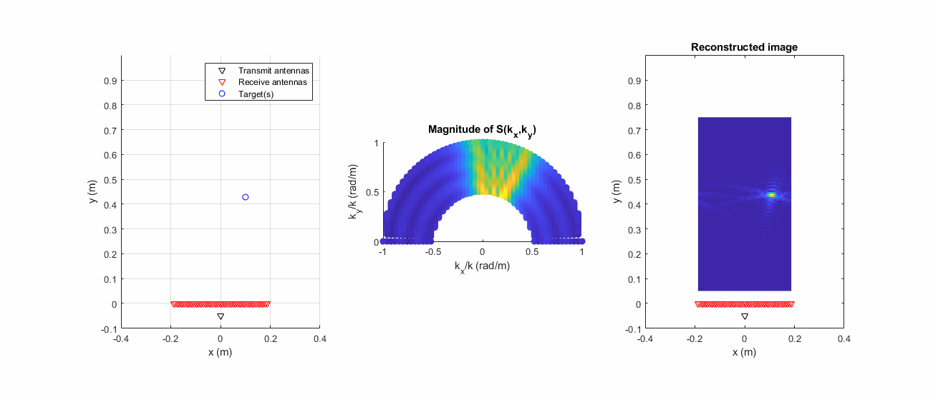
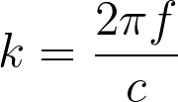
What makes Fourier processing so efficient?
Code available here https://bit.ly/2XGCVbH
Full process for image computation:
1. Fourier transform and variable change
2. Back-propagation
This approach is often referred as the Range Migration Algorithm (RMA) or k-ω algorithm
Lopez-Sanchez, J. M., & Fortuny-Guasch, J. (2000). 3-D radar imaging using range migration techniques. IEEE Transactions on antennas and propagation, 48(5), 728-737.
Zhuge, X., & Yarovoy, A. G. (2012). Three-dimensional near-field MIMO array imaging using range migration techniques. IEEE Transactions on Image Processing, 21(6), 3026-3033.
3. Inverse Fourier transform
Note: 1. The back-propagation step can be greatly accelerated using Stolt interpolation instead of a summation.
2. In this example, we add an additional phase shift to compensate for the offset of the transmit antenna.
STh-01
Notes:
S(k_x,y) = \int S(k_x,k) e^{j ( k(y+\Delta_y) + \sqrt{k^2-k_x^2}\, y)}dk
S(k_x,y) = \int S(k_x,k)\, e^{j \overbrace{(k + \sqrt{k^2-k_x^2})}^{k_y} y}dk
I(x,y) = \mathfrak{F}^{-1}(S(k_x,y))

Slide 11
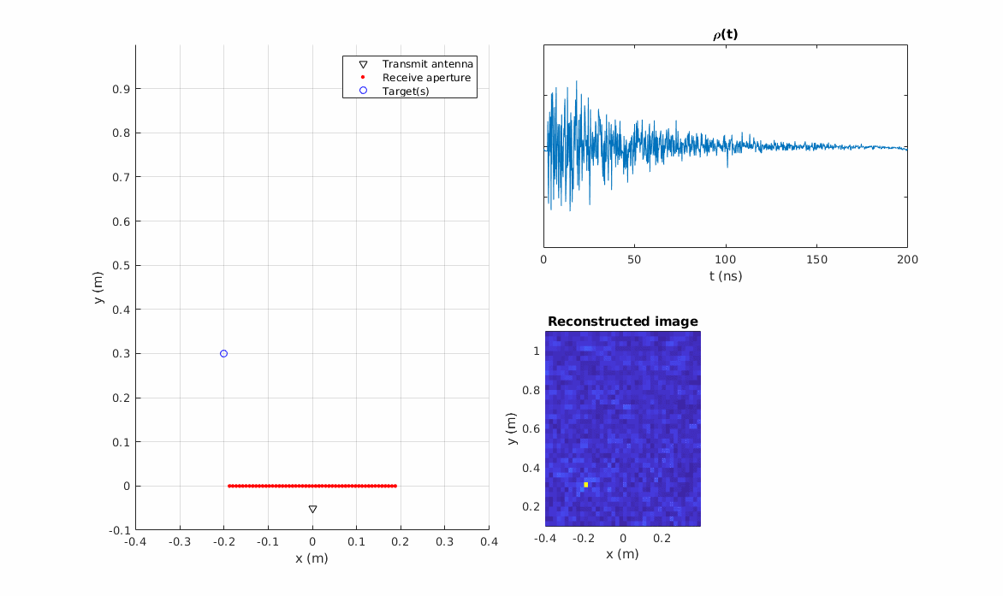
Making Fourier techniques compatible with computational imaging
Problem: the use of frequency-diverse antenna does not grant us direct access to the spatial dimension
Measurement of a "compressed" signal:
How to efficiently retrieve the signals in the aperture?
Identification of signals in the radiating aperture
STh-01
Notes:
g = \int_{r_r} {\color{red} \int_{r} G(r_t,r) f(r) G(r,r_r)\ d^3 r }\ C(r_r)\, d^2 r_r
{\color{red} s_\omega(r_r) = \int_{r} G_\omega(r_t,r)\ f(r) G_\omega(r,r_r)\ d^3 r }

Slide 12
Making Fourier techniques compatible with computational imaging
Problem: the use of frequency-diverse antenna does not grant us direct access to the spatial dimension
The signals undergo a known distortion
In matrix form
with
Problem: a simple matrix inversion reconstruction requires the sacrifice of a dimension
with
Measurement of a "compressed" signal
Identification of signals in the radiating aperture
Pros: we just retrieved our lost spatial dimension
Cons: our frequency dimension is now missing
STh-01
Notes:
\rho = \sum_{r_r} H \odot {\color{red} s}
{\color{red} \hat{s}_{eq}} = H^+ \odot (\rho,...,\rho)

Slide 13
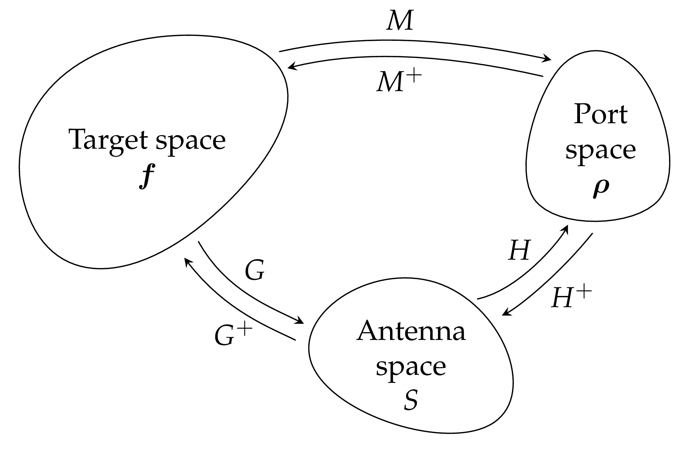
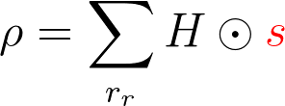
Making Fourier techniques compatible with computational imaging
Problem: the use of frequency-diverse antenna does not grant us direct access to the spatial dimension
An estimation is carried out using an equalization
The measured "compressed" signal is multiplied by each line of the pseudo-inverse matrix
The signals reconstructed in the radiating aperture can finally be used to reconstruct images using Fourier techniques.
The measurement can also be written as a Hadamard product (element-wise multiplication)
with
STh-01
Notes:
\rho_\omega = \int_{r_r} {\color{red} \int_{r} G_\omega(r_t,r) f(r) G_\omega(r,r_r)\ d^3 r } \ H_\omega(r_r) d^2 r_r
{\color{red} s_\omega(r_r) = \int_{r} G_\omega(r_t,r)\ f(r) G_\omega(r,r_r)\ d^3 r }
\rho_\ = \int_{r_r} {s_\omega(r_r)} \ H_\omega(r_r) d^2 r_r
\rho_\omega = H_\omega \color{red} s_\omega^T
\rho \in \mathbb{C}^{n_f \times 1}
{\color{red} s_\omega} \in \mathbb{C}^{1 \times n_{r_r}}
{\color{red}\hat{s}_\circ} = H^+\rho

Slide 14
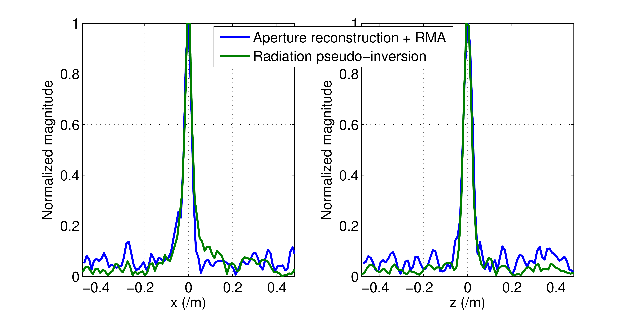
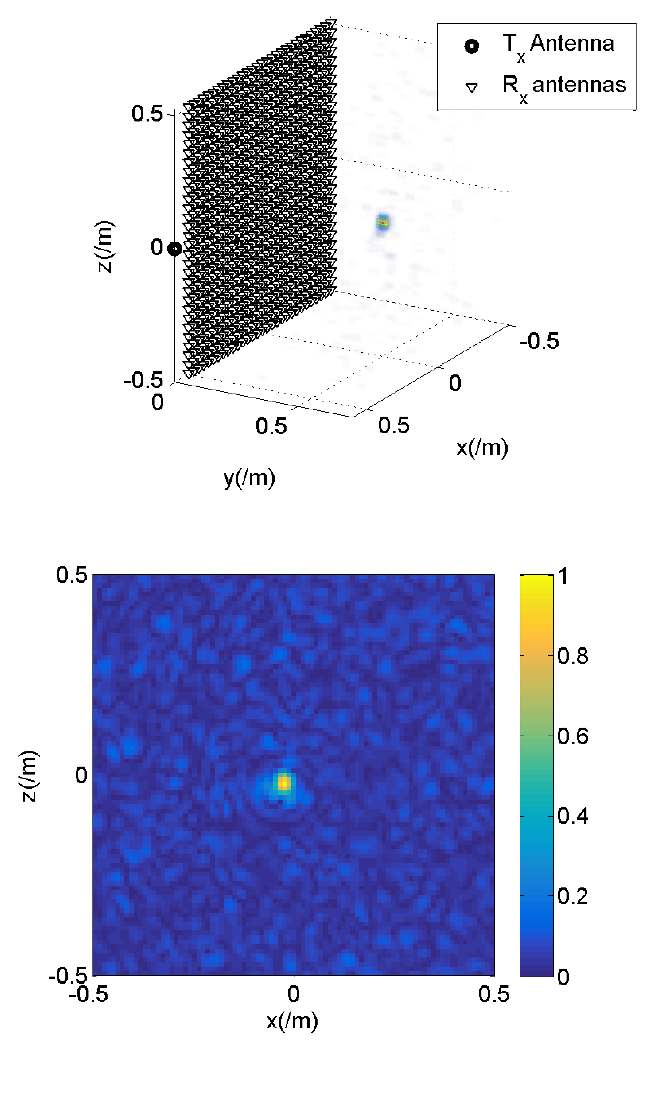
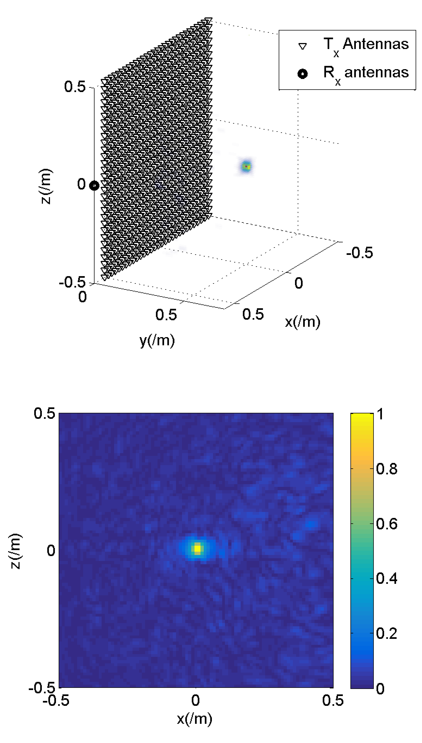
Performance comparison : Equalization+RMA VS full-matrix approach
Equalization+RMA
Full-matrix approach
 | Pre-computation time | Computation time
Eq+RMA | 4.8 s | 2.4 s
Full-matrix | 38 min | 66 s
Data presented in 2015, significant progress has been made on both methods since
Fromenteze, T., Kpré, E. L., Decroze, C., Carsenat, D., Yurduseven, O., Imani, M., ... & Smith, D. R. (2015, September). Unification of compressed imaging techniques in the microwave range and deconvolution strategy. In 2015 European Radar Conference (EuRAD) (pp. 161-164). IEEE.
STh-01

Slide 15
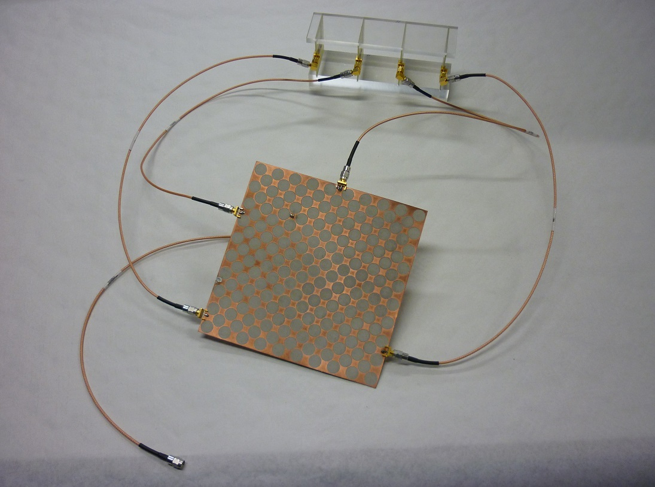
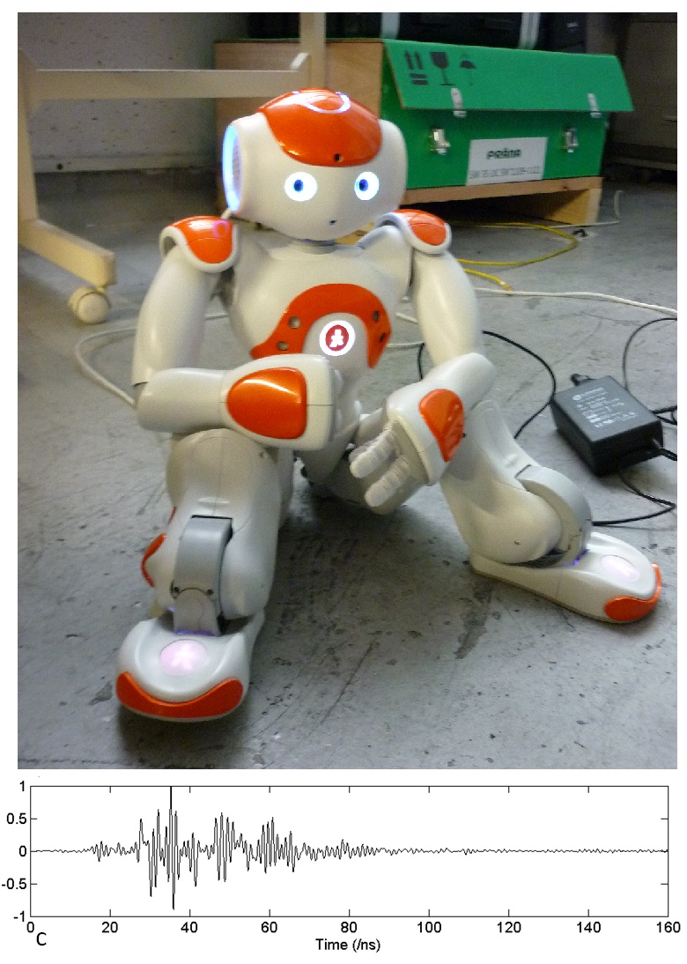
Examples of implementations
From 4 antennas to 1 receiver
Frequency range: 2-4 GHz
7 fps (limited by communication times between equipment)
Fromenteze, T., Decroze, C., & Carsenat, D. (2014). Waveform coding for passive multiplexing: Application to microwave imaging. IEEE Transactions on Antennas and Propagation, 63(2), 593-600.
STh-01

Slide 16
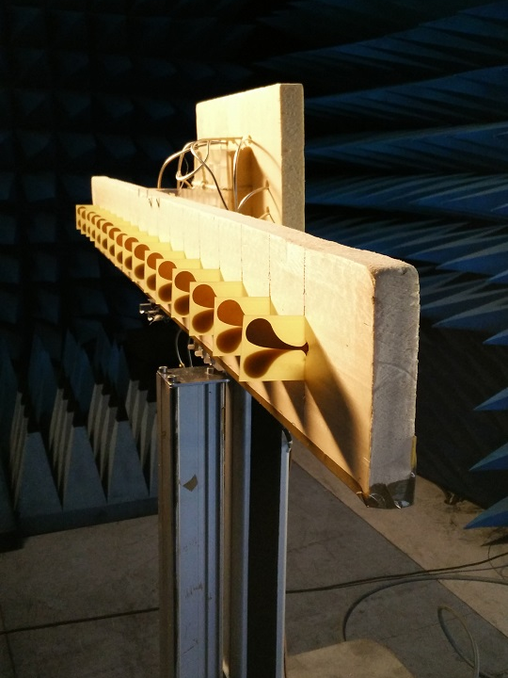
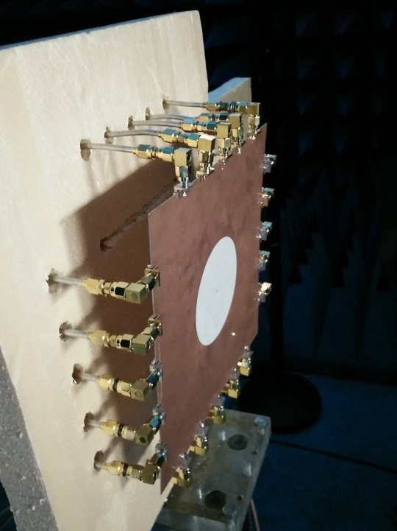
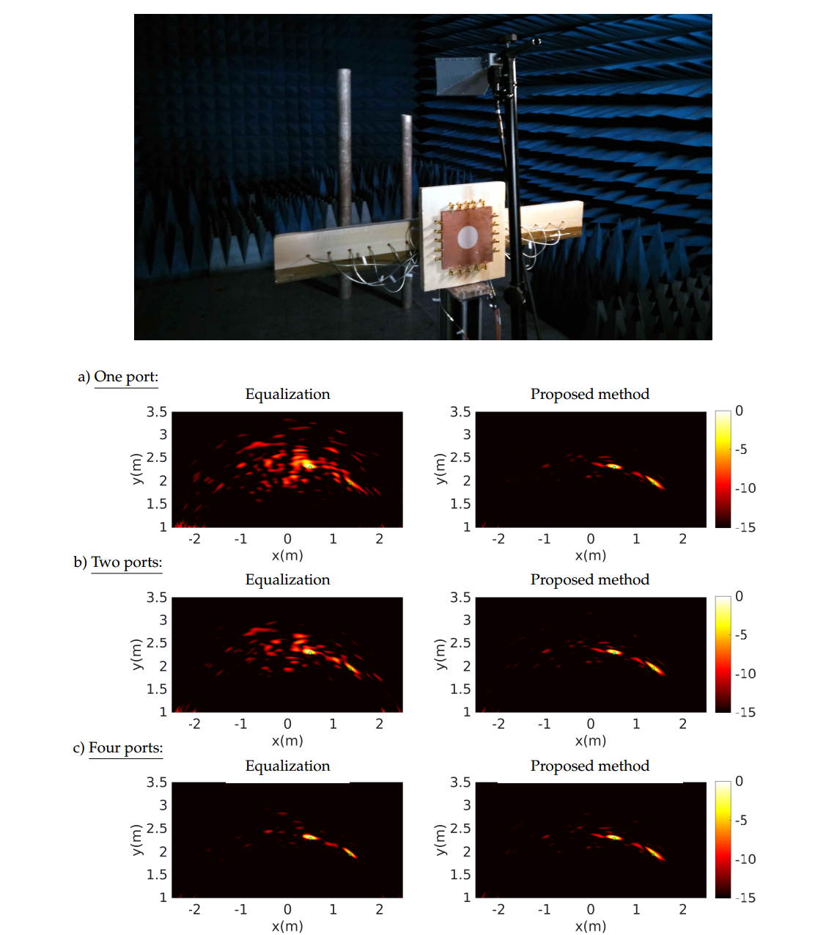
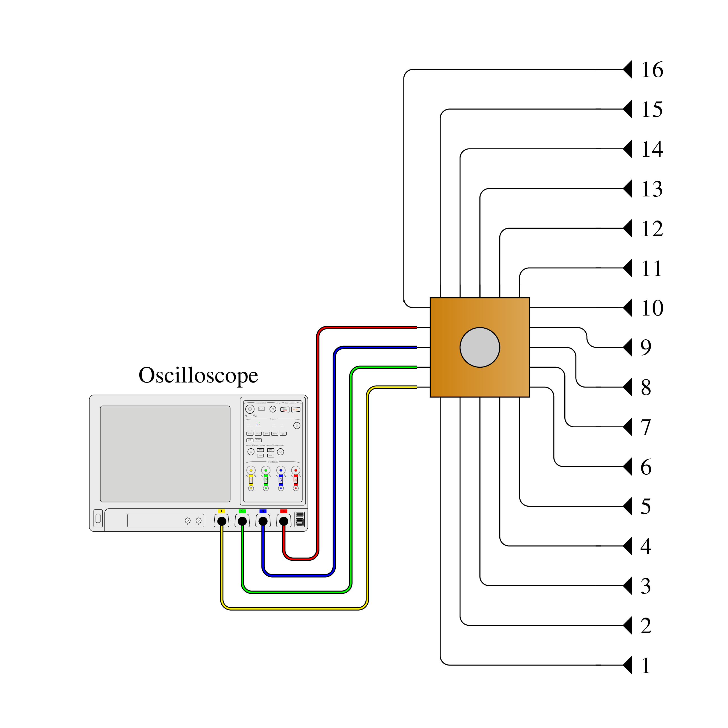
Examples of implementations
From 16 antennas to 4 receivers
Improvement of the equalization technique by a sparsity-driven technique based on Toeplitz matrices
Frequency range: 2-4 GHz​
Fromenteze, T., Kpré, E. L., Decroze, C., & Carsenat, D. (2015, September). Passive UWB beamforming: AN to M compression study. In 2015 European Radar Conference (EuRAD) (pp. 169-172). IEEE.
Fromenteze, T., Decroze, C., Abid, S., & Yurduseven, O. (2018). Sparsity-Driven Reconstruction Technique for Microwave/Millimeter-Wave Computational Imaging. Sensors, 18(5), 1536.
STh-01

Slide 17
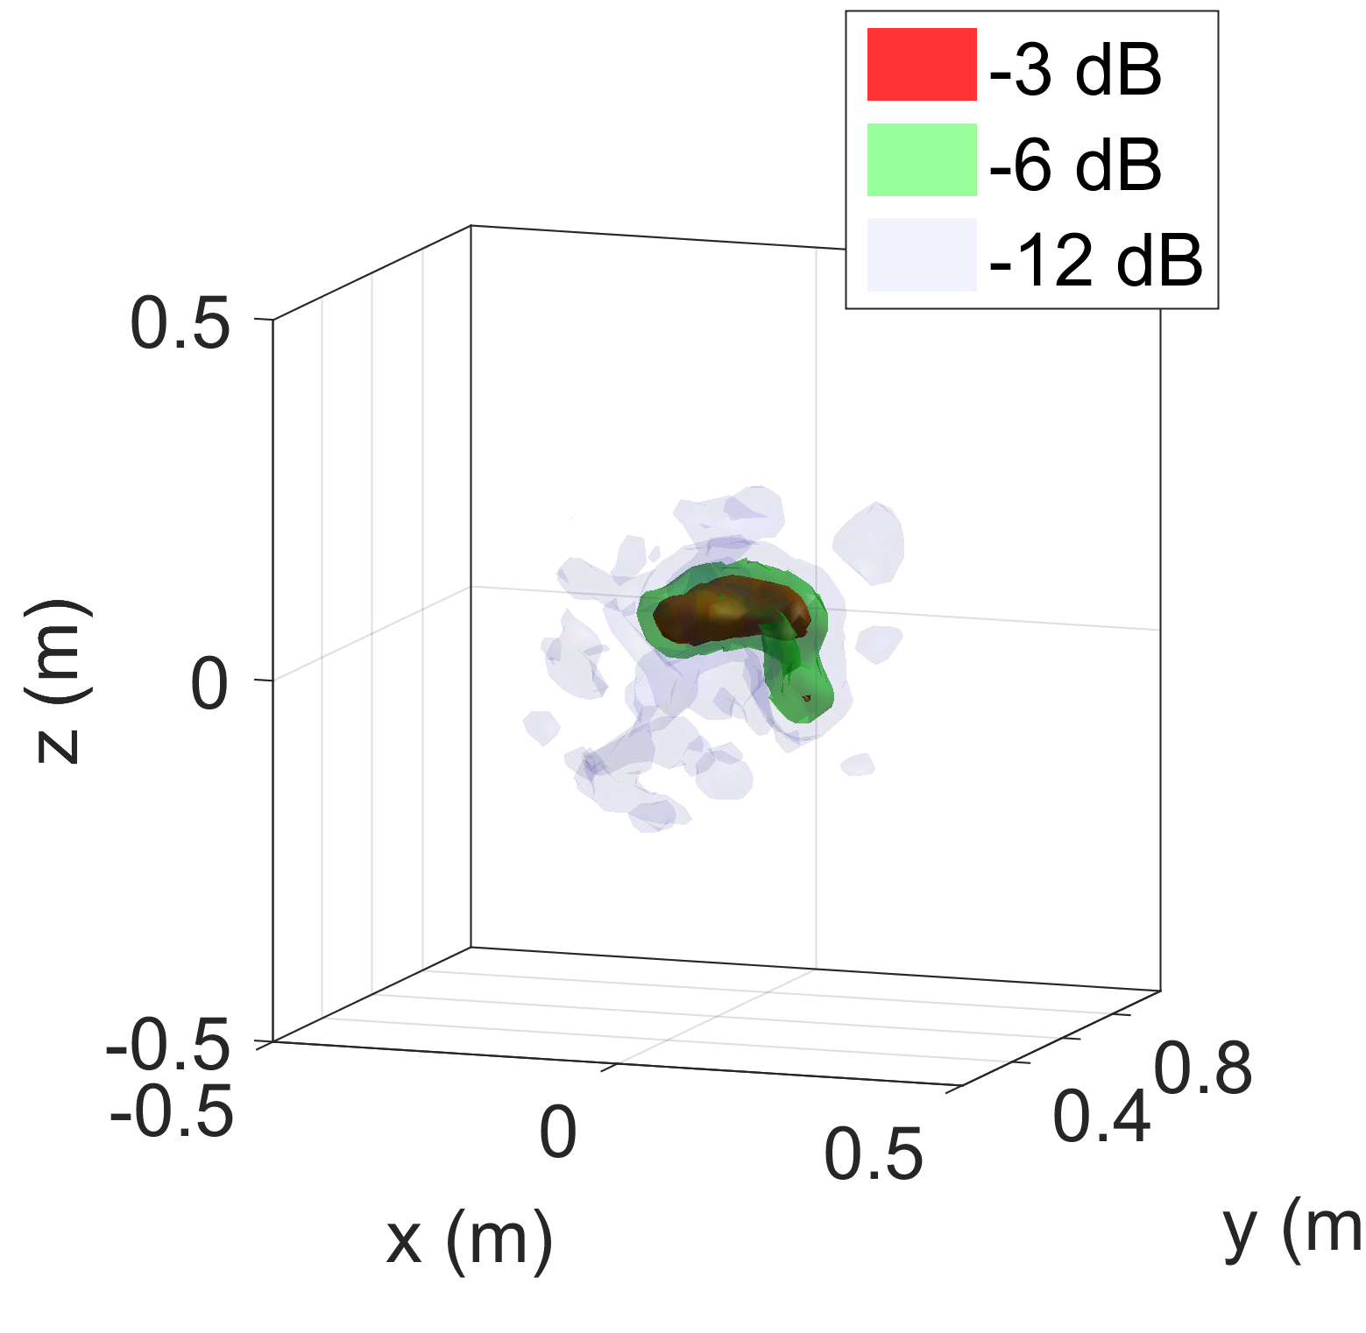
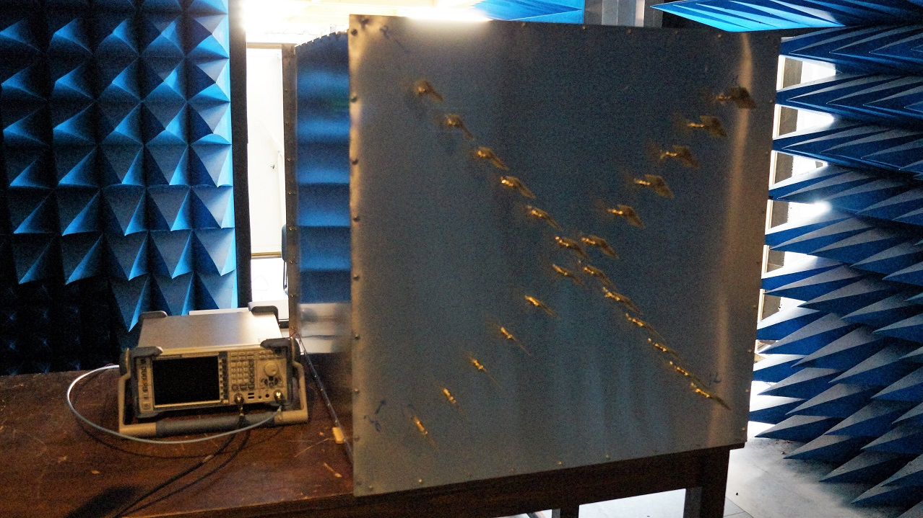
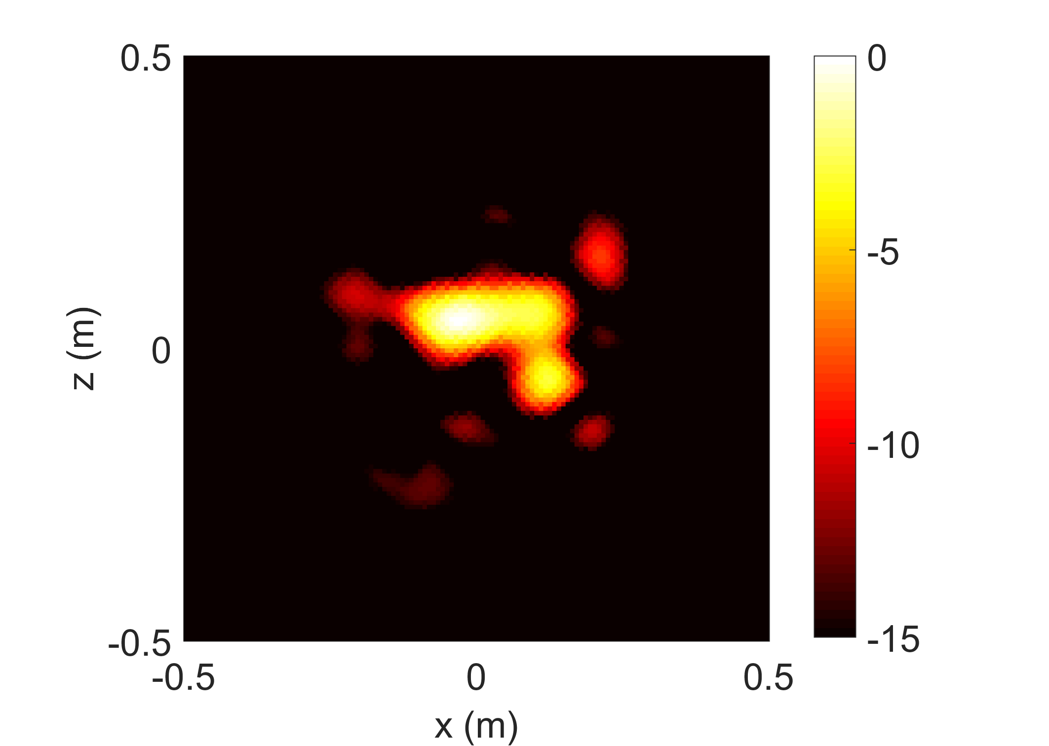
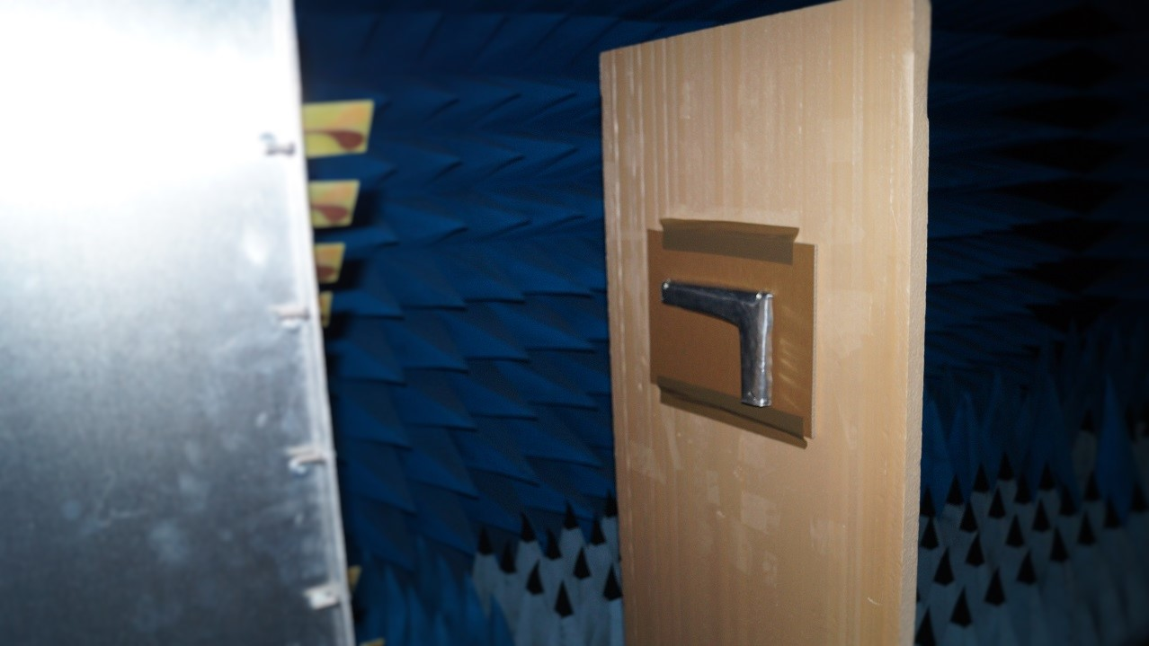
Examples of implementations
Image computation: 1.5 s with MIMO RMA
Going MIMO: From 24x24 antennas to 1 transceiver
Frequency range: 2-10 GHz​
Fromenteze, T., Kpré, E. L., Carsenat, D., Decroze, C., & Sakamoto, T. (2016). Single-shot compressive multiple-inputs multiple-outputs radar imaging using a two-port passive device. IEEE Access, 4, 1050-1060.
STh-01

Slide 18
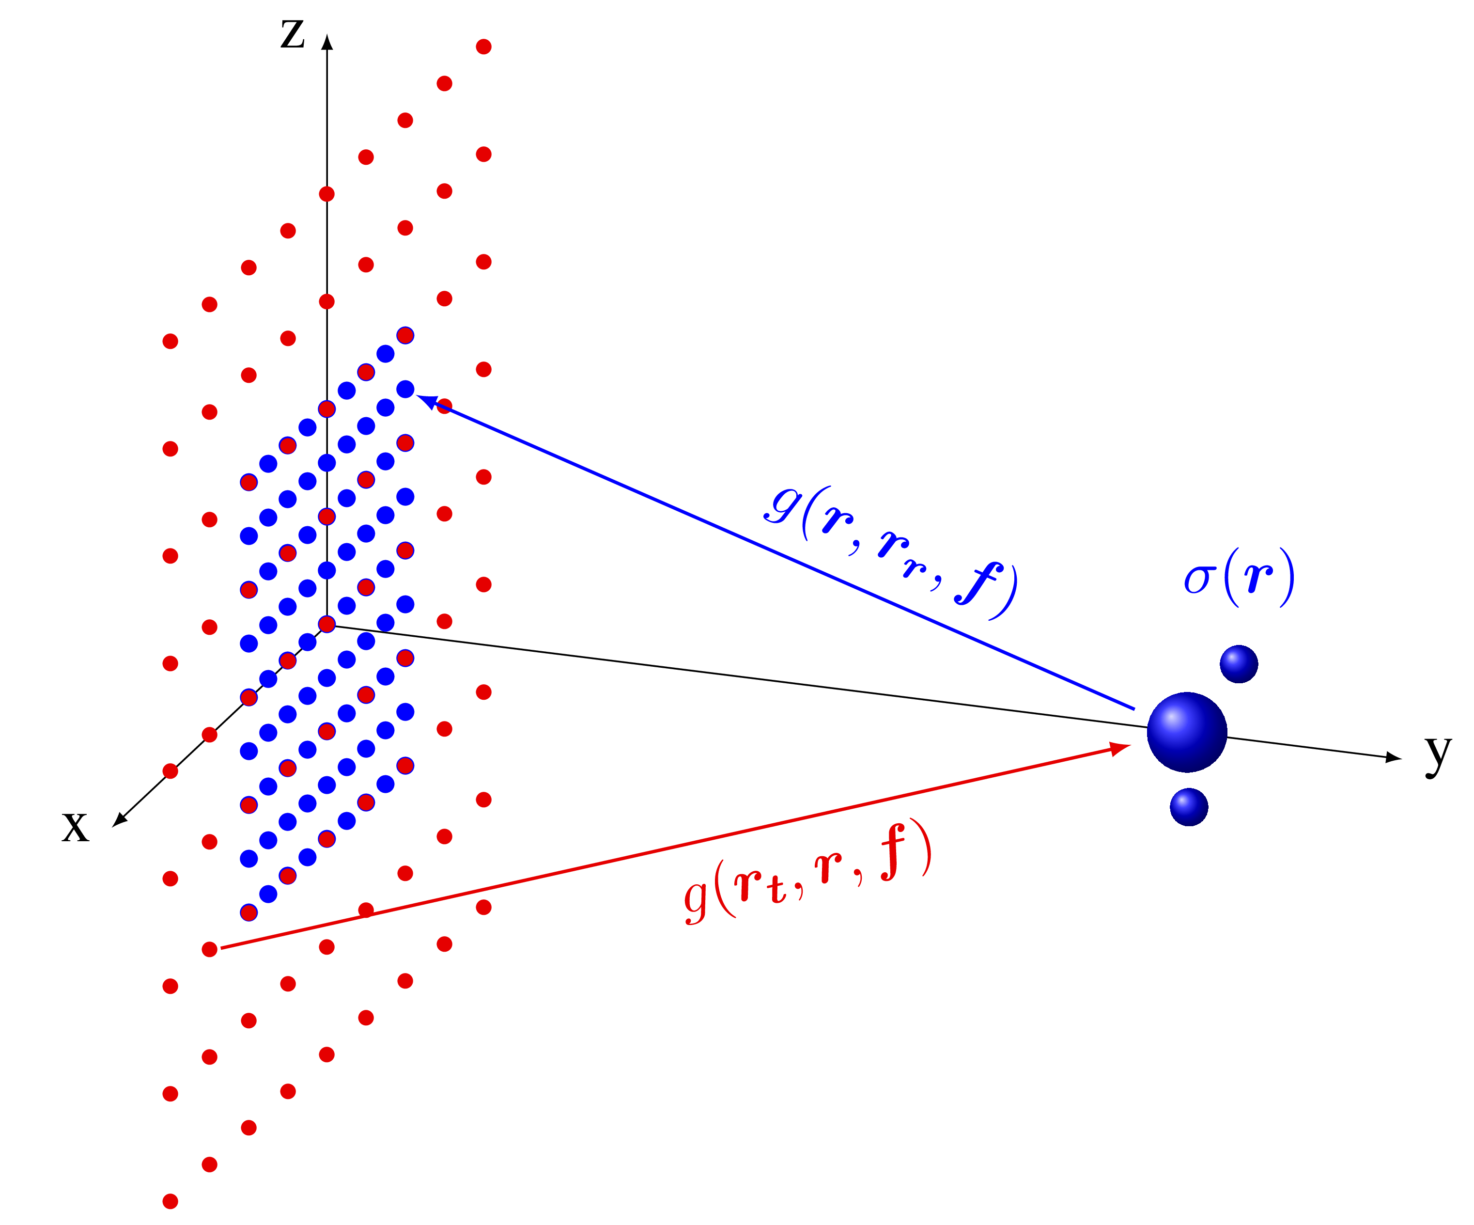
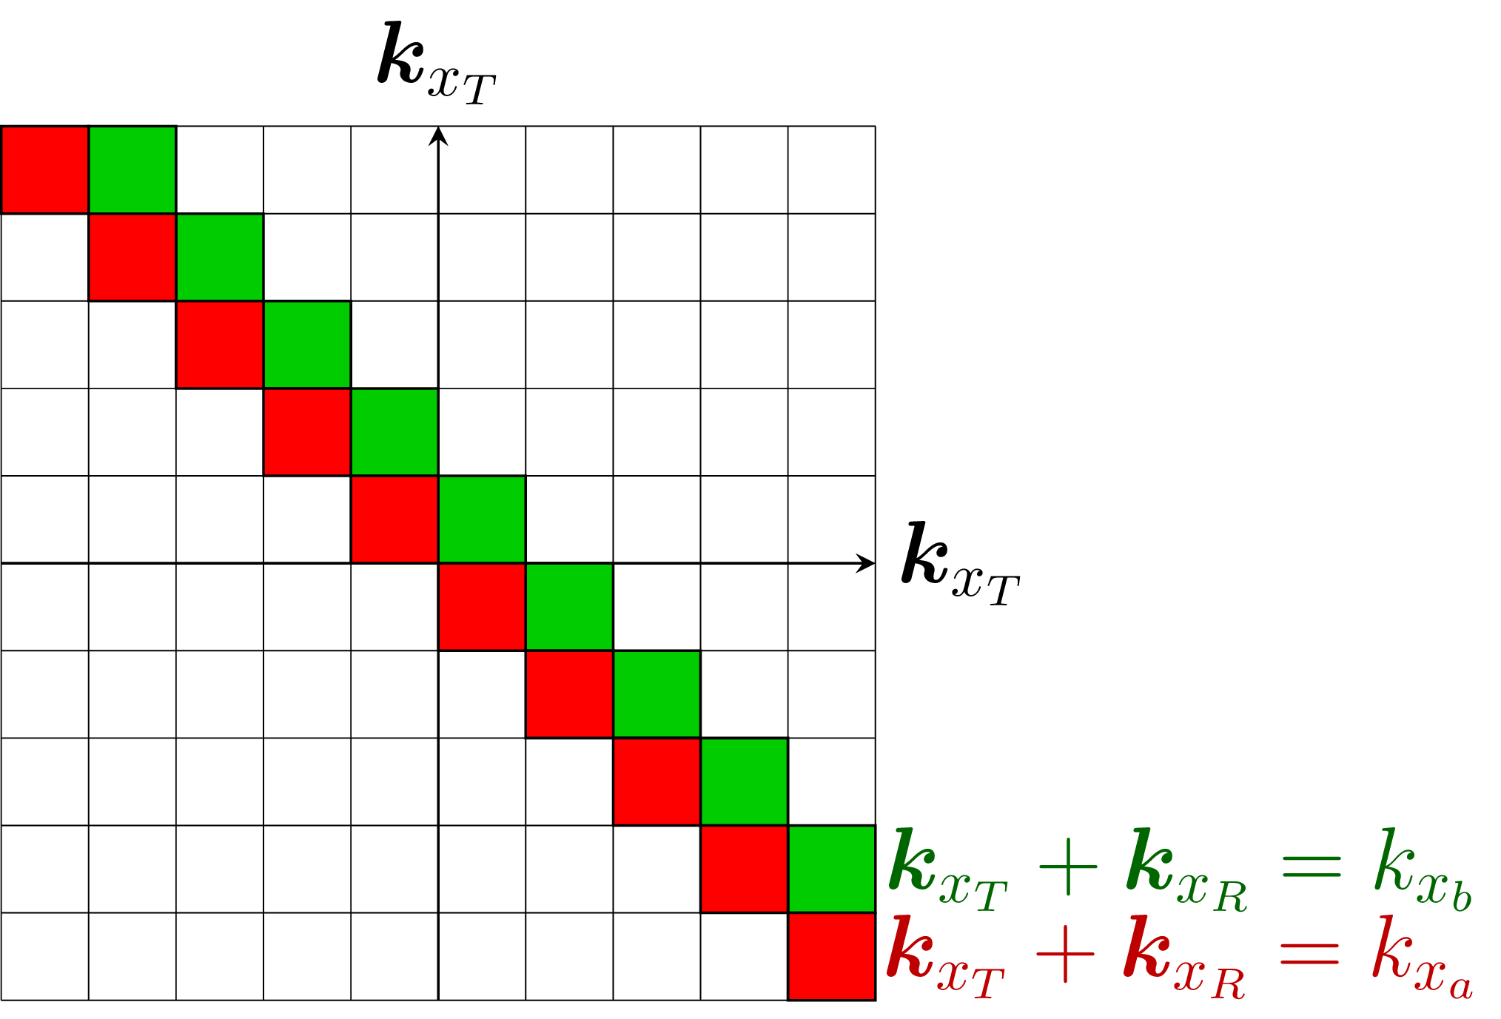
Improving the MIMO RMA
Bottleneck of the RMA: interpolating the Tx and Rx plane waves
Plane wave fusion can be computationally intensive
Everything else can be done from Fast-Fourier transforms
Fromenteze, T., Yurduseven, O., Berland, F., Decroze, C., Smith, D. R., & Yarovoy, A. G. (2019). A Transverse Spectrum Deconvolution Technique for MIMO Short-Range Fourier Imaging. IEEE Transactions on Geoscience and Remote Sensing.
STh-01
Notes:
\hat{\sigma}(x,y,z) = k_{y_T} k_{y_R} \int_{k_x} \int_{k_y} \int_{k_z} S(k_{x_T},k_{z_T},k_{x_R},k_{z_R},k) e^{j k_y y} e^{j k_x x} e^{j k_z z} dk_x dk_y dk_z

Slide 19
Improving the MIMO RMA
The initial approach is quite abstract and based on asymptotic developments of radiation integrals
Fromenteze, T., Yurduseven, O., Berland, F., Decroze, C., Smith, D. R., & Yarovoy, A. G. (2019). A Transverse Spectrum Deconvolution Technique for MIMO Short-Range Fourier Imaging. IEEE Transactions on Geoscience and Remote Sensing.
STh-01

Slide 20
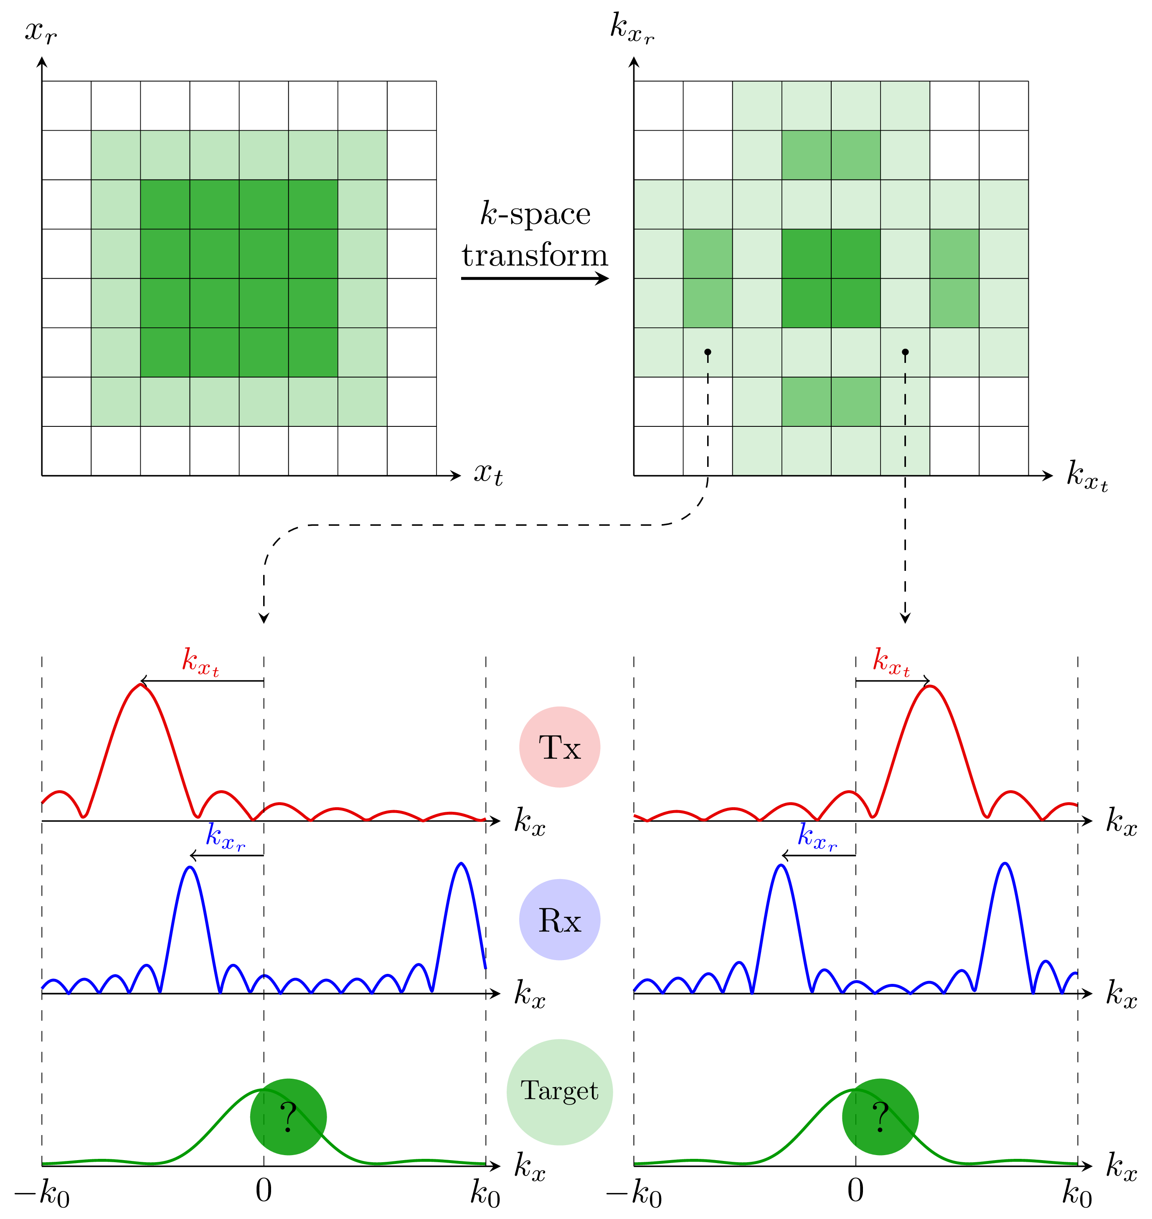
Improving the MIMO RMA
Introducing the transverse spectrum deconvolution (TSD RMA)
Core idea: it's all about radiation patterns
Main advantages:
- more intuitive and visual approach
- k-space patterns depend only on the spatial sampling not on the frequency
Fromenteze, T., Yurduseven, O., Berland, F., Decroze, C., Smith, D. R., & Yarovoy, A. G. (2019). A Transverse Spectrum Deconvolution Technique for MIMO Short-Range Fourier Imaging. IEEE Transactions on Geoscience and Remote Sensing.
STh-01

Slide 21
Improving the MIMO RMA
Interrogation of a spectrum through known radiation patterns
Core idea: it's all about radiation patterns
Target spectrum
Tx radiation patterns
Rx radiation patterns
Expression in matrix form and separation of spatial variables
Reconstruction of transverse spectral data by pseudo-inversion
Main advantages:
- more intuitive and visual approach
- k-space patterns depend only on the spatial sampling not on the frequency
1. Interpolation calculations are replaced by matrix multiplication
2. These calculations are made without any frequency dependence
3. RAM consumption is greatly reduced
4. Reconstructions are more accurate
Fromenteze, T., Yurduseven, O., Berland, F., Decroze, C., Smith, D. R., & Yarovoy, A. G. (2019). A Transverse Spectrum Deconvolution Technique for MIMO Short-Range Fourier Imaging. IEEE Transactions on Geoscience and Remote Sensing.
STh-01
Notes:
S = \int_{k_x} \int_{k_z} {\color{red} P_t(k_x-k_{x_t},k_z-k_{z_t})}\, {\color{DarkGreen} S_c(k_x,k_z,k)} {\color{blue} P_r(k_x-k_{x_r},k_z-k_{z_r})}\ dk_x\ dk_z
S(k) = {\color{Magenta} P_x}\ {\color{DarkGreen} S_c(k)} \ {\color{Magenta} P_z}
{\color{DarkGreen} \hat{S}_c(k)} = {\color{Magenta} P_x^+}\ S(k) \ {\color{Magenta} P_z^+}

Slide 22
Improving the MIMO RMA
Definition of a new state of the art of range-migration algorithms
Application to large and densely populated MIMO arrays
Validation with a MIMO array of 71⁴ radiating elements
more than 25 million interactions at each frequency
Fromenteze, T., Yurduseven, O., Berland, F., Decroze, C., Smith, D. R., & Yarovoy, A. G. (2019). A Transverse Spectrum Deconvolution Technique for MIMO Short-Range Fourier Imaging. IEEE Transactions on Geoscience and Remote Sensing.
STh-01
Notes:
S = \int_{k_x} \int_{k_z} {\color{red} P_t(k_x-k_{x_t},k_z-k_{z_t})}\, {\color{DarkGreen} S_c(k_x,k_z,k)} {\color{blue} P_r(k_x-k_{x_r},k_z-k_{z_r})}\ dk_x\ dk_z
S(k) = {\color{Magenta} P_x}\ {\color{DarkGreen} S_c(k)} \ {\color{Magenta} P_z}
{\color{DarkGreen} \hat{S}_c(k)} = {\color{Magenta} P_x^+}\ S(k) \ {\color{Magenta} P_z^+}

Slide 23
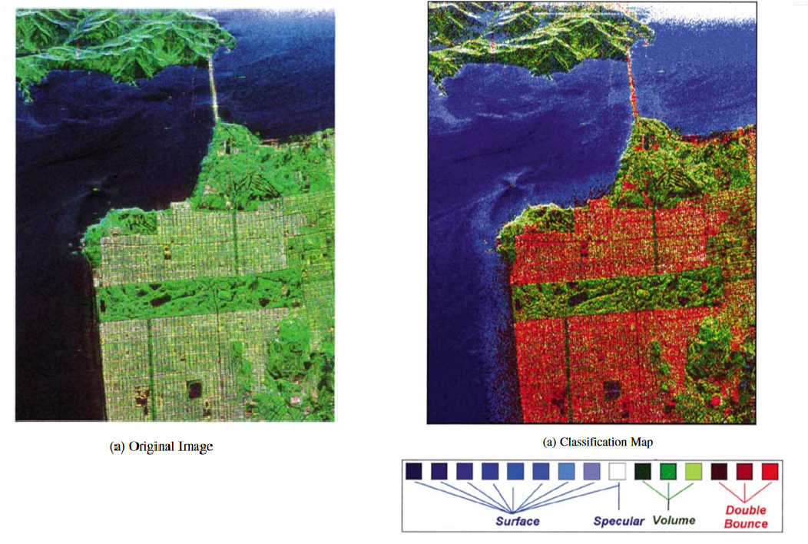
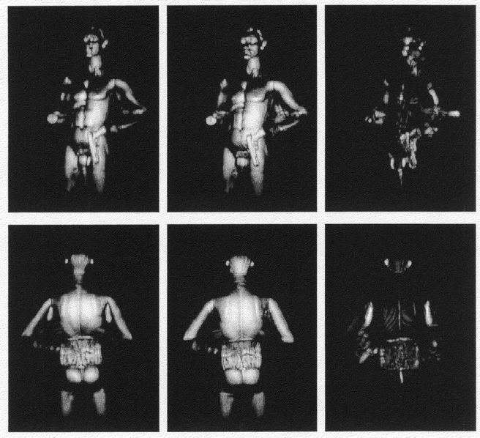
Polarimetric computational imaging
Motivation: Study of anisotropic/multiple-bounce scattering
Far-field: Estimation of soil parameters
Short-range: Threat detection
Unsupervised Terrain Classification Preserving Polarimetric Scattering Characteristics"
J-S Lee, M.R. Grunes, E. Pottier, L. Ferro-Famil - IEEE TGRS, 2004
Holographic arrays for multi-path imaging artifact reduction"
D.L. McMakin, D.M. Sheen, T.E. Hall - US Patent, 2005
STh-01

Slide 24
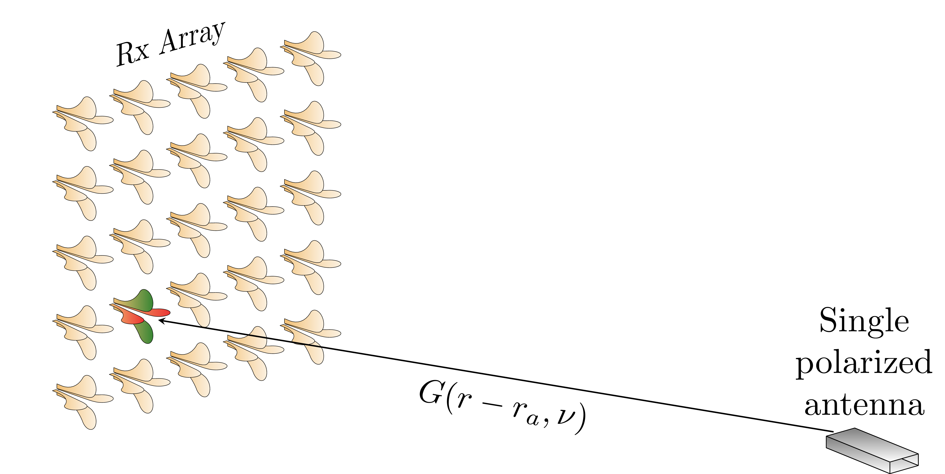
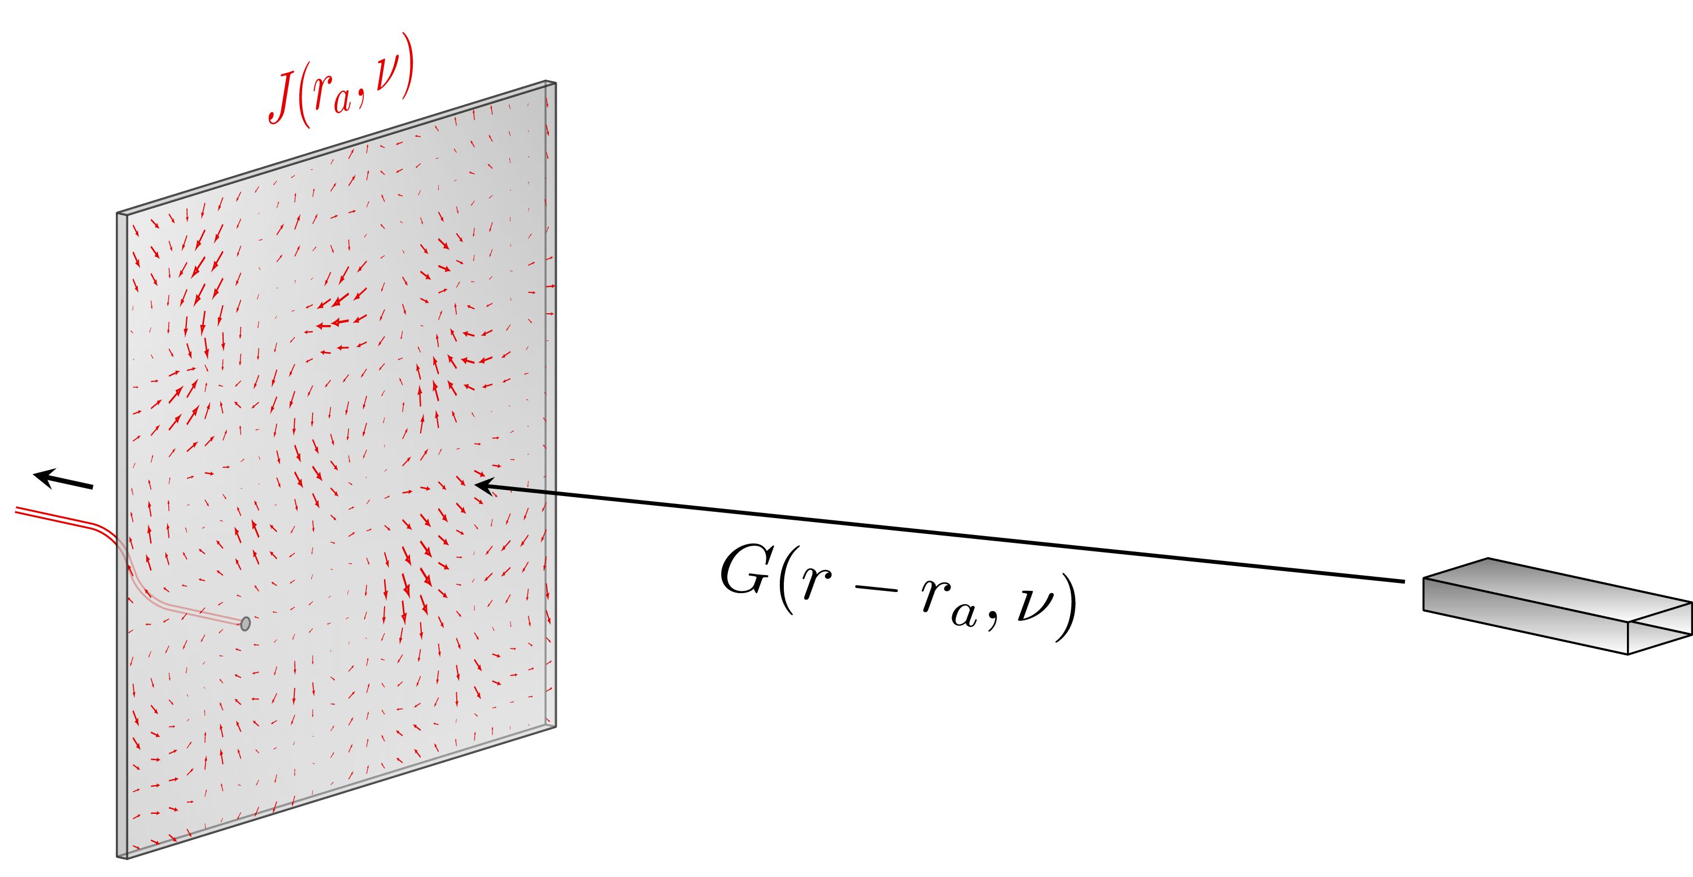
Polarimetric computational localization
Conventional approach
Computational approach
Doubles the hardware constraints compared to scalar systems
Fromenteze, T., Boyarsky, M., Yurduseven, O., Gollub, J., Marks, D. L., & Smith, D. R. (2017, July). Computational polarimetric localization with a radiating metasurface. In 2017 IEEE International Symposium on Antennas and Propagation & USNC/URSI National Radio Science Meeting (pp. 407-408). IEEE.
STh-01

Slide 25
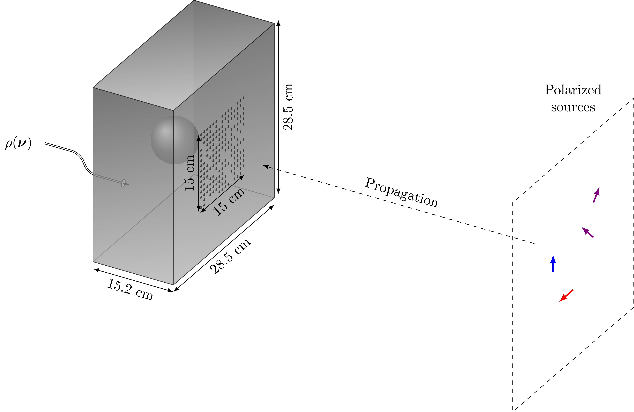
Polarimetric computational localization
We now get out of the scalar approximation
Measured signal
in the polarization space:
=
Polarized sources
Transfer function of the cavity
(3 polarizations on its surface)
Dyadic Green's function
To lighten the notation, frequencies are implicit
Fromenteze, T., Boyarsky, M., Yurduseven, O., Gollub, J., Marks, D. L., & Smith, D. R. (2017, July). Computational polarimetric localization with a radiating metasurface. In 2017 IEEE International Symposium on Antennas and Propagation & USNC/URSI National Radio Science Meeting (pp. 407-408). IEEE.
STh-01
Notes:
g = \int_{r_a} \int_r \overline{C}(r_a) \overline{\overline{G}}(r,r_a) \overline {s}(r) dr_a dr
g = \overline{C}\, \overline{\overline{G}} \overline{s}
\overline{\overline{G}}(r,r_a) = (1 + \frac{1}{k^2} \Delta \Delta\, \cdot ) \frac{\exp(-j k \lvert r - r_a \lvert )}{\lvert r - r_a \lvert }\ \overline{\overline{I\, }}

Slide 26
Polarimetric computational localization
We now get out of the scalar approximation
Measured signal
Discrete model
Reconstruction
To lighten the notation, frequencies are implicit
Fromenteze, T., Boyarsky, M., Yurduseven, O., Gollub, J., Marks, D. L., & Smith, D. R. (2017, July). Computational polarimetric localization with a radiating metasurface. In 2017 IEEE International Symposium on Antennas and Propagation & USNC/URSI National Radio Science Meeting (pp. 407-408). IEEE.
STh-01
Notes:
g = \int_{r_a} \int_r \overline{C}(r_a) \overline{\overline{G}}(r,r_a) \overline {s}(r) dr_a dr
g = \overline{C}\, \overline{\overline{G}} \overline{s}
\overline{\overline{G}}(r,r_a) = (1 + \frac{1}{k^2} \Delta \Delta\, \cdot ) \frac{\exp(-j k \lvert r - r_a \lvert )}{\lvert r - r_a \lvert }\ \overline{\overline{I\, }}
\hat{\overline{s}} = \left( \overline{\overline{G}}\, \overline{C} \right)^+ g

Slide 27
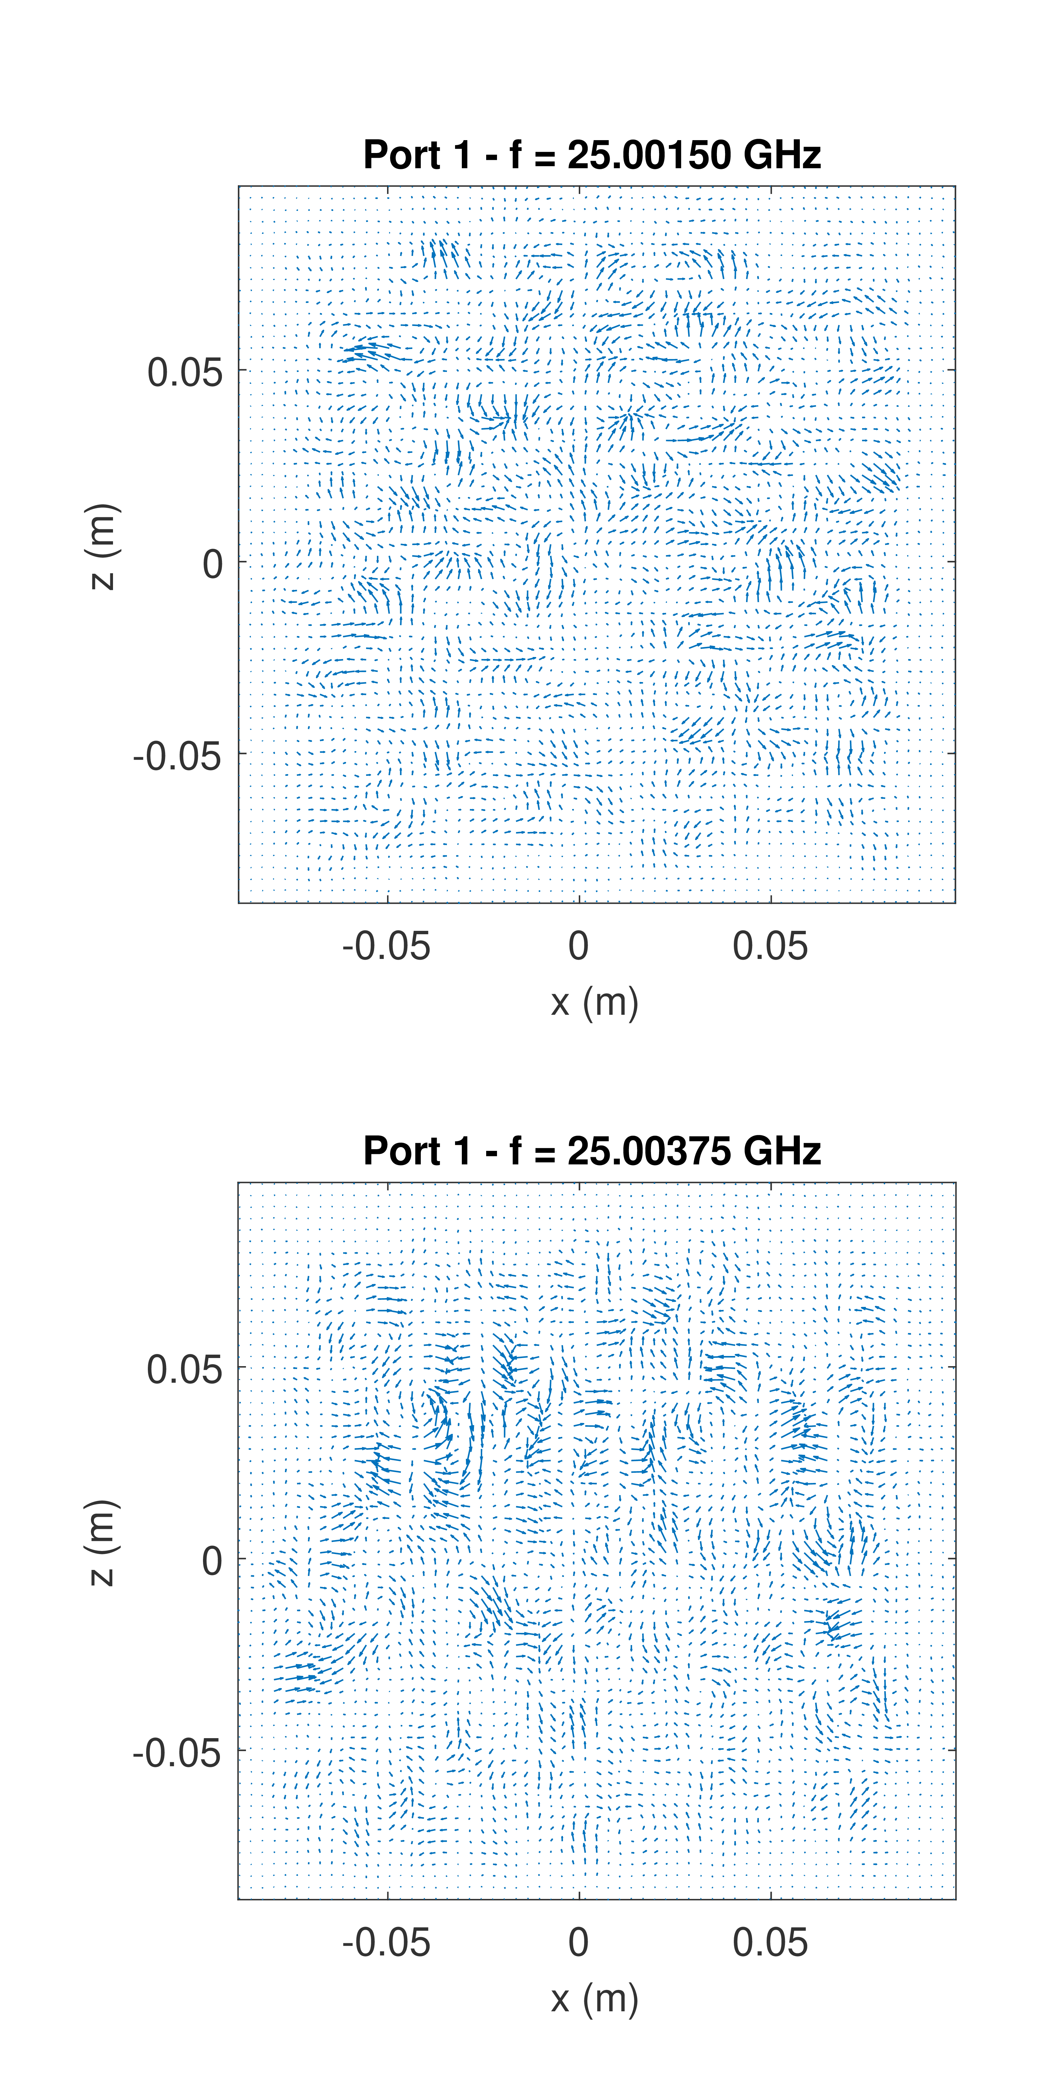
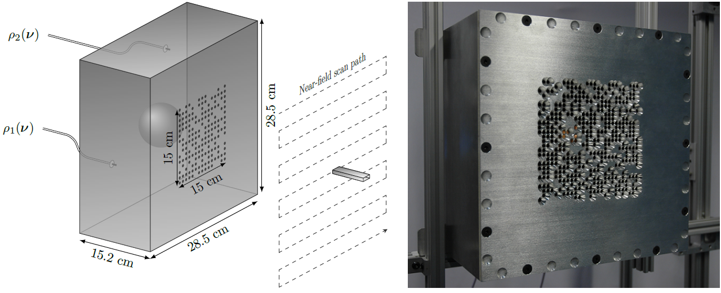
Polarimetric computational localization
Cavity quality factor Q~12 000
Near field scans
Fromenteze, T., Boyarsky, M., Yurduseven, O., Gollub, J., Marks, D. L., & Smith, D. R. (2017, July). Computational polarimetric localization with a radiating metasurface. In 2017 IEEE International Symposium on Antennas and Propagation & USNC/URSI National Radio Science Meeting (pp. 407-408). IEEE.
STh-01
Notes:
g = \int_{r_a} \int_r \overline{C}(r_a) \overline{\overline{G}}(r,r_a) \overline {s}(r) dr_a dr
g = \overline{C}\, \overline{\overline{G}} \overline{s}
\overline{\overline{G}}(r,r_a) = (1 + \frac{1}{k^2} \Delta \Delta\, \cdot ) \frac{\exp(-j k \lvert r - r_a \lvert )}{\lvert r - r_a \lvert }\ \overline{\overline{I\, }}

Slide 28
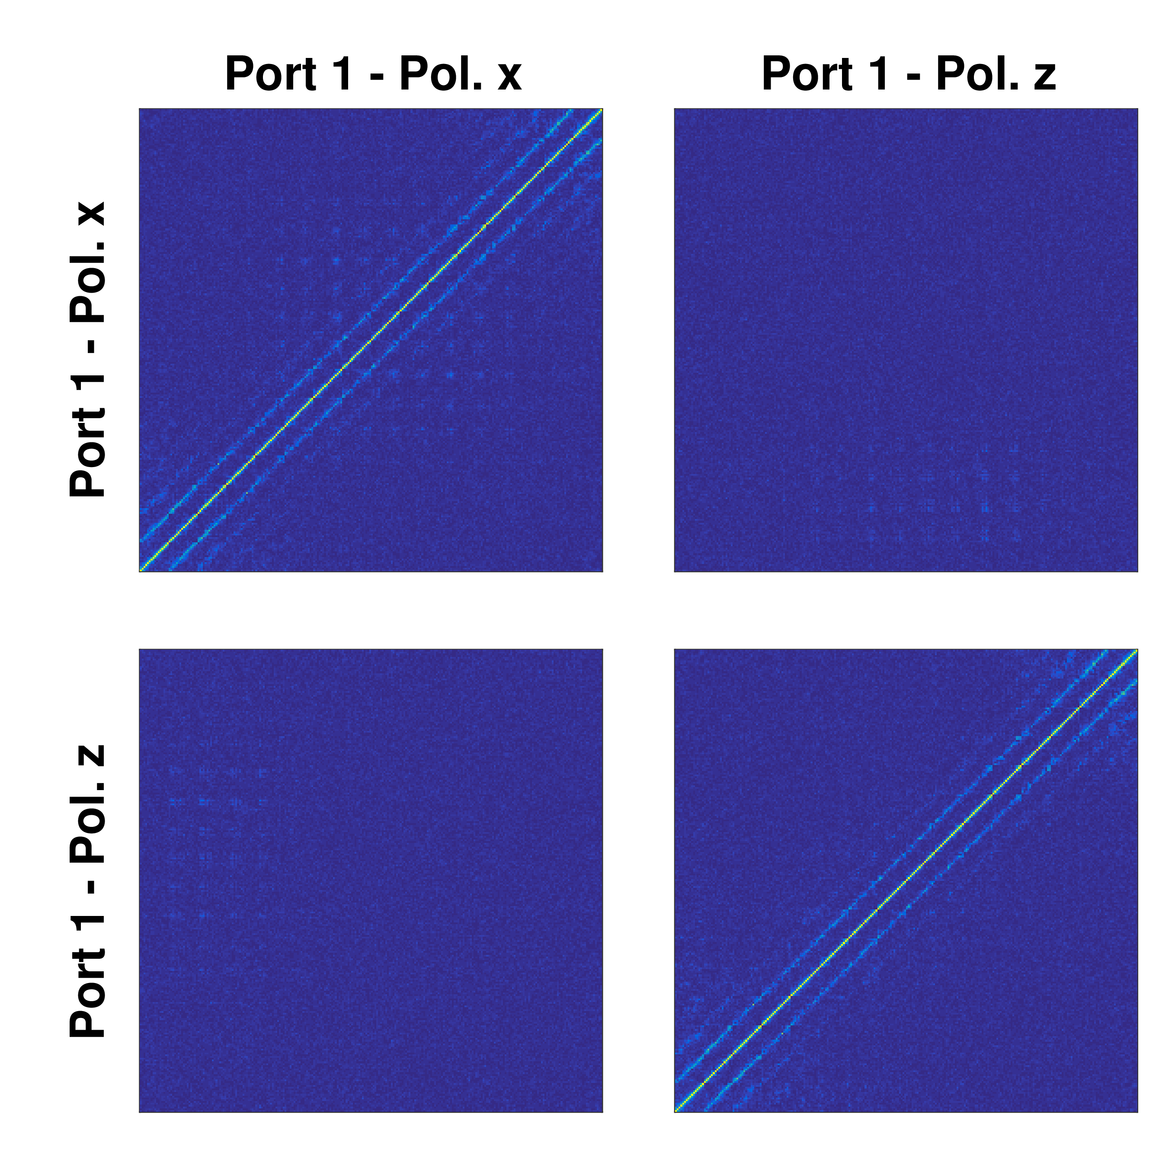
Polarimetric computational imaging
Near field scans
Spatial correlations:
Fromenteze, T., Boyarsky, M., Yurduseven, O., Gollub, J., Marks, D. L., & Smith, D. R. (2017, July). Computational polarimetric localization with a radiating metasurface. In 2017 IEEE International Symposium on Antennas and Propagation & USNC/URSI National Radio Science Meeting (pp. 407-408). IEEE.
STh-01
Notes:
g = \int_{r_a} \int_r \overline{C}(r_a) \overline{\overline{G}}(r,r_a) \overline {s}(r) dr_a dr
g = \overline{C}\, \overline{\overline{G}} \overline{s}
\overline{\overline{G}}(r,r_a) = (1 + \frac{1}{k^2} \Delta \Delta\, \cdot ) \frac{\exp(-j k \lvert r - r_a \lvert )}{\lvert r - r_a \lvert }\ \overline{\overline{I\, }}

Slide 29
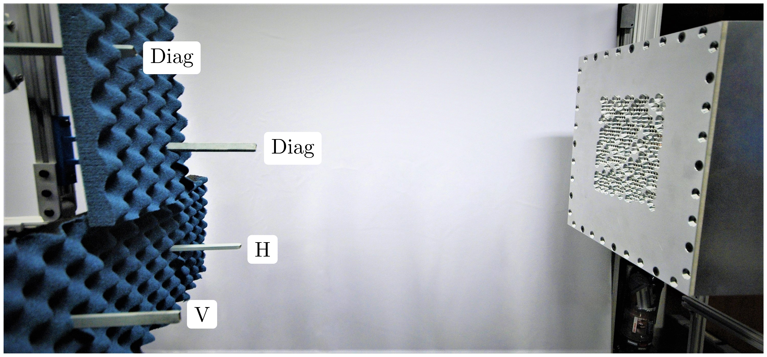
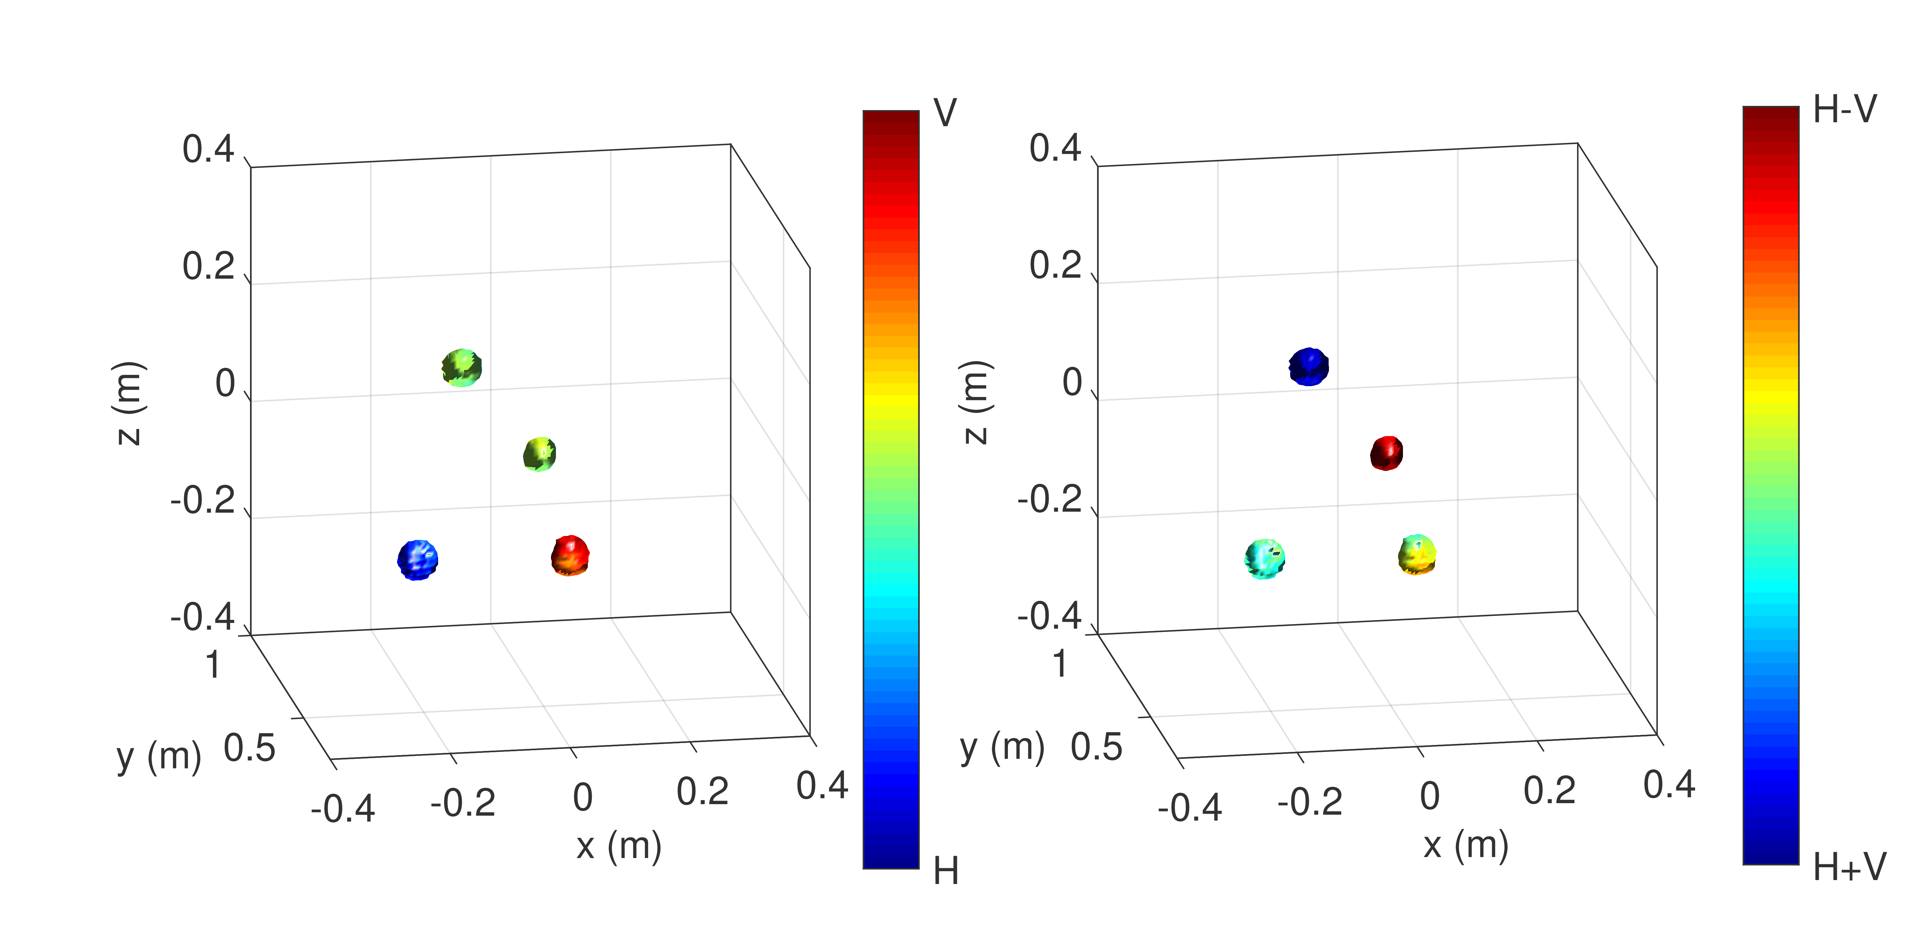
Polarimetric computational localization
Reconstruction
- Frequency range : 18.5-26 GHz
- 801 Frequency samples
- 134 × 36 × 134 ~ 650 000 voxels
- Volume of 0.8 × 0.75 × 0.8 m³
- Computed in less than a second using Fourier processing
-5dB isosurfaces
Fromenteze, T., Boyarsky, M., Yurduseven, O., Gollub, J., Marks, D. L., & Smith, D. R. (2017, July). Computational polarimetric localization with a radiating metasurface. In 2017 IEEE International Symposium on Antennas and Propagation & USNC/URSI National Radio Science Meeting (pp. 407-408). IEEE.
STh-01
Notes:
g = \int_{r_a} \int_r \overline{C}(r_a) \overline{\overline{G}}(r,r_a) \overline {s}(r) dr_a dr
g = \overline{C}\, \overline{\overline{G}} \overline{s}
\overline{\overline{G}}(r,r_a) = (1 + \frac{1}{k^2} \Delta \Delta\, \cdot ) \frac{\exp(-j k \lvert r - r_a \lvert )}{\lvert r - r_a \lvert }\ \overline{\overline{I\, }}

Slide 30
Polarimetric computational imaging
Scalar imaging forward model
measured frequency-domain signal
scalar Tx electric field
scalar Rx electric field
scalar reflectivity function (Δε(r))
If our target exhibits anisotropic/depolarizing behavior:
Each point in space must be defined as a susceptibility tensor
polarization conversion
The scattered field then interacts with the Rx aperture
Fromenteze, T., Yurduseven, O., Boyarsky, M., Gollub, J., Marks, D. L., & Smith, D. R. (2017). Computational polarimetric microwave imaging. Optics express, 25(22), 27488-27505.
STh-01
Notes:
\overline{E_i}^{sca}(r) = {\color{blue} \overline{E_i}(r)} {\color{DarkGreen} \overline{\overline{\chi}}(r)}
g_{i,j}(\omega) = \int_r {\color{blue} \overline{E_i} (r)} {\color{DarkGreen} \overline{\overline{\chi}}(r)}\, {\color{red} \overline{E_j} (r)^T}\, dr

Slide 31
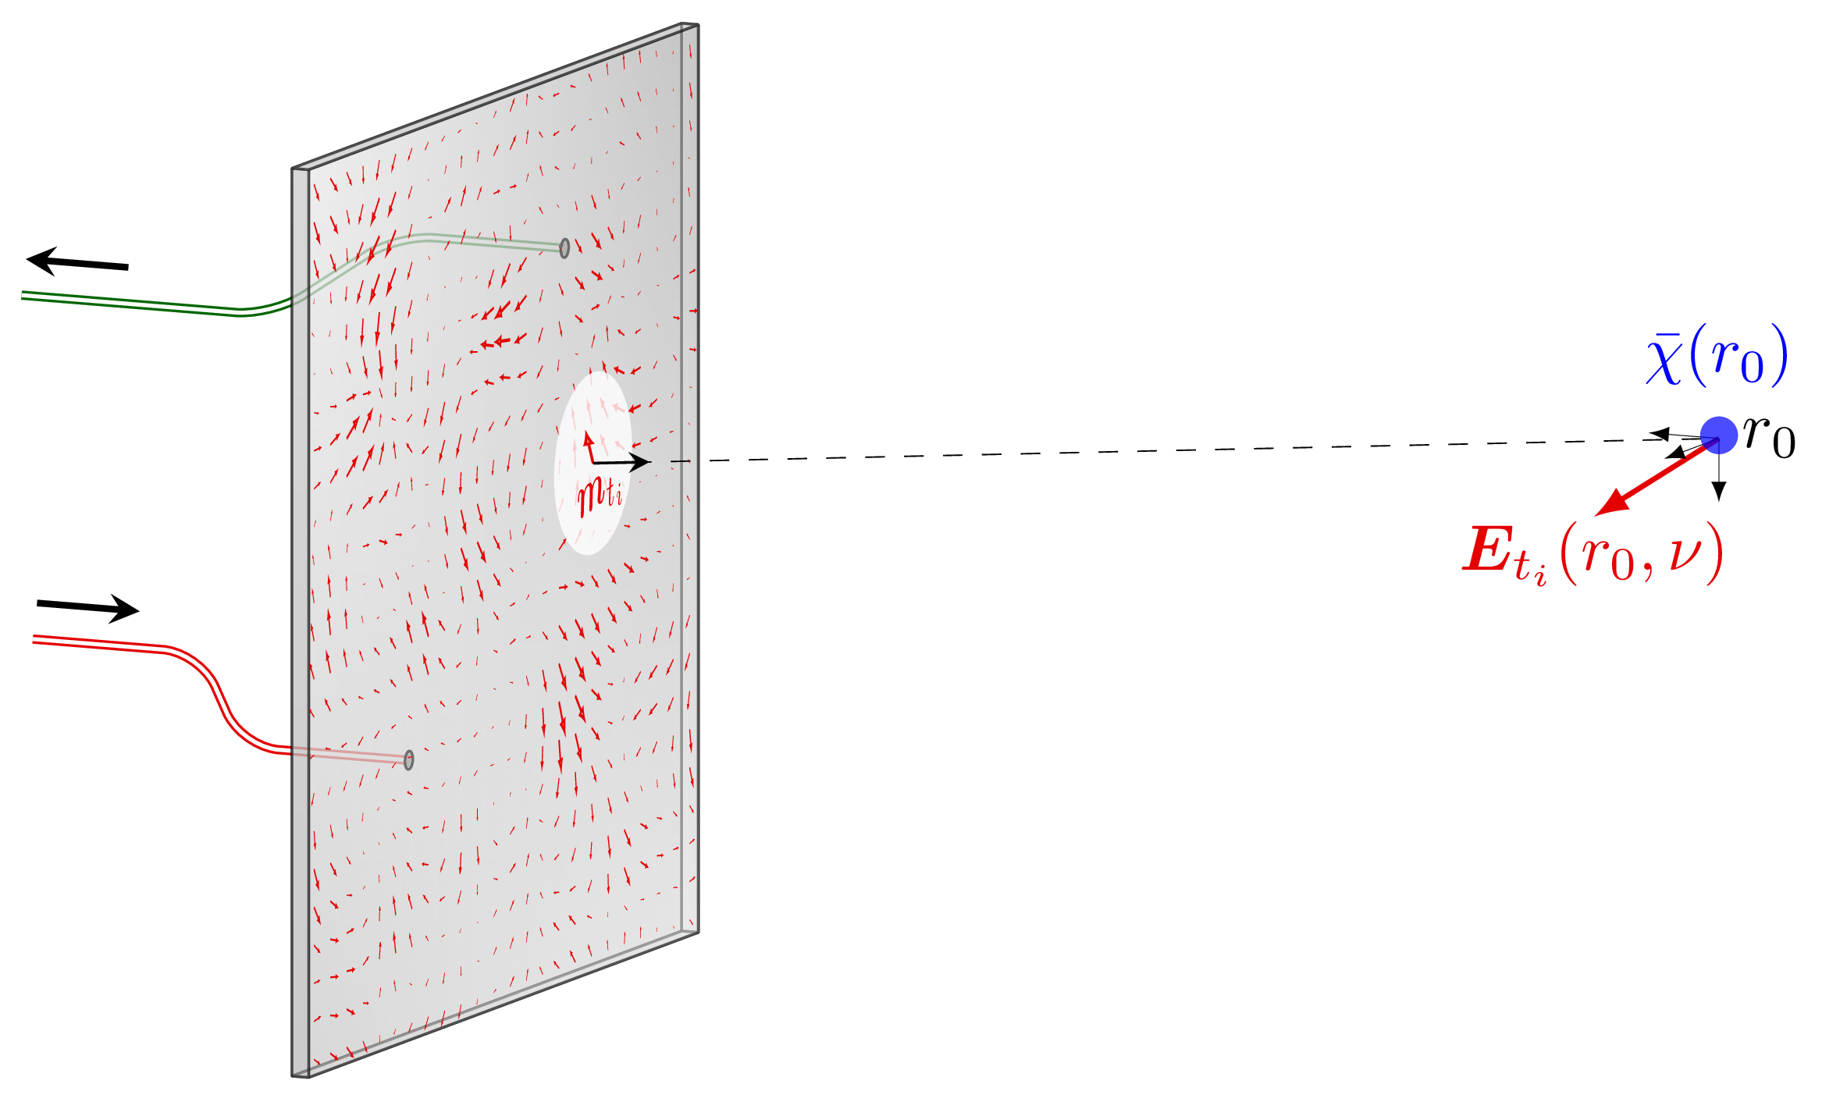
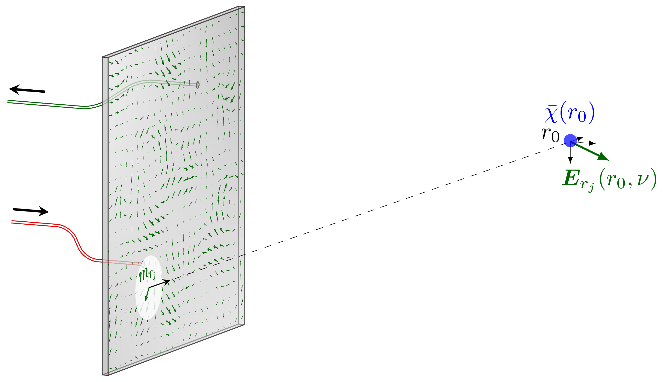
Polarimetric computational imaging
Operating with a single two-ports panel
Forward model of the polarimetric imaging problem
Operating with two panels
Tx E-field
Rx E-field
Fromenteze, T., Yurduseven, O., Boyarsky, M., Gollub, J., Marks, D. L., & Smith, D. R. (2017). Computational polarimetric microwave imaging. Optics express, 25(22), 27488-27505.
STh-01
Notes:
\overline{E_i}^{sca}(r) = {\color{DarkGreen} \overline{\overline{\chi(r)}}}\, {\color{blue} \overline{E_i}(r)}
g_{i,j}(\omega) = \int_r {\color{red} \overline{E_j} (r)}\, {\color{DarkGreen} \overline{\overline{\chi(r)}}}\, {\color{blue} \overline{E_i} (r)}\, dr

Slide 32
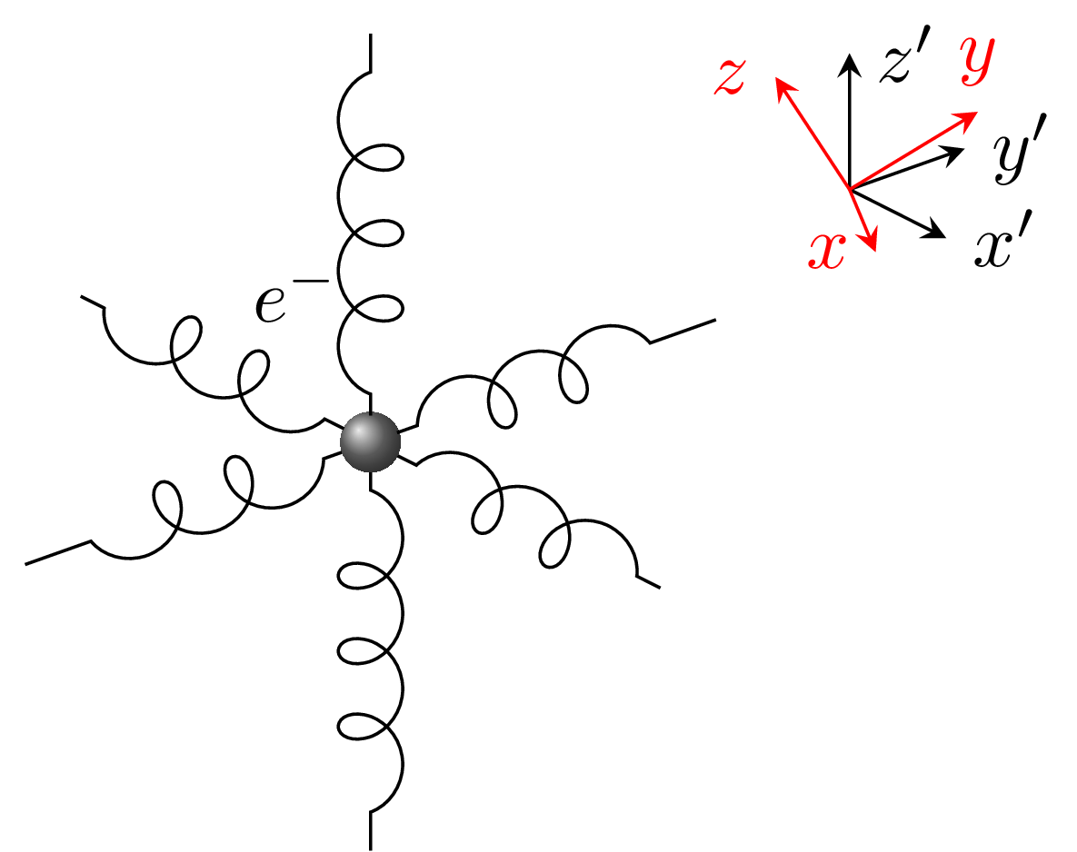
Polarimetric computational imaging
Understanding the physics behind the susceptibility tensors:
The electrons within the target medium are represented by a simple mechanical model
Forward model of the polarimetric imaging problem
Rotation matrix
Diagonalized tensor
Fromenteze, T., Yurduseven, O., Boyarsky, M., Gollub, J., Marks, D. L., & Smith, D. R. (2017). Computational polarimetric microwave imaging. Optics express, 25(22), 27488-27505.
STh-01
Notes:
\overline{E_i}^{sca}(r) = {\color{DarkGreen} \overline{\overline{\chi(r)}}}\, {\color{blue} \overline{E_i}(r)}
g_{i,j}(\omega) = \int_r {\color{red} \overline{E_j} (r)}\, {\color{DarkGreen} \overline{\overline{\chi(r)}}}\, {\color{blue} \overline{E_i} (r)}\, dr
{\color{DarkGreen} \overline{\overline{\chi}}(r) = \overline{\overline{R}}(r) \text{diag}(\bar \xi(r))\overline{\overline{R}}(r)^T}

Slide 33
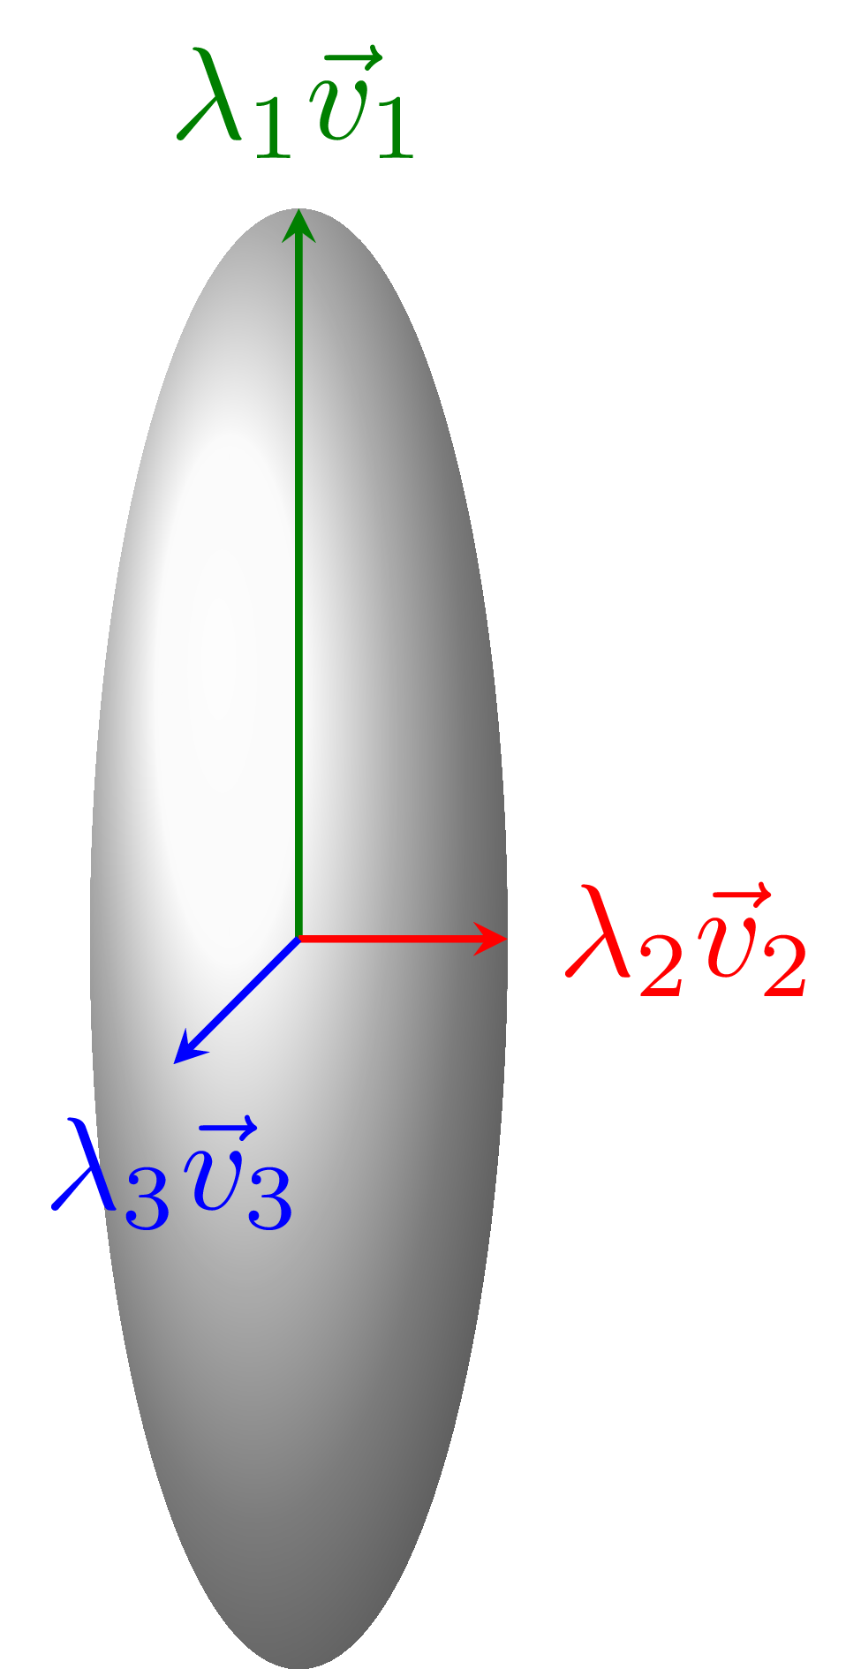
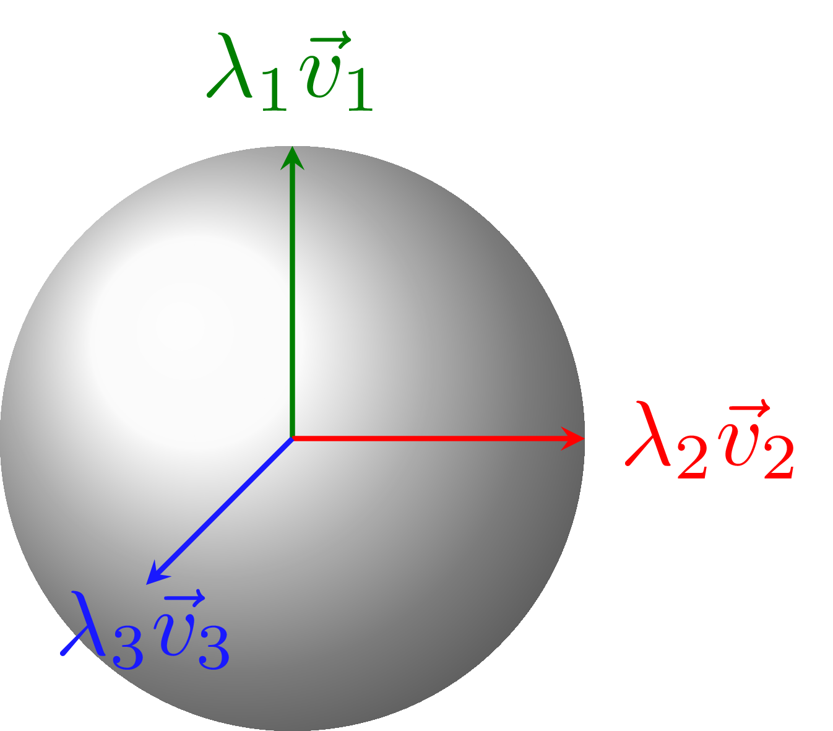
Polarimetric computational imaging
Understanding the physics behind the susceptibility tensors:
The electrons within the target medium are represented by a simple mechanical model
Eigendecompositions helps to identify the directions of the main axis of the tensors (eigenvectors) and the associated eigenvalues define the anisotropic behavior of each voxel
Isotropic scattering
Anisotropic scattering
Rotation matrix
Diagonalized tensor
Fromenteze, T., Yurduseven, O., Boyarsky, M., Gollub, J., Marks, D. L., & Smith, D. R. (2017). Computational polarimetric microwave imaging. Optics express, 25(22), 27488-27505.
STh-01
Notes:
\overline{E_i}^{sca}(r) = {\color{DarkGreen} \overline{\overline{\chi(r)}}}\, {\color{blue} \overline{E_i}(r)}
g_{i,j}(\omega) = \int_r {\color{red} \overline{E_j} (r)}\, {\color{DarkGreen} \overline{\overline{\chi(r)}}}\, {\color{blue} \overline{E_i} (r)}\, dr
{\color{DarkGreen} \overline{\overline{\chi}}(r) = \overline{\overline{R}}(r) \text{diag}(\bar \xi(r))\overline{\overline{R}}(r)^T}

Slide 34
Polarimetric computational imaging
Understanding the physics behind the susceptibility tensors:
The electrons within the target medium are represented by a simple mechanical model
Analogy with diffusion tensor imaging Magnetic Resonance Imaging
The main axis analysis of the tensors reconstructed in each voxel makes it possible to reconstruct the path of the fibers in the brain
Rotation matrix
Diagonalized tensor
https://en.wikipedia.org/wiki/File:DiffusionMRI_glyphs.png
https://www.siemens-healthineers.com/magnetic-resonance-imaging/options-and-upgrades/clinical-applications/syngo-dti-tractography
Fromenteze, T., Yurduseven, O., Boyarsky, M., Gollub, J., Marks, D. L., & Smith, D. R. (2017). Computational polarimetric microwave imaging. Optics express, 25(22), 27488-27505.
STh-01
Notes:
\overline{E_i}^{sca}(r) = {\color{DarkGreen} \overline{\overline{\chi(r)}}}\, {\color{blue} \overline{E_i}(r)}
g_{i,j}(\omega) = \int_r {\color{red} \overline{E_j} (r)}\, {\color{DarkGreen} \overline{\overline{\chi(r)}}}\, {\color{blue} \overline{E_i} (r)}\, dr
{\color{DarkGreen} \overline{\overline{\chi}}(r) = \overline{\overline{R}}(r) \text{diag}(\bar \xi(r))\overline{\overline{R}}(r)^T}

Slide 35
Polarimetric computational imaging
Forward model of the polarimetric imaging problem
Solving the inverse problem
The Tx and Rx vector fields are inversed to reveal the interaction between each couple of polarization states
Criteria to be met to ensure successful reconstruction
The radiated fields in transmission and reception must be simultaneously orthogonal in three domains:
- in frequency
- in polarization
- spatially
Fromenteze, T., Yurduseven, O., Boyarsky, M., Gollub, J., Marks, D. L., & Smith, D. R. (2017). Computational polarimetric microwave imaging. Optics express, 25(22), 27488-27505.
STh-01
Notes:
{\color{DarkGreen} \hat{\overline{\overline{\chi}}}(r)} = {\color{blue} \overline{E_i}(r)^+} g_{i,j}\, {\color{red} \overline{E_j}(r)^+}

Slide 36
Polarimetric computational imaging
Computing the spatial correlation for each pair of ports and polarizations
Fromenteze, T., Yurduseven, O., Boyarsky, M., Gollub, J., Marks, D. L., & Smith, D. R. (2017). Computational polarimetric microwave imaging. Optics express, 25(22), 27488-27505.
STh-01
Notes:
{\color{DarkGreen} \hat{\overline{\overline{\chi}}}(r)} = {\color{blue} \overline{E_i}(r)^+} g_{i,j}\, {\color{red} \overline{E_j}(r)^+}

Slide 37
Polarimetric computational imaging
Experimental validation
Imaging targets made with thin copper wires
Number of frequency samples: 3601
Frequency range: 17.5-26.5 GHz
Fromenteze, T., Yurduseven, O., Boyarsky, M., Gollub, J., Marks, D. L., & Smith, D. R. (2017). Computational polarimetric microwave imaging. Optics express, 25(22), 27488-27505.
STh-01

Slide 38
Polarimetric computational imaging
Results with the letter D
Reconstructed from the measurement of a single frequency-domain signal
For each voxel
9 tensor elements (only 6 are independent)
each tensor element is a complex value
The diversity of representations of such tensors remains unexplored for these applications
Special feature of the short-range polarimetric imaging
We obtain projections on the propagation axis
x and z are the transverse axis, y is the longitudinal (propagation) axis
Fromenteze, T., Yurduseven, O., Boyarsky, M., Gollub, J., Marks, D. L., & Smith, D. R. (2017). Computational polarimetric microwave imaging. Optics express, 25(22), 27488-27505.
STh-01

Slide 39
Polarimetric computational imaging
Results with the letter D
Reconstructed from the measurement of a single frequency-domain signal
Extraction of a cross-section plan
The phase is included in the reconstructions and can be color-coded to reveal more information
The results are still based Born first approximation
we must keep a critical eye on the analysis of the results
x and z are the transverse axis, y is the longitudinal (propagation) axis
Fromenteze, T., Yurduseven, O., Boyarsky, M., Gollub, J., Marks, D. L., & Smith, D. R. (2017). Computational polarimetric microwave imaging. Optics express, 25(22), 27488-27505.
STh-01

Slide 40
Polarimetric computational imaging
Improvements with basic processing
Correlation of transverse components
Optimized SNR noise reduced by the coherent sum of the useful parts of the tensor
Anisotropic behavior orientation of copper wires revealed by the phase information
Fromenteze, T., Yurduseven, O., Boyarsky, M., Gollub, J., Marks, D. L., & Smith, D. R. (2017). Computational polarimetric microwave imaging. Optics express, 25(22), 27488-27505.
STh-01
Notes:
\hat{\chi}_{corr}(r) = \hat{\chi}_{x,x}(r) \cdot \hat{\chi}_{z,z}(r)^*

Slide 41
Polarimetric computational imaging
Going further with eigendecompositions
The diagonalization of the tensors is computed for each voxel on the real and imaginary parts separately
Fromenteze, T., Yurduseven, O., Boyarsky, M., Gollub, J., Marks, D. L., & Smith, D. R. (2017). Computational polarimetric microwave imaging. Optics express, 25(22), 27488-27505.
STh-01
Notes:
\hat{\chi}_{corr}(r) = \hat{\chi}_{x,x}(r) \cdot \hat{\chi}_{z,z}(r)^*

Slide 42
Polarimetric computational imaging
Going further with eigendecompositions
RGB color-coding according to the orientation of the main axis of each ellipsoid
Fromenteze, T., Yurduseven, O., Boyarsky, M., Gollub, J., Marks, D. L., & Smith, D. R. (2017). Computational polarimetric microwave imaging. Optics express, 25(22), 27488-27505.
STh-01
Notes:
\hat{\chi}_{corr}(r) = \hat{\chi}_{x,x}(r) \cdot \hat{\chi}_{z,z}(r)^*

Slide 43
Polarimetric phaseless imaging
In conclusion of this work
Conventional MIMO polarimetric system
Computational MIMO polarimetric system
Double the hardware constraints compared to systems based on the scalar approximation
Very few applications in short range imaging due to these limitations
Requires a single measurement chain provided that a full scan of the near fields is carried out
Paves the way for volumetric reconstruction of susceptibility tensors
Fromenteze, T., Yurduseven, O., Boyarsky, M., Gollub, J., Marks, D. L., & Smith, D. R. (2017). Computational polarimetric microwave imaging. Optics express, 25(22), 27488-27505.
STh-01

Slide 44
Phaseless computational imaging
Conventional MIMO system
Motivation for this work
is it possible to reconstruct images from the intensity measurement of signals that interacted with a target?
In other words, can we replace our VNAs with spectrum analyzers and a little mathematics?
Are computational systems compatible with/supportive of these objectives?
Phase measurement also creates heavy hardware constraints on each measurement chain
STh-01

Slide 45
Phaseless computational imaging
First concern: phase information is crucial
2D Fourier
transform
Phase swap
STh-01

Slide 46
Phaseless computational imaging
First concern: phase information is crucial
After the phase swap and an inverse 2D Fourier transform
STh-01

Slide 47
Phaseless computational imaging
Key element: phase information can however be encoded in the intensity information
Signals received in an aperture in the presence of two isotropic point sources
Interferences of complex contributions:
Transformation of phase information into intensity fluctuation
Inverse problem solving: Phase retrieval algorithms
STh-01

Slide 48
Phaseless computational imaging
Objective: Application to microwave imaging
Expression of the measured signals
Matrix formalism
Reconstruction by pseudo-inversion
Intensity measurement: Reflectivity reconstruction?
STh-01
Notes:
s(r_t,r_r) = \int_r G(r_t,r_r) \sigma(r) G(r,r_r) d^3r
s_I = \lvert s \lvert ^2 = \lvert H \sigma \lvert ^2

Slide 49
Phaseless computational imaging
Intensity measurement: Reflectivity reconstruction?
Solving an optimization problem
Convex programming
Example: CVX and Matlab
Iterative algorithm
Example: Truncated Wirtinger Flow
Candes, E. J., Li, X., & Soltanolkotabi, M. (2015). Phase retrieval via Wirtinger flow: Theory and algorithms. IEEE Transactions on Information Theory, 61(4), 1985-2007.
STh-01
Notes:
s(r_t,r_r) = \int_r G(r_t,r_r) \sigma(r) G(r,r_r) d^3r
s_I = \lvert s \lvert ^2 = \lvert H \sigma \lvert ^2

Slide 50
Phaseless computational imaging
Experimental validation: SAR PhaseLess imaging
Aperture size: 60 × 60 cm²
Number of samples: 61 × 61 = 3721
Background measurement (without marbles)
The results converge towards those obtained with phase measurement
Once again, the hardware constraint is transferred to the software layer
Complex measurements
Intensity measurements
STh-01
Notes:
s(r_t,r_r) = \int_r G(r_t,r_r) \sigma(r) G(r,r_r) d^3r
s_I = \lvert s \lvert ^2 = \lvert H \sigma \lvert ^2

Slide 51
Phaseless computational imaging
Cavity-based phaseless localization
First step: localizing a source from an intensity measurement
The diversity of the magnitudes of near-field scans is the basis for encoding information
ν1 = 23 GHz - ν2 = 23.002 GHz
Fromenteze, T., Liu, X., Boyarsky, M., Gollub, J., & Smith, D. R. (2016). Phaseless computational imaging with a radiating metasurface. Optics express, 24(15), 16760-16776.
STh-01
Notes:
s(r_t,r_r) = \int_r G(r_t,r_r) \sigma(r) G(r,r_r) d^3r
s_I = \lvert s \lvert ^2 = \lvert H \sigma \lvert ^2

Slide 52
Phaseless computational imaging
Cavity-based phaseless localization
First step: localizing a source from an intensity measurement
Reconstruction from the measurement of two signals on the output ports of the cavity
The diversity of the magnitudes of near-field scans is the basis for encoding information
Algorithm: Truncated Wirtinger Flow
Number of spatial samples: 20 × 20 × 10
Number of frequency samples: 3601
Frequency range: 17.5-26.5 GHz
Fromenteze, T., Liu, X., Boyarsky, M., Gollub, J., & Smith, D. R. (2016). Phaseless computational imaging with a radiating metasurface. Optics express, 24(15), 16760-16776.
STh-01
Notes:
s(r_t,r_r) = \int_r G(r_t,r_r) \sigma(r) G(r,r_r) d^3r
s_I = \lvert s \lvert ^2 = \lvert H \sigma \lvert ^2

Slide 53
Phaseless computational imaging
Cavity-based phaseless imaging
Switching to the interrogation of a reflectivity function
Small object for the determination of the point spread function
Use of a more advanced technique based on the sparsity of the scene to be imaged
Yuan, Z., Wang, H., & Wang, Q. (2019). Phase retrieval via sparse wirtinger flow. Journal of Computational and Applied Mathematics, 355, 162-173.
Yurduseven, O., Fromenteze, T., Marks, D. L., Gollub, J. N., & Smith, D. R. (2017). Frequency-diverse computational microwave phaseless imaging. IEEE Antennas and Wireless Propagation Letters, 16, 2808-2811.
STh-01
Notes:
s(r_t,r_r) = \int_r G(r_t,r_r) \sigma(r) G(r,r_r) d^3r
s_I = \lvert s \lvert ^2 = \lvert H \sigma \lvert ^2

Slide 54
Phaseless computational imaging
Cavity-based phaseless imaging
Switching to the interrogation of a reflectivity function
Key parameter: ratio M/N
M number of measurements
N number of voxels
M/N = 0.3
M/N = 0.6
M/N = 0.8
Comparison of the performances achieved by the different approaches
Complex measurement
Sparse
WF
Regular
WF
Yurduseven, O., Fromenteze, T., Marks, D. L., Gollub, J. N., & Smith, D. R. (2017). Frequency-diverse computational microwave phaseless imaging. IEEE Antennas and Wireless Propagation Letters, 16, 2808-2811.
STh-01
Notes:
s(r_t,r_r) = \int_r G(r_t,r_r) \sigma(r) G(r,r_r) d^3r
s_I = \lvert s \lvert ^2 = \lvert H \sigma \lvert ^2

Slide 55
Phaseless computational imaging
Complex-based reconstruction
Phaseless reconstruction
Yurduseven, O., Fromenteze, T., Marks, D. L., Gollub, J. N., & Smith, D. R. (2017). Frequency-diverse computational microwave phaseless imaging. IEEE Antennas and Wireless Propagation Letters, 16, 2808-2811.
STh-01

Slide 56
Phaseless computational imaging
Interesting feature of phaseless imaging: relaxes the phase coherency requirements for applications where large apertures are needed
Without phase error
Without phase error
With phase error
Complex-Based
With phase error
Without phase error
With phase error
Phaseless
Yurduseven, O., Fromenteze, T., & Smith, D. R. (2018). Relaxation of alignment errors and phase calibration in computational frequency-diverse imaging using phase retrieval. IEEE Access, 6, 14884-14894.
STh-01

Slide 57
STh-01
MODERN ADVANCES IN COMPUTATIONAL IMAGING AT MICROWAVE AND MILLIMETRE-WAVE FREQUENCIES
Okan Yurduseven^{#1}, Thomas Fromentèze^{#2}
^{#1}Queen’s University Belfast, UK
^{#2}Xlim Research Institute, University of Limoges, France
¹okan.yurduseven@qub.ac.uk, ²thomas.fromenteze@unilim.fr

