Slide 1
STh-01
MODERN ADVANCES IN COMPUTATIONAL IMAGING AT MICROWAVE AND MILLIMETRE-WAVE FREQUENCIES
Okan Yurduseven^{#1}, Thomas Fromenteze^{#2}
^{#1}Queen’s University Belfast, UK
^{#2}University of Limoges, France
¹okan.yurduseven@qub.ac.uk, ²thomas.fromenteze@unilim.fr

Slide 2
STh-01
General Introduction to Microwave and Millimeter-wave Computational Imaging; Formalisms, Systems and Image Reconstruction
Okan Yurduseven^{#1}, Thomas Fromenteze^{#2}
^{#1}Queen’s University Belfast, UK
^{#2} Xlim Research Institute, University of Limoges, France
¹okan.yurduseven@qub.ac.uk, ²thomas.fromenteze@unilim.fr

Slide 3




Outline of the First Part
Introduction
  Electromagnetic spectrum and imaging
  Imaging tradeoffs (low frequency, high frequency, wideband, narrowband, active, passive, monostatic, bistatic, multistatic)
  Resolution and point spread function (PSF)
  Microwave imaging and conventional imaging modalities
Computational Imaging
  Frequency-diverse imaging
  Image reconstruction algorithms
  Metasurface antennas for computational imaging
  Application: Imaging of human-sized objects for security-screening
    Objects with metal and dielectric threat targets
    Real-time acquisition and person reconstructions on the move
    Microwave (computational) and mmW (spotlight) sensor fusion example
STh-01

Slide 4
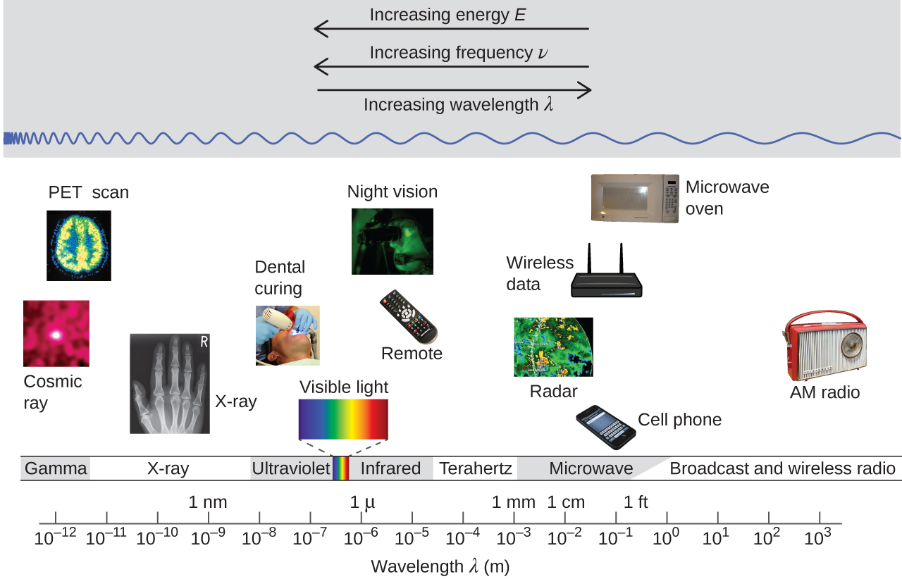
Electromagnetic Spectrum and Imaging
STh-01

Slide 5
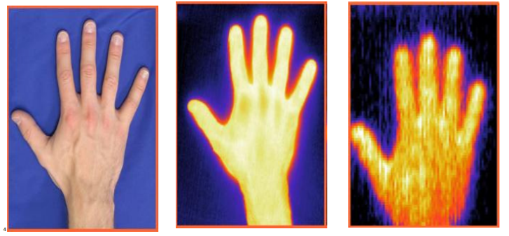
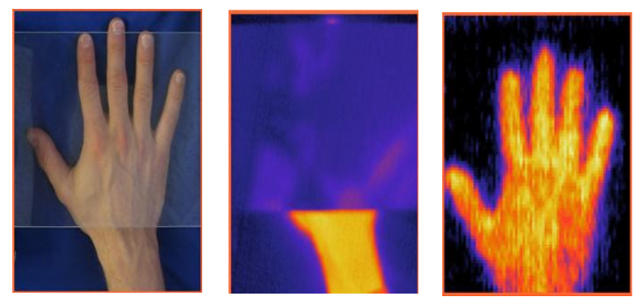
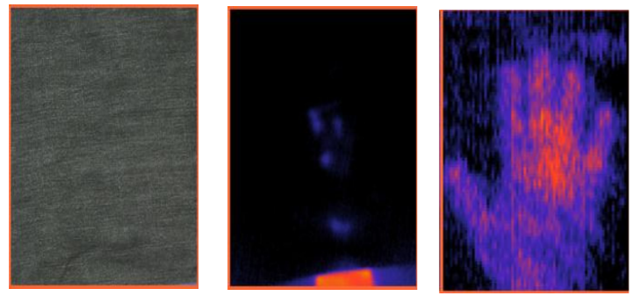
Electromagnetic Spectrum and Imaging
Optical
IR
mmW
Optical
IR
mmW
Source: http://www.vision4thefuture.org
STh-01

Slide 6
Low Frequency vs High Frequency
Low frequency
  Advantages:
    Mature and low-cost component technology (off-the-shelf)
    Better propagation
  Disadvantages:
    Low resolution
  High frequency
  Advantages
    High resolution
      Disadvantages
        High attenuation / short penetration depth in dielectric media
        High component costs
STh-01

Slide 7
Wideband vs Narrowband
Narrowband Imaging
  Advantages:
    Simple RF backend
  Disadvantages:
    Poor range resolution
      An extreme case: Single frequency imaging
Wideband Imaging
  Advantages:
    Superior range resolution
  Disadvantages:
    Complex RF backend
STh-01

Slide 8
Active vs Passive
Active Imaging
  An active radar system relies on illuminating the imaged object and measuring the back-scattered radar signal. It requires transmit and receive antennas.
  Advantages:
    Superior signal-to-noise (SNR)
  Disadvantages:
    Requires a transmit unit as well as a receive unit
    Requires higher power and exhibits more complex system architecture
Passive Imaging
  Advantages:
    Only the receiver unit is required. No active illumination is needed.
  Disadvantages:
    Low SNR. Extremely sensitive receiving unit is needed at very low signal levels (a common technique is increasing the integration time).
STh-01

Slide 9
Radar Layout
For an active radar, depending on the orientation of the transmit and receive antennas and the data acquisition structure, a radar is said to be “monostatic”, “bistatic” or “multi-static”.
A monostatic radar uses the same antenna aperture to transmit and receive. Alternatively, it can use two antennas that are close to each other in a so-called “quasi-monostatic” layout.
A bistatic radar uses two antennas; one transmit and one receive to perform imaging.
A multi-static radar uses multiple transmit and receive antennas to perform imaging. They can form a multiple-input-multiple-output (MIMO) layout, which has found numerous applications, not only in imaging but also in 5G recently.
Tx / Rx
Imaged Object
Tx
Imaged Object
Rx
Tx1
Rx1
Imaged Object
Tx2
Rx2
STh-01

Slide 10
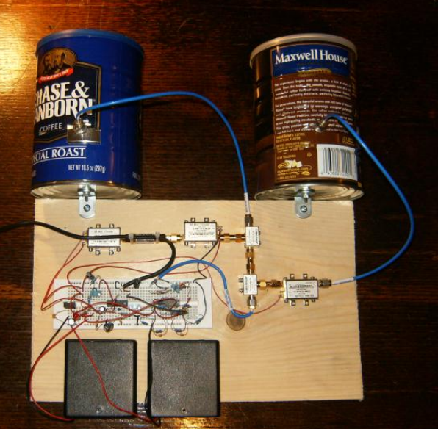
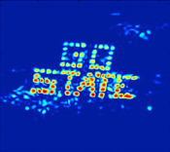
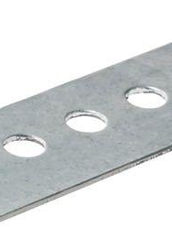
Microwave Radar Architecture
Anybody can build a radar using off-the-shelf components!
Below is a picture of a FMCW radar using that operates at 2.4 GHz.
A typical radar block diagram is seen below.
Tx Ant.
Att.
PA
Coupler
Signal
Source
LO
IF
RF
Rx Ant.
Signal Proc.
Mixer
Imaged Object
Build a Small Radar System Capable of Sensing Range, Doppler, and Synthetic Aperture Radar Imaging
Dr. Gregory L. Charvat, Mr. Jonathan H. Williams, Dr. Alan J. Fenn, Dr. Steve Kogon, Dr. Jeffrey S. Herd
STh-01

Slide 11
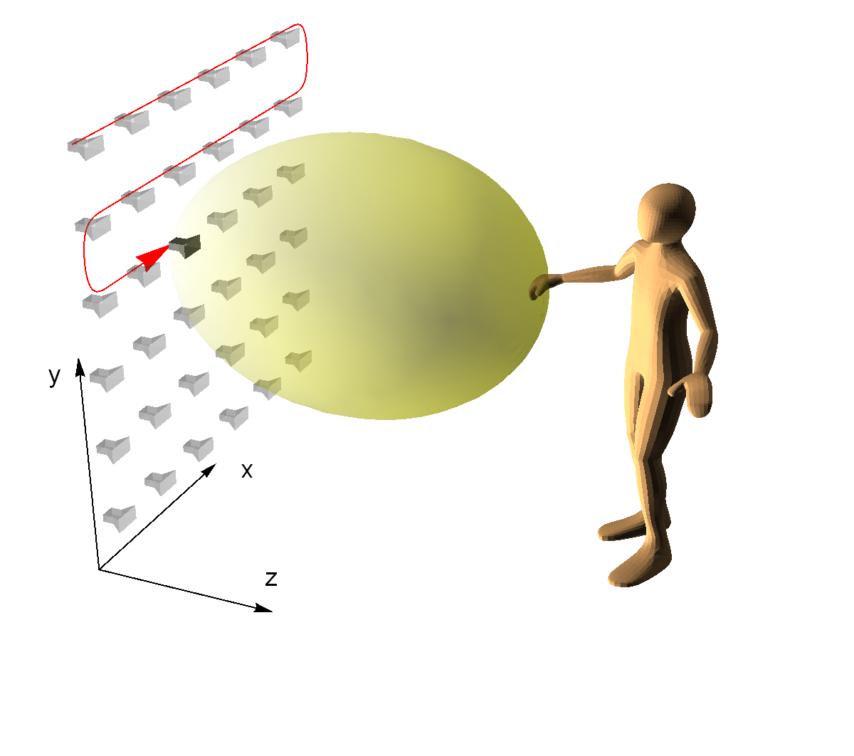
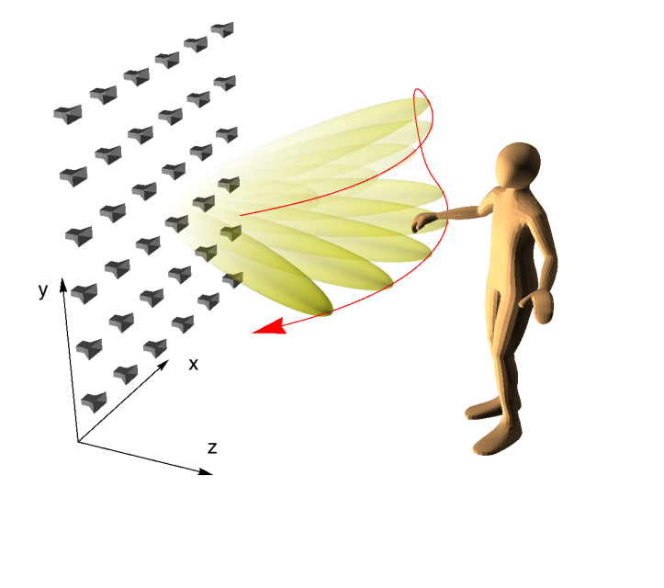
Conventional Imaging Examples
Synthetic aperture radar (SAR) is a very common way to image a scene. Most commonly, a SAR aperture is synthesized by means of a mechanical raster scanning process.
Alternatively, switching mechanisms and all-electronic beam synthesis can be used.
Both these techniques have pros and cons.
Synthetic Aperture
Phased Array
Obtaining Measurements
Steerable antennas can provide direct illumination of regions over a volume, but costly for entire active aperture.
Synthetic aperture radar techniques avoid phase shifters, use switching or mechanical scanning.
STh-01

Slide 12
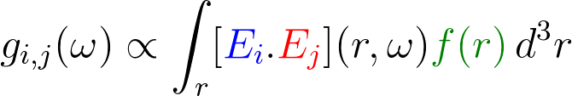





Imaging Problem
General description of the forward model
a measurement corresponds to the interaction between electromagnetic fields and a target characterized by a reflectivity function
measured frequency-domain signal
Tx electric field
Rx electric field
reflectivity function ( Δε(r) )
Approximations
- Scalar fields and reflectivity
- No direct coupling effect between Tx and Rx
- Linearization of Maxwell equations (weak scattering)
STh-01
Notes:
Equations generated on
https://www.codecogs.com/latex/eqneditor.php
g_{i,j}(\omega) \propto \int_r [{\color{Blue} E_{i}} . {\color{Red} E_{j}}] (r,\omega) {\color{DarkGreen} f(r)}\, d^3r

Slide 13

First-Born Approximation
The forward model presented below exhibits a fundamental simplification to the imaging problem.
This simplification is a linearization process known as the first Born approximation.
First Born approximation assumes that the total field within the region of interest can be modeled as the incident field as opposed to incident field + scattered field (or total field).
The first Born approximation makes the assumption that the total field is not perturbed by the scattered field.
$$Etotal=Einc=ETxERx$$
Linearized with First Born approximation
STh-01
Notes:
http://www.jpier.org/PIERB/pierb79/01.17081003.pdf

Slide 14

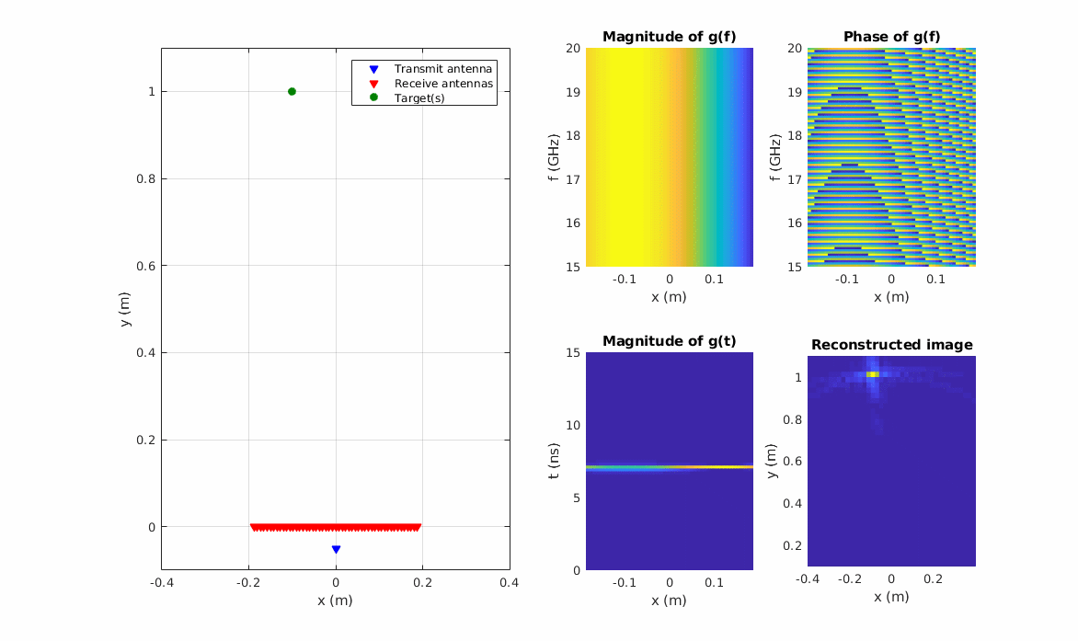



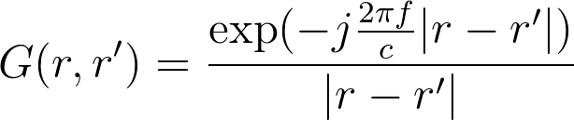
Simulation of a simple 2D imaging system
Single Input Multiple Outputs (SIMO) system
Code available here
https://bit.ly/2Jbfdfn
Starting from the forward model
the model is simplified considering isotropic sources and a point target:
for 1 Tx antenna
for 101 Rx antennas
with the Green's function defined as
STh-01
Notes:
{\color{Blue} E_{i} = G(r,r_t)}
{\color{DarkGreen} f(r) = \delta(r-r_C)}
G(r,r') = \frac{\exp(-j \frac{2\pi f}{c}\lvert r - r' \lvert )}{\lvert r - r' \lvert}

Slide 15
Simulation of a simple 2D imaging system
Single Input Multiple Outputs (SIMO) system
Code available here
https://bit.ly/2Jbfdfn
Starting from the forward model
the model is simplified considering isotropic sources and a point target:
for 1 Tx antenna
for 101 Rx antennas
with the Green's function defined as
STh-01
Notes:
{\color{Blue} E_{i} = G(r,r_t)}
{\color{DarkGreen} f(r) = \delta(r-r_C)}
G(r,r') = \frac{\exp(-j \frac{2\pi f}{c}\lvert r - r' \lvert )}{\lvert r - r' \lvert}

Slide 16
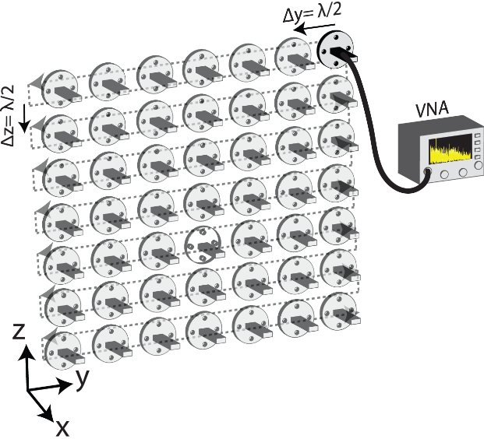
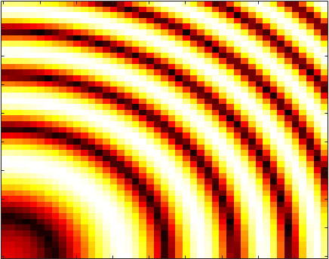
Imaging Problem
In this example, we consider the mechanical raster scanning scenario.
A 10 cm x 10 cm aperture is synthesized at the Nyquist limit (λ/2) and a single waveguide antenna is moved point-by-point.
The SAR aperture depicted in this example performs a point-by-point scanning of the scene.
The synthesized aperture consists of 18*18=324 sampling points (or individually switched antennas) .
The received signal can be expressed as follows. This is also known as the forward-model.
r_{t}: transmit coordinates
r_{r}: receive coordinates
r: scene coordinates
f: reflectivity
w: frequency
E: E-field in scene
For this scenario:
i=j
E_{Tx}=E_{Rx}
STh-01
Notes:
Equations generated on
https://www.codecogs.com/latex/eqneditor.php
g_{i,j}(\omega) = \int_r {\color{Blue} E_{i}(r,\omega)} {\color{Red} E_{j}(r,\omega)}\, {\color{DarkGreen} f(r)}\, d^3 r

Slide 17
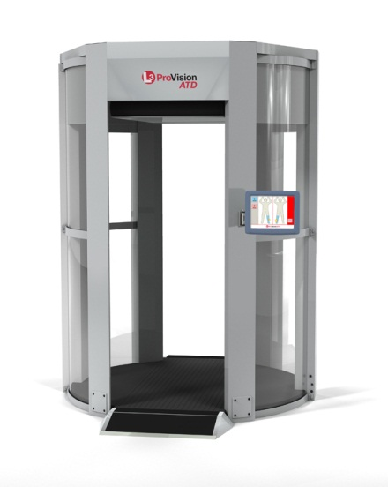
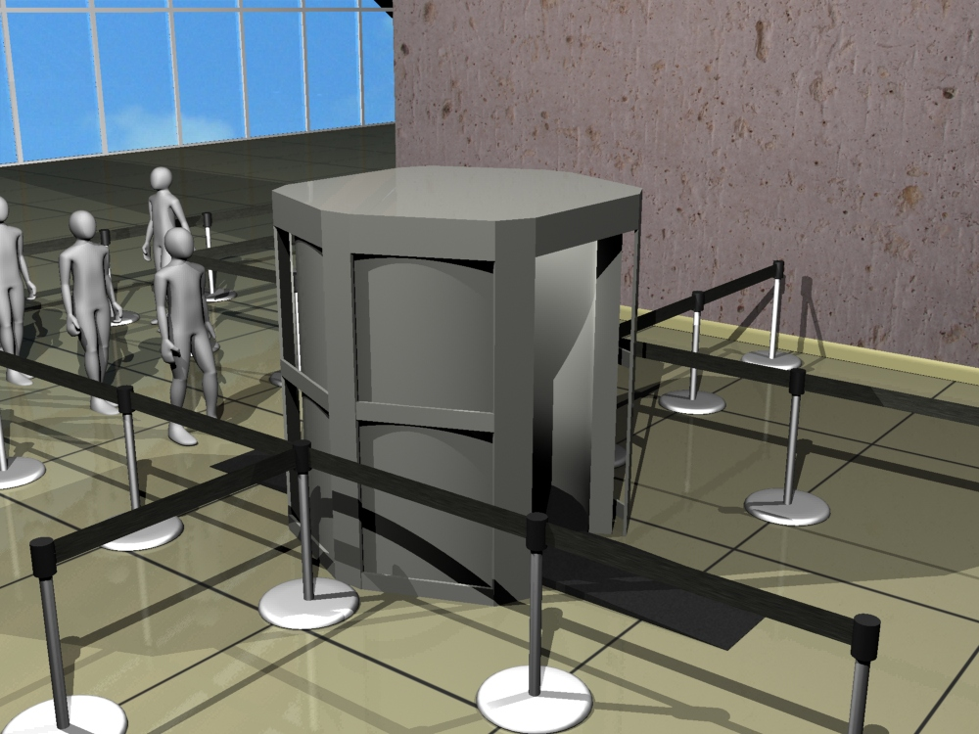
Imaging Problem
An example imaging problem: Security-screening.
A cylindrical aperture is synthesized by means of mechanical scanning a vertical antenna array.
STh-01

Slide 18
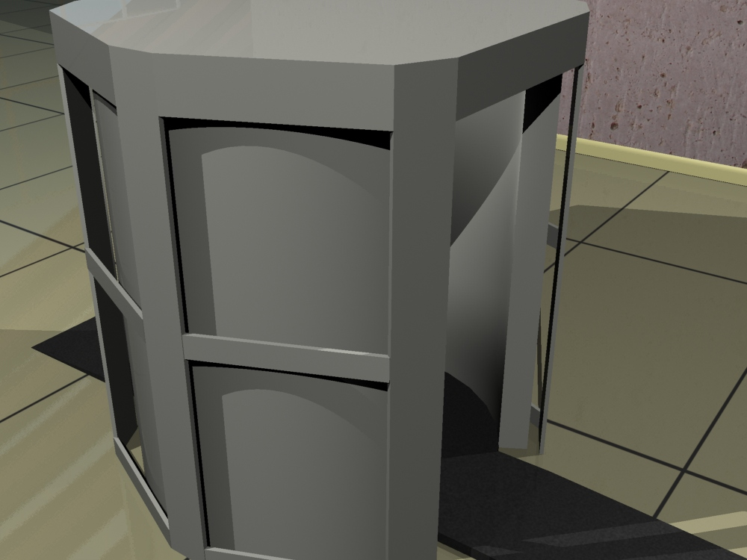
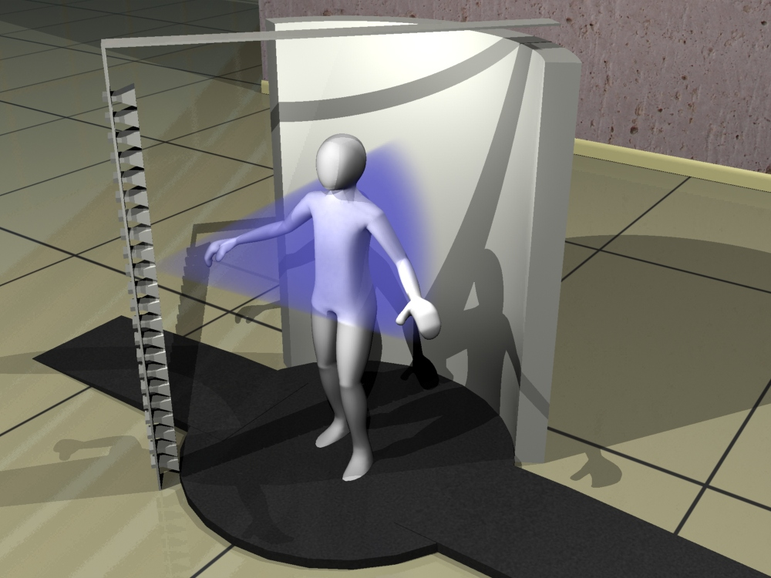
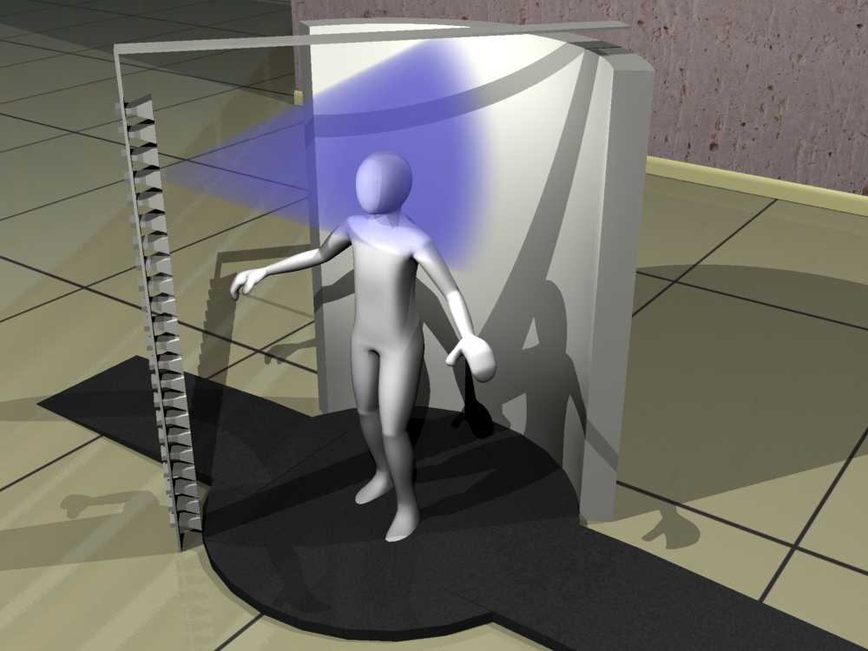
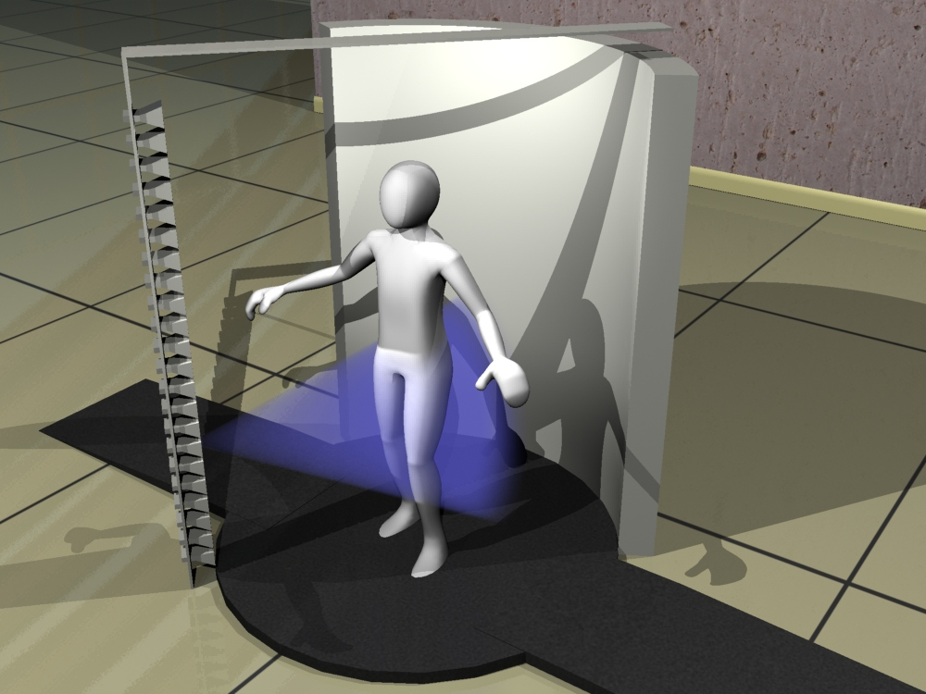
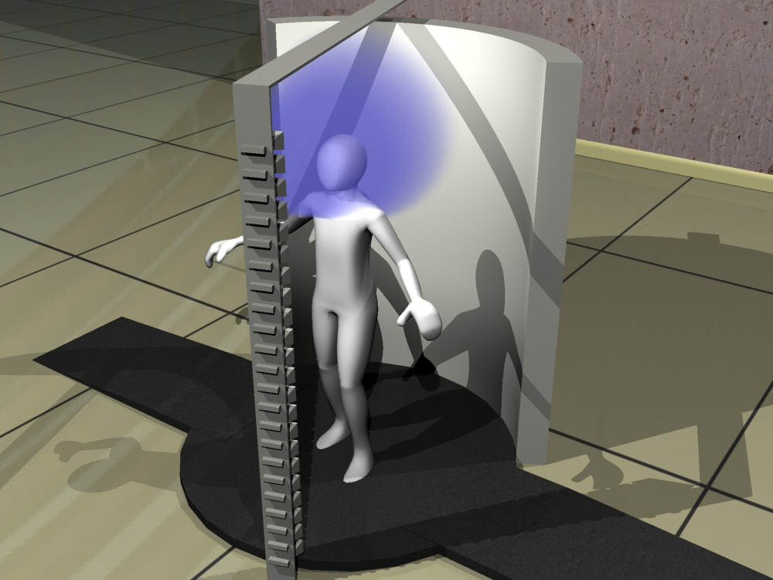
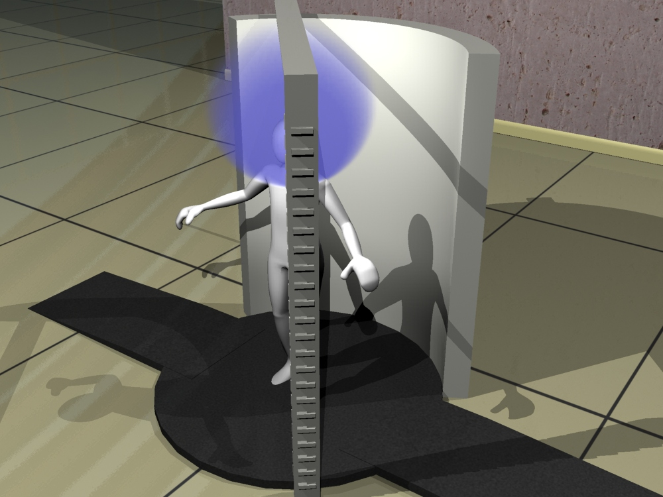
Current Airport Security Screening Checkpoints
A cylindrical aperture is synthesized by means of mechanical scanning a vertical antenna array.
This type of data acquisation, albeit being simple, is not real-time.
STh-01

Slide 19
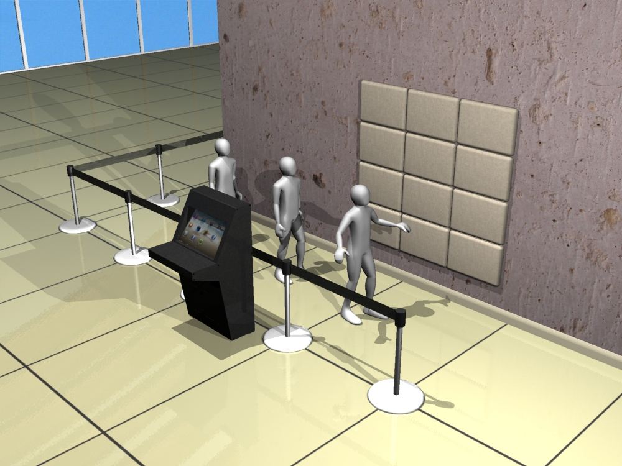
Motivation for Computational Imaging
Data acquisation and image reconstruction in real-time?
Needs a more clever approach to imaging.
STh-01

Slide 20
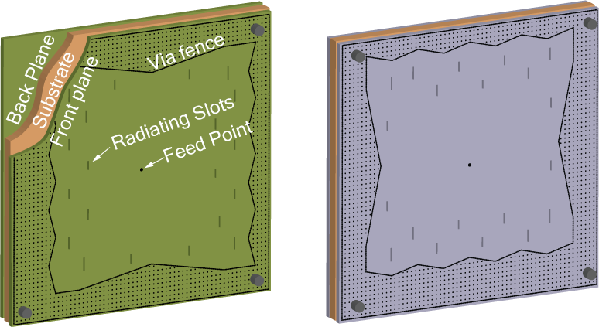
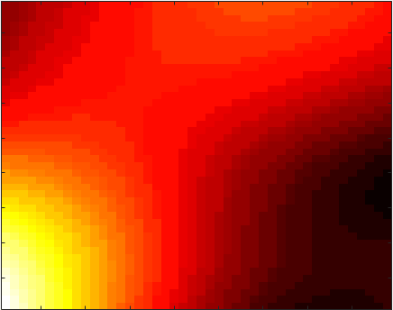
Encoding Scene Information using a Single Channel?
A significant simplification in the hardware layer can be achieved by radiating coded wave patterns and compressing the back-scattered signal in the physical domain.
This is as opposed to raster scanning the scene to do point-by-point imaging.
Antenna for Computational Imaging
Antenna Radiated Fields
Single
Channel
Imaging Equation
Coded field patterns projected to scene
STh-01

Slide 21
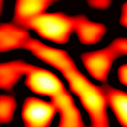
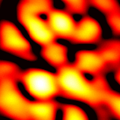
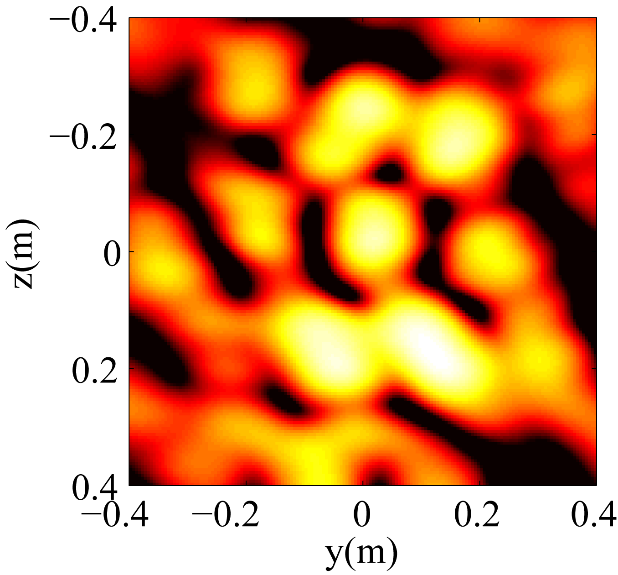
Frequency Diverse Metasurfaces
One way to acheieve coded field patterns is to use frequency-diversity. Frequency-diversity is a technique to radiate spatially-incoherent radiation patterns as a function of frequency.
Cavity Backed Metasurface Panel
  Copper clad circuit board plus via fence boundary form a 2D irregularly shaped dielectric cavity
  Back-fed cylindrical coplanar waveguide mode scatters and mixes in the cavity
  Distribution of irises in the PCB radiate a complex waveform that is a function driving frequency
  These metasurfaces generates a set of highly frequency diverse field
22.09 GHz
22.00 GHz
21.91 GHz
Radiation Patterns @ 1 m
STh-01

Slide 22
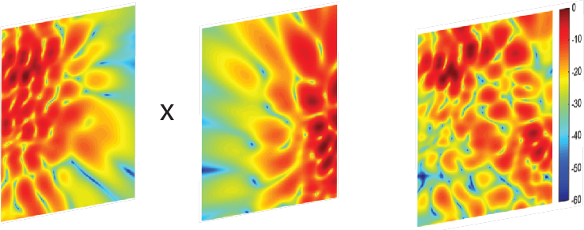
Measurement Masks
Let us now consider the forward-model under the context of frequency-diverse antennas.
Transmitter
Receiver
Operation at 100 Frequencies across the K-band (18-26.5 GHz)
Panel size: 10 cm x 10 cm
1 channel per aperture instead of 324.
Tx
Rx
Meas. Mask
Measurement Matrix (H)
†M: Number of measurements
N: Number of voxels
Generated waveform (@ 1 m, 22 GHz)
STh-01

Slide 23
Image Reconstruction
A number of algorithms (linear and non-linear) can be used for image reconstruction.
Pseudo-inverse:
Matched filter:
Least-Squares: Iterative solution.
TwIST+TV – Iterative solution - requires scene sparsity as prior.
Regularization
Sparsity
STh-01

Slide 24

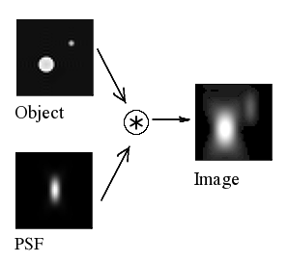
Point Spread Function
Point-spread-function (PSF) determines the response of an imaging system to a point source.
It is an important metric to analyse how much a point source spreads out in reconstructed images and hence the diffraction limited resolution characteristics of the imager.
Knowing the resolution limit plays a crucial role in knowing the minimum detectable feature size in reconstructed images.
Source: https://en.wikipedia.org/wiki/Point_spread_function
STh-01

Slide 25
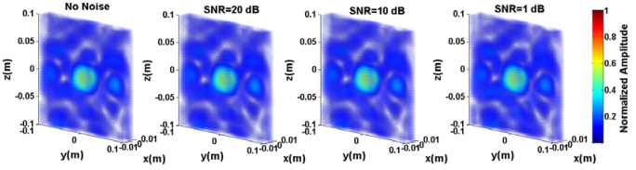
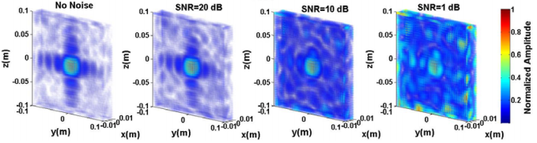
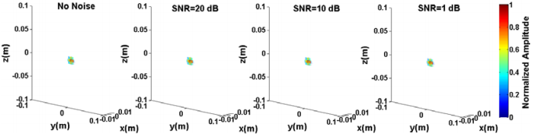
Point Spread Function
Matched-filter is a single-shot reconstruction technique and is known to be resistive to noise in measurements. Below is the PSF pattern of a frequency-diverse imaging system reconstructed using the matched filter technique as a function of noise.
Least-squares can be applied in an iterative manner. Reconstruction is susceptible to system noise.
TwIST+TV is an iterative technique and requires a strong prior, such as sparsity.
Source: Yurduseven, O., Imani, M.F., Odabasi, H., Gollub, J., Lipworth, G., Rose, A. and Smith, D.R., 2015. Resolution of the frequency diverse metamaterial aperture imager. Progress In Electromagnetics Research, 150, pp.97-107.
STh-01

Slide 26
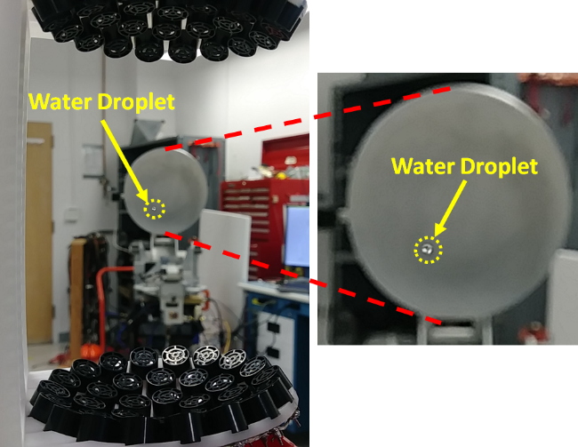
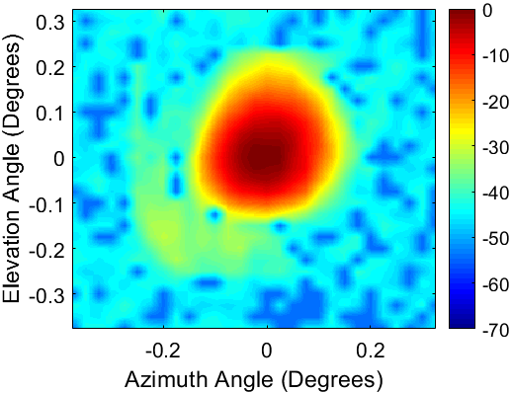
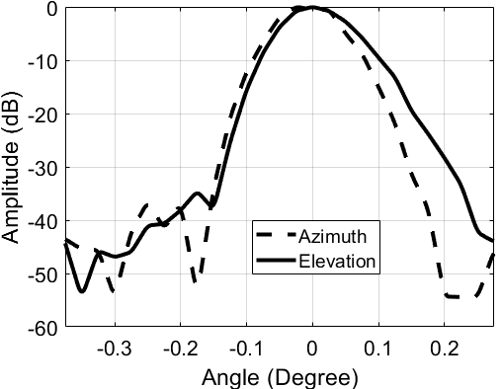
Resolution
Resolution limit of an imaging system governs the minimum feature size that we can distinguish in reconstructed images.
For an imaging scenario, it is desired that this limit is as small as possible.
There are two different resolution limits we can define:
  Range resolution: The resolution along the optical axis is defined as the range resolution. Considering a typical imaging scenario, this is in the direction from the imaging aperture to the imaged object.
  Cross-range resolution: The resolution in the plane parallel to the aperture plane is known as the cross-range resolution.
  There are other types of terminologies used for resolution definition, such as angular resolution, depth resolution, lateral resolution etc.
  All these terms can be traced back to the range and cross-range resolution limits.
Several techniques can be used to improve the imaging resolution:
  Reducing the imaging distance
  Increasing the operating frequency band
  Increasing the operating frequency
  How do we determine resolution?
    The most common way to determine the resolution limit of an aperture is to analyse the PSF patterns. The full-width-half-maximum (FWHM) of the PSF pattern in range and cross-range planes is a widely used technique in the literature to determine the resolution limit.
Source: Yurduseven, O., Cooper, K. and Chattopadhyay, G., 2018. Point-Spread-Function (PSF) Characterization of a 340-GHz Imaging Radar Using Acoustic Levitation. IEEE Transactions on Terahertz Science and Technology, 9(1), pp.20-26.
STh-01

Slide 27
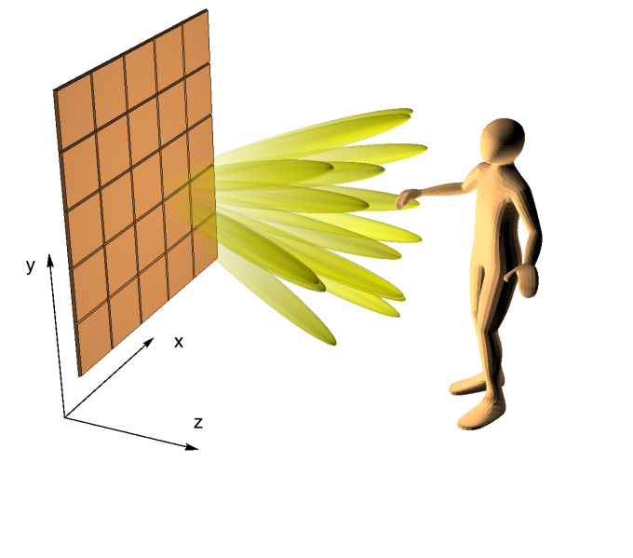
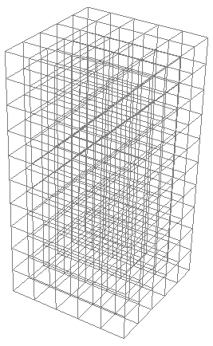

Image Formation within the Computational Approach
The Imaging problem constitutes finding the reflectivity function f(x, y, z) of the scene:
The region of interest (ROI)
is discretely sampled
Tx/Rx
Panels
Field
Propagation
Field of view
Imaging Equation:
Finite resolution allows discrete sampling of the scene (at Nyquist)
g is the measurements vector; f is the reflectivity vector (voxels); and, H is the measurement matrix
Physical Model:
First Born Approximation:
Free space propagation of the fields from the panels to each voxel
Single event scattering
Reconstruction:
Matched Filter (MF)
Least Squares (LS) – Iterative approach
STh-01

Slide 28
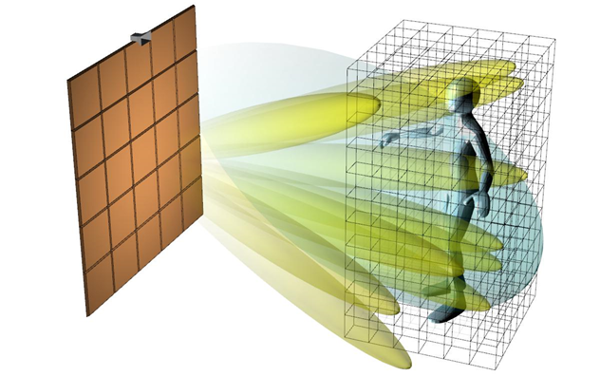



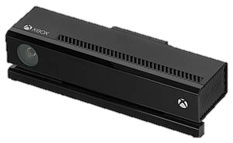




Image Formation within the Computational Approach
Imaging Scene
Scene domain
Region of interest, extracted from domain using Kinect
$${\{f}_{i}\}$$
$${\{f}_{i}\}$$
$$E_{inc}$$
$$E_{inc}$$
Sensor Fusion:
IR sensor identifies the region of interest for reconstruction
Table Parameters:
Kinect
STh-01

Slide 29
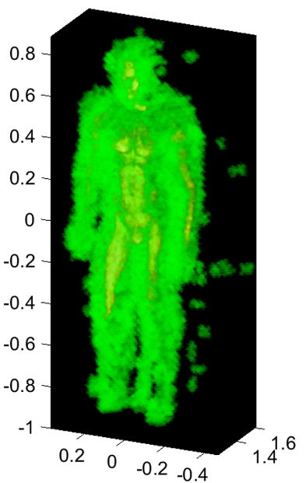
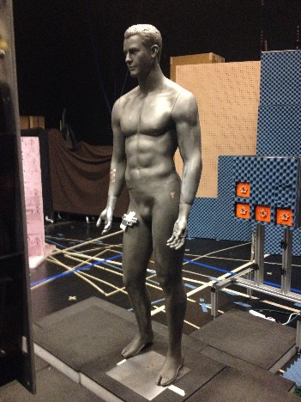
Constraining the Region of Interest (RoI) for Imaging
Below is an example of sensor fusion, leveraging an optical camera to constrain the RoI for image reconstruction.
For computational imaging, this process has two distinct advantages:
  Reducing the number of unknowns for image reconstruction.
  Adding a strong prior to the inverse problem by reducing the solution space.
Constrained RoI
Full RoI
STh-01

Slide 30
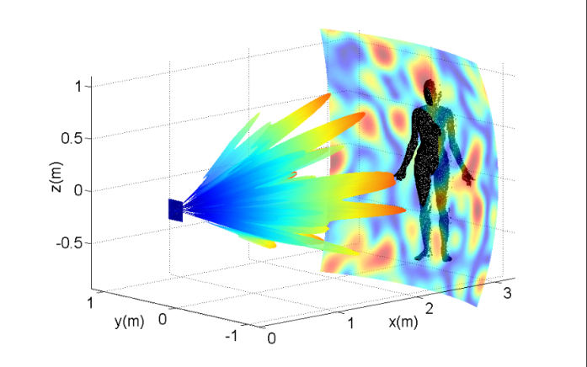
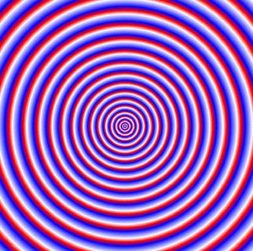
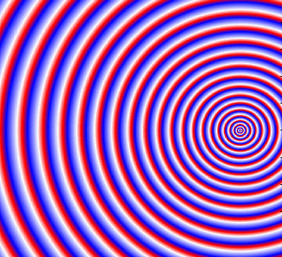
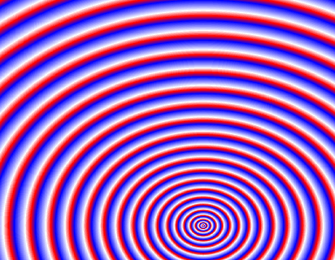
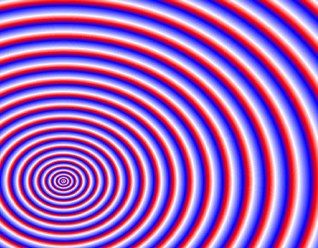
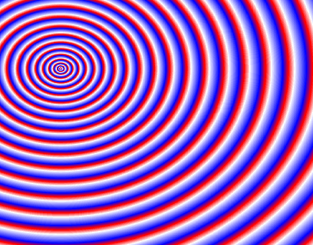
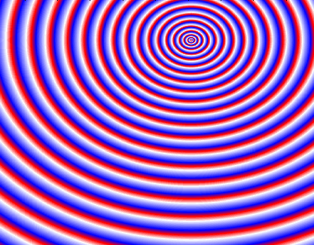

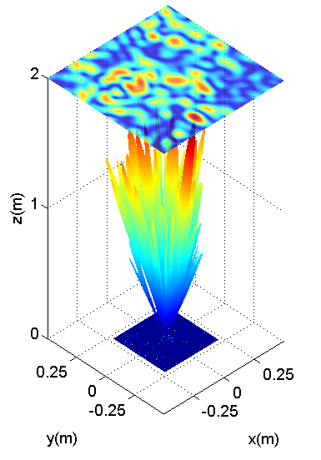




Computational Imaging Steps
Frequency-Diverse Antenna
Reconstruct (f)
Measurements (g)
Elements Modeled
as Dipoles
Propagate Dipoles to Scene
Imaged Object
STh-01

Slide 31
Frequency-Diverse Antennas
Designing a frequency-diverse antenna requires the optimization of certain parameters:
  Quality (Q-) factor
    A high Q-factor suggests
      Widened impulse response
      Minimized correlation between the measurement modes
  Radiation efficiency
    Governs the imaging signal-to-noise ratio (SNR)
  Antenna volume / antenna size
    An important for the Q-factor
  Number of radiating irises (QB/f)
    Increases the radiation efficiency
    Reduces the Q-factor
  Distribution of irises
    Effective aperture and sampling redundancy
STh-01

Slide 32







Metasurface Antennas
Frequency diversity: An aperture consisting of geometrically varying metamaterial elements will excite different radiation patterns.
CELC
Microstrip/CELC
Planar/CELC
Each element radiates as a magnetic dipole, with a geometrically dependent polarizability
A frequency sweeps will generate a diverse set of waveforms that can be used to encode information in the scene.
STh-01

Slide 33


Metasurface Antennas
Frequency-Diversity
Method 1: cELC Antennas
Method 2: Cavity Antennas
The diversity of the radiated field patterns comes from the randomized distribution of the resonance frequencies of the radiating elements.
The diversity of the radiated field patterns comes from the diversity of the guided-mode.
STh-01

Slide 34

Metasurface Antennas
Method 2: Cavity Antennas
Below are the guided-mode field patterns launched into the cavity-backed feeding structure as a function of frequency.
The meta-elements on the metasurface layer sample these guided-mode patterns which vary as a function of operating frequency.
17.5 GHz
22 GHz
26.5 GHz
STh-01

Slide 35

Effective Aperture Concept
Effective aperture of a synthesized imaging system is defined as the convolution of the transmit and receive apertures.
Effective Aperture
Tx
Rx
Source: Ahmed, S.S., 2014. Electronic microwave imaging with planar multistatic arrays. Logos Verlag Berlin GmbH.
STh-01

Slide 36




Effective Aperture Concept
We can use the effective aperture concept to optimize the distribution of the radiating elements on a frequency-diverse antenna aperture.
Extent of the effective aperture and sampling redundancy are among the most important design criteria.
STh-01

Slide 37





Effective Aperture Concept
17.5 GHz
22 GHz
26.5 GHz
K-band
Source: Yurduseven, O., Gollub, J.N., Marks, D.L. and Smith, D.R., 2016. Frequency-diverse microwave imaging using planar Mills-Cross cavity apertures. Optics express, 24(8), pp.8907-8925.
STh-01

Slide 38











Metasurface Antenna Examples for Computational Imaging
cELC
Printed Cavity
Printed MC Cavity
Air-Filled Cavity
4
1
3
4
STh-01

Slide 39

Frequency-Diversity and Q-Factor
The quality (Q-) factor of a frequency-diverse antenna governs the orthogonality of the measurement modes.
The Q-factor of a frequency-diverse antenna can be measured using the time-domain impulse response of the antenna. Longer impulse response suggests a higher Q-factor.
Singular value decomposition (SVD) can be used to analyze the orthogonality of the measurement modes.
A higher Q-factor suggests a slowly decaying singular value pattern – better conditioned measurement matrix.
Low Q
High Q
STh-01

Slide 40

Sensing Matrix and SVD
From previous slides, we know that the sensing matrix is the element-wise product of the E-field patterns radiated by the frequency-diverse antennas and propagated to the imaged scene.
Measurement Matrix (H)
Inverse problems are conventionally ill-posed (high condition number). To analyze the conditioning of the sensing matrix, we perform an SVD analysis. Using SVD on H:
$$UσV^{∗}=\text{SVD}(H)$$
Diagonal matrix consisting of singular values
STh-01

Slide 41


Sensing Matrix and SVD
$$UσV^{∗}=\text{SVD}(H)$$
Diagonal matrix consisting of singular values
Below is an example of singular value pattern as a function of Q-factor.
SAR
Frequency-Diverse (Q=330)
STh-01

Slide 42

Sensing Matrix and SVD
A fast decaying SVD pattern suggests a high correlation between the field patterns radiated by the frequency-diverse antenna as a function of frequency.
Condition number of the sensing matrix is defined as the ratio between the highest singular value and the smallest singular value:
$$CN=σmax/σmin$$
Best Case Scenario: 1
Worst Case Scenario: Inf.
STh-01

Slide 43







Simulation of a 2D computational imaging system
Starting from the forward model
Code available here
https://bit.ly/308DnNi
the model is simplified considering isotropic sources and a point target:
for 1 Tx antenna
Where is the set of transfer functions of the metasurface
STh-01

Slide 44

Simulation of a 2D computational imaging system
Starting from the forward model
the model is simplified considering isotropic sources and a point target:
for 1 Tx antenna
Where is the set of transfer functions of the metasurface
STh-01
Notes:
\color{red}C(r_k) = \mathfrak{F}^{-1}\left(n(t) \exp\left(\frac{-t}{2\tau}\right)\right)
\color{red} n(t) \sim \mathcal{N}(\mu=0,\,\sigma^{2}=1)
\color{red} Q = 2\pi f_c \tau

Slide 45



Frequency-Diversity and Q-Factor
Q-Factor
In order to analyze the effect of Q-factor (hence mode diversity) on imaging, we study a simple imaging scenario, consisting of 8 Tx and 8 Rx antennas.
Q=10
Q=100
Q=250
Q=500
Source: Yurduseven, O., Gollub, J.N., Rose, A., Marks, D.L. and Smith, D.R., 2016. Design and simulation of a frequency-diverse aperture for imaging of human-scale targets. IEEE Access, 4, pp.5436-5451.
STh-01

Slide 46




3D Printed Cavity-Backed Antenna
Antennas for computational imaging, such as frequency-diverse antennas, exhibit unusual aperture architectures. As well as PCB prototyping, such antennas can also be fabricated using 3D printing techniques.
Dual-Mode FDM Printer
Electrifi Filament
Source: Yurduseven, O., Flowers, P., Ye, S., Marks, D.L., Gollub, J.N., Fromenteze, T., Wiley, B.J. and Smith, D.R., 2017. Computational microwave imaging using 3D printed conductive polymer frequency-diverse metasurface antennas. IET Microwaves, Antennas & Propagation, 11(14), pp.1962-1969.
STh-01

Slide 47




3D Printed Cavity-Backed Antenna
The 3D cavity-backed metasurface antenna presented in this example was printed using a conductive filament as the 3D printing material.
Each meta-element iris across the Mills-Cross metasurface consists of subwavelength slots of varying lengths to ensure that the overall radiation response of the antenna remains flat across the frequency band of interest.
STh-01

Slide 48



An Example Computational Imaging System
System Layout
The system consists of 72 receive and 24 transmit cavity-backed metasurface antennas. Each antenna is 10 cm x 10 cm. In total, the system has only 96 antennas.
Synthesizing the same aperture at the Nyquist limit, we would need more than 137,000 antennas!
Measurement Modes: (24 Tx panels) x (72 Rx panels) x (100 freqs.) = 172,800
Source: Gollub, J.N., Yurduseven, O., Trofatter, K.P., Arnitz, D., Imani, M.F., Sleasman, T., Boyarsky, M., Rose, A., Pedross-Engel, A., Odabasi, H. and Zvolensky, T., 2017. Large metasurface aperture for millimeter wave computational imaging at the human-scale. Scientific reports, 7, p.42650.
STh-01

Slide 49

Multiple-Input-Multiple-Output (MIMO) Computational Imaging System Example
Antennas
Transmitter
Receiver
Radio Gen: 5.x
Computer
System Control Code
Reconstruction Algorithm
Structured Light Sensor
STh-01

Slide 50
System Resolution
Questions to be asked:
How does the resolution compare to the resolution of a conventional SAR system?
In other words, are we still diffraction limited?
To answer these questions, we need to analyze the resolution limit. That is the PSF!
Range Resolution
Cross-Range Resolution
STh-01

Slide 51
System Resolution
To retrieve the PSF pattern of the computational imaging system, we image a metal bead placed at d=1 m in from of the aperture.
The reconstructed 3D PSF patterns are then analyzed to calculate the FWHM values in range and cross-range to determine the resolution limits.
The observed values are in good agreement with the theoretical values.
Experimental PSF
Cross-range: 7.2 mm
Range: 17.6 mm
Position: 1 m
Threshold: 20 dB
STh-01

Slide 52



System Resolution
Once the resolution limits are analyzed, we can use standard target bases to validate these results.
A very common target example is the USAF resolution target.
We place the resolution target at d=1 m (the distance where the PSF analysis was carried out).
Experimental Res. Targets
15 mm
7 mm
10 mm
STh-01

Slide 53




Experimental Reconstruction – Matched Filter
Imaging a human sized object requires that an electrically large aperture is synthesized.
To test the computational imaging concept for this application, we first need to eliminate challenges related to data acquisition speed. The best test scenario for this is a static scene.
For this example, we image a mannequin target painted in conductive material to replicate the reflectivity response of the human skin at microwave frequencies.
Y: 0.6 m,
(edge @ -1 m)
X: 1.3 m
Y: -0.6 m
(edge @ 1 m)
X: 1.3 m
Y: 0 m,
X: 1.3 m
STh-01

Slide 54



Experimental Reconstruction – Least Squares
Y: 0.6 m,
(edge @ -1 m)
X: 1.3 m
Y: -0.6 m
(edge @ 1 m)
X: 1.3 m
Y: 0 m,
X: 1.3 m
STh-01

Slide 55


Threat Detection
A significant advantage of microwave imaging is that we can see what is behind optically opaque materials.
This has a particular application in security screening: Imaging and detection of threat objects behind clothing.
Microwave imaging is a qualitative method; i.e. in this case, we are retrieving the susceptibility (reflectivity distribution) of the scene.
The biggest challenge is that the human skin is a very good reflector at microwave frequencies!
Microwave Image
Photo
Source: Ahmed, S.S., 2014. Electronic microwave imaging with planar multistatic arrays. Logos Verlag Berlin GmbH.
STh-01

Slide 56



Color-Coding in Reconstructions
To achieve threat detection from reconstructed microwave images, typically, complex signal processing techniques are used.
A very primitive, simple technique could be the color-coding the reconstructed images as a function of depth.
Color-Coded Intensity Image
Intensity Image
STh-01

Slide 57

Experimental Reconstruction – Threat Objects
Threat object: Gun phantom
STh-01

Slide 58




Experimental Reconstruction – Threat Objects
MF
MF – Color Coded
LS
LS – Color Coded
STh-01

Slide 59
Experimental Reconstruction – Threat Objects
Threat Object: Dielectric
STh-01

Slide 60





Experimental Reconstruction – Dielectric Threat Objects
MF
LS
Clean - MF
Clean - LS
STh-01

Slide 61



Specularity
Imaging at microwave and mmW frequencies exhibits specularity: An object reflects the incoming illumination in a specific direction (or directions). If the receiver is not positioned in the reflection direction, no information is received.
This phenomenon shows itself as missing parts in reconstructed images.
Source: Ahmed, S.S., 2014. Electronic microwave imaging with planar multistatic arrays. Logos Verlag Berlin GmbH.
Source: Yurduseven, O., Gollub, J.N., Rose, A., Marks, D.L. and Smith, D.R., 2016. Design and simulation of a frequency-diverse aperture for imaging of human-scale targets. IEEE Access, 4, pp.5436-5451.
STh-01

Slide 62


Specularity
How to address specularity?
One way to address it is that we can look at the imaged object from multiple angles.
We can then stitch those images together.
Here, we look at an example with a mannequin object carrying a backpack with a cooker in it.
Looking at the stitched image, previously invisible parts are visible!
STh-01

Slide 63

Specularity
How to address specularity?
Another way is to address specularity is that we can place antennas in directions where we cannot capture the return signal.
Therefore, the system layout must be optimized for the imaging problem at hand.
Additional
Antennas
STh-01

Slide 64




Experimental Imaging – Person Reconstructions
Microwave imaging of people requires that data acquisition is done in-real time. This is because periodic movements, such as breathing etc displaces the surface of the human body. This results in blurring in reconstructed images if not corrected.
For conventional imaging systems, this is an extremely challenging problem. Consider the 2.1 m x 2.1 m aperture that was presented for the frequency-diverse imaging system. Conventionally, this aperture would require over 137,000 channels, each sweeping over operating frequency band.
Through computational imaging, the recued number of channels, 96, enables 7 frames per second data acquisition. As a result, it is possible to acquire date in real-time.
STh-01

Slide 65



Dynamic Reconfigurability
Sensor Fusion and Spotlight Imaging
Reconfigurable Metasurface Antennas
We have previously presented an example of sensor fusion which involved the integration of an optical camera with a mmW imaging system to constrain the RoI for imaging.
Another example could be the integration of two imaging systems operating at different frequencies.
As well as creating quasi-random radiation patterns, metasurface antennas can be used to radiate specific beam patterns, such as focusing a focal spot to generate spotlight modes.
STh-01

Slide 66





Dynamic Reconfigurability
Sensor Fusion and Spotlight Imaging
Reconfigurable Metasurface Antennas
In the below example, a metasurface antenna that focuses its radiation at d=1 m distance is presented.
This focusing pattern can be changed dynamically
The metasurface radiates at 75 GHz, within the W-band frequency regime.
STh-01

Slide 67





Sensor Fusion and Spotlight Imaging
As a second type sensor fusion example, we K-band frequency-diverse computational imaging system with a W-band spotlight aperture.
K-band system, because of its lower frequency, can be used to do fast low resolution imaging for detection. W-band spotlight system can be activated to do high resolution identification.
Transmit Aperture
Receive Aperture
Sensing Matrix
STh-01

Slide 68


Sensor Fusion and Spotlight Imaging
Identification
Detection
Yurduseven, O., Marks, D.L., Fromenteze, T., Gollub, J.N. and Smith, D.R., 2017. Millimeter-wave spotlight imager using dynamic holographic metasurface antennas. Optics express, 25(15), pp.18230-18249.
STh-01

Slide 69
STh-01
MODERN ADVANCES IN COMPUTATIONAL IMAGING AT MICROWAVE AND MILLIMETRE-WAVE FREQUENCIES
Okan Yurduseven^{#1}, Thomas Fromenteze^{#2}
^{#1}Queen’s University Belfast, UK
^{#2}University of Limoges, France
¹okan.yurduseven@qub.ac.uk, ²thomas.fromenteze@unilim.fr

