Slide 1
Coarsening versus selection of a lenghtscale
Chaouqi Misbah,
LIPHy (Laboratoire Interdisciplinaire de Physique)
Univ. J. Fourier, Grenoble and CNRS, France
with P. Politi, Florence, Italy

Slide 2
2 general classes of evolution
1) Length scale selection
Time

Slide 3
2 general classes of evolution
1) Length scale selection
Time
2) Coarsening
Time

Slide 4
Questions
Can one say if coarsening takes place in advance?
What is the main idea?
How can this be exploited?
Can one say something about coarsening exponent?
Is this possible beyond one dimension?
How general are the results?
Bray, Adv. Phys. 1994: necessity for vartiaional eqs.
Non variational eqs. are the rule in nonequilibrium systems
P. Politi et C.M. PRL (2004), PRE(2006,2007,2009)

Slide 5
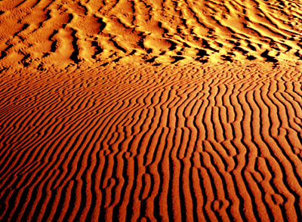
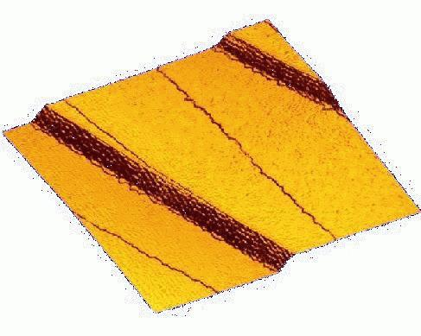
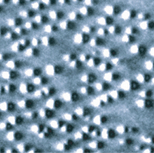
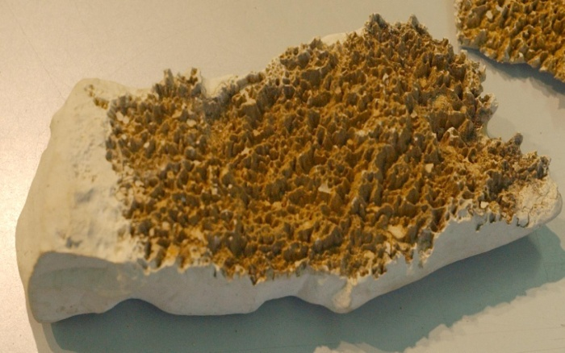
Some examples of coarsening

Slide 6
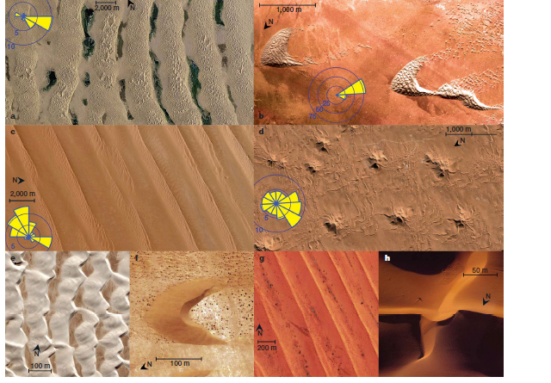
Andreotti et al. Nature, 457 (2009)

Slide 7
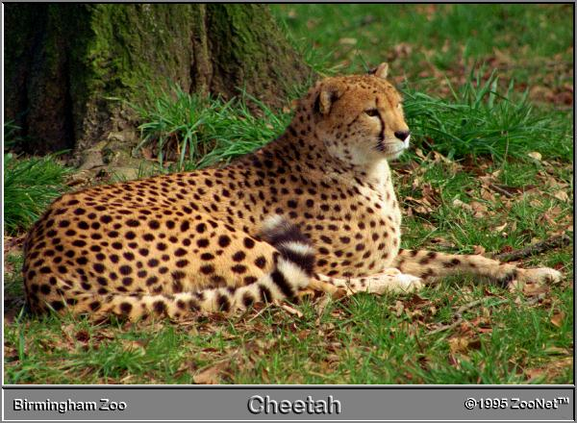
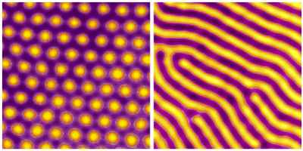
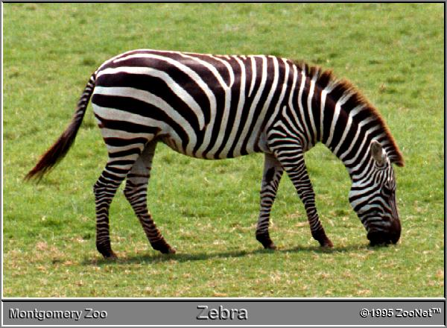
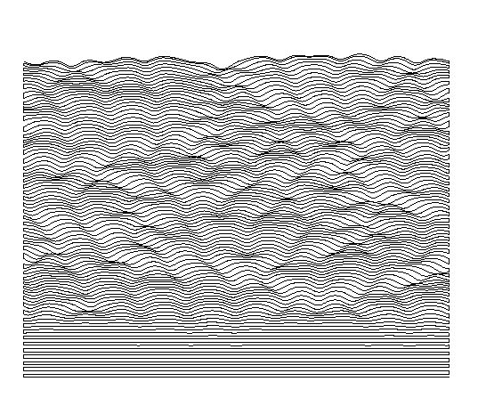
That’s not me!

Slide 8
Myriad of pattern forming systems
1) Finite wavenumber bifurcation
Lengthscale
(no room for complex
dynamics, generically )
Amplitude equation (one or two modes)

Slide 9
2) Zero wavenumber bifurcation

Slide 10
2) Zero wavenumber bifurcation
Far from threshold
Complex dynamics expected

Slide 11
Can one say in advance if coarsening takes place ?
Yes, analytically, for a certain class of equations
and more generally …….

Slide 12
What is the main idea?
Coarsening is due to phase
instability (wavelength fluctuations)
Phase modes are the relevant ones!
Eckhaus
stable
unstable

Slide 13
General class of equations (step flow, sand ripples….)
Arbitrary functions

Slide 14
How can this be exploited?

Slide 15
Example:Generalized Landau-Ginzburg equation
(trivial solution is supposed unstable)
Example of LG eq.:
Unstable if
or

Slide 16
steady solution
Patricle subjected to a force B
Example

Slide 17
Coarsening
U=-1
U=1
Kink-Antikink anihilation
time
+1
-1

Slide 19
Stability vs phase fluctuations?
: Fast phase
:slow phase
Local wavenumber:

Slide 20
Full branch unstable vs phase fluctuations
: Fast phase
:slow phase
Local wavenumber:

Slide 21
Full branch unstable vs phase fluctuations
: Fast phase
:slow phase
Local wavenumber:
Sovability condition:
Derivation possible for any nonlinear equation

Slide 22
Full branch unstable vs phase fluctuations
: Fast phase
:slow phase
Local wavenumber:
Sovability condition:

Slide 25
Particle with mass unity in time
Subject to a force

Slide 26
Particle with mass unity in time
Subject to a force
is the action

Slide 27
Particle with mass unity in time
Subject to a force
is the action
But remind that
:energy

Slide 28
Particle with mass unity in time
Subject to a force
is the action
But remind that
:energy

Slide 29
has sign of
A: amplitude
: wavelength

Slide 30
wavelength
No coarsening
amplitude

Slide 31
wavelength
No coarsening
coarsening
amplitude

Slide 32
wavelength
No coarsening
coarsening
amplitude
Interrupted
coarsening

Slide 33
wavelength
P. Politi, C.M., Phys. Rev. Lett. (2004)
No coarsening
Coarsening
amplitude
Interrupted
coarsening
Coarsening
C.M., O. Pierre-Louis, Y. Saito, Review of Modern Physics (sous press)

Slide 34
General class of equations (step flow, sand ripples….)
Arbitrary functions

Slide 35
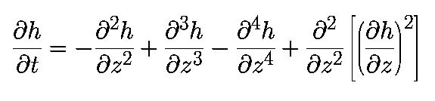
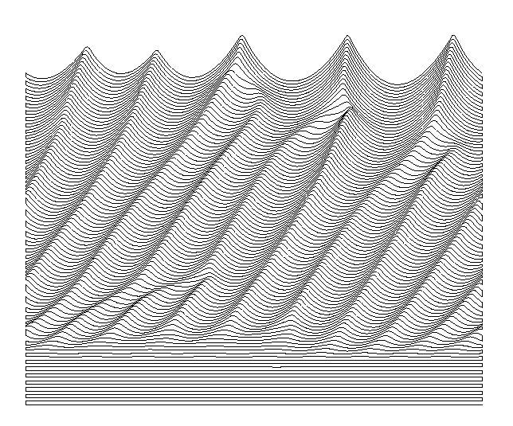
Sand Ripples, Csahok, Misbah, Rioual,Valance EPJE (1999).

Slide 36
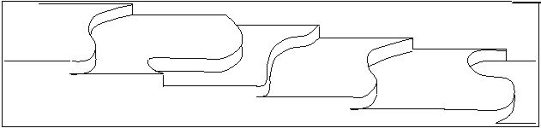
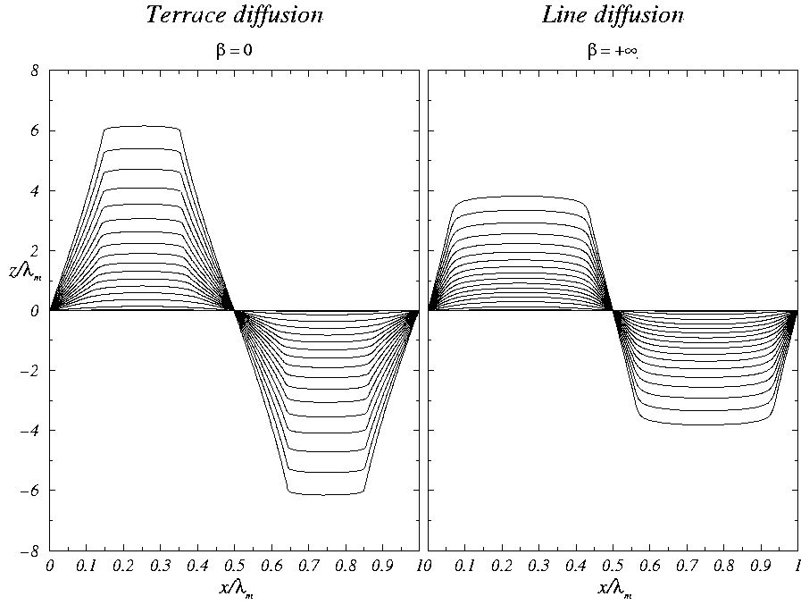
Wavelength
Example: meandering of steps
on vicinal surfaces
frozen
branch stops
amplitude
O. Pierre-Louis et al. Phys. Rev. Lett. 80, 4221 (1998) and many other
examples ,
See :C.M., O. Pierre-Louis, Y. Saito, Review of Modern Physics (sous press)

Slide 37
Andreotti et al. Nature, 457 (2009)

Slide 38
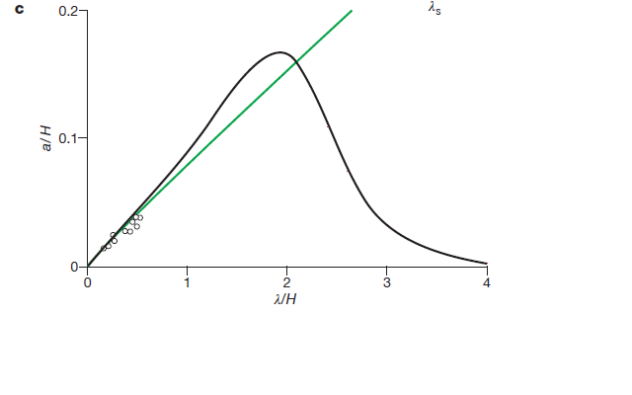
Dunes (Andreotti et al. Nature, 457 (2009))

Slide 39
Can one say something about coarsening exponent?
P. Politi, C.M., Phys. Rev. E (2006)

Slide 40
Coarsening exponent
LG
GL and CH in 1d
Other types of equations

Slide 41
Some illustrations
If non conserved: remove
If non conserved
Use of

Slide 42
time
Coarsening
U=-1
U=1
Finite (order 1)

Slide 43
Remark: what really matters is the behaviour of V close
to maximum; if it is quadratic, then ln(t)
Conserved:
Nonconserved

Slide 44
Other scenarios (which arise in MBE)
B(u) (the force) vanishes at infinity only
Conserved
Non conserved
Benlahsen, Guedda
(Univ. Picardie, Amiens)

Slide 45
General class of equations (step flow, sand ripples….)
Arbitrary functions

Slide 46
Transition from coarsening to selection of a length scale
Golovin et al. Phys. Rev. Lett. 86, 1550 (2001).
Cahn-Hilliard equation
coarsening
Kuramoto-Sivashinsky
After rescaling
no coarsening
For a critical
Fold singularity of the steady branch
Wavelength
Amplitude

Slide 47
New class of eqs: new criterion ; P. Politi and C.M., PRE (2007)
If
KS equation
Steady-state periodic solutions exist only if G is odd
If not stability depends on sign of

Slide 48
Extension to higher dimension possible
C.M., and P. Politi, Phys. Rev. E (2009)
Analogy with mechanics is not possible
Phase diffusion equation can be derived
A link between sign of D and slope of a certain quantity
(not the amplitude itself like in 1D)
The exploitation of
allows extraction of coarsening exponent

Slide 49
Summary
1)
Phase diffusion eq. provides the key for coarsening,
D is a function of steady-state solutions
(e.g. fluctuations-dissipation theorem).
2) D has sign of for a certain class of eqs
3) Which type of criterion holds for other classes of equations?
But D can be computed in any case.
4) Coarsening exponent can be extracted for any equation and at
any dimension from steady considerations, using

