Slide 1
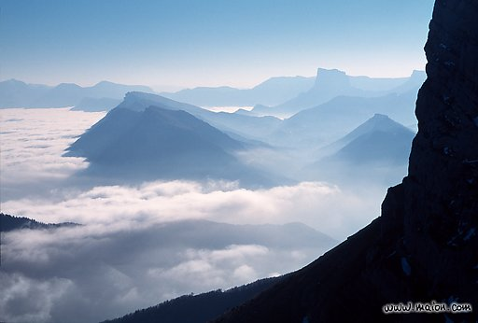
Lecture 2: nonlinear equations
from symmetry and conservation:
application to sand ripples
Chaouqi MISBAH
LIPhy (Laboartoire Interdisciplinaire de Physique)
Univ. J. Fourier Grenoble and CNRS France

Slide 2
Geometrical formulation
normal velocity
Remark: in 3D add Gauss curvature and use surface operator

Slide 3
Conservation constraints
Csahok, C.M., Valance Physica D 128 (1999) 87–100
1) No conservation
1) Mass conservation
If anisotropy:

Slide 4
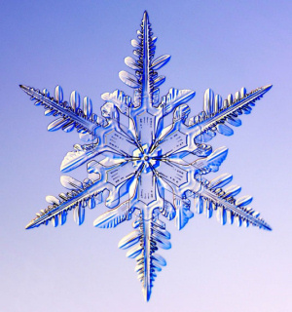
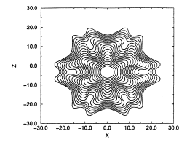
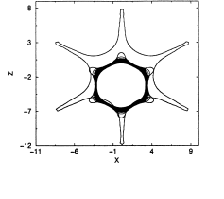
Snowflacke
Dense pattern
Star fish

Slide 5
« Weakly » nonlinear equations
1) No conservation
z
x
h(x)
Kuramoto-Sivashinsky

Slide 6
Spatiotemporal chaos

Slide 7
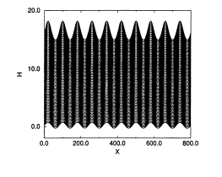
KS equation and
this one can be made
free of parameter

Slide 8
2) Mass conservation
Case C=0 or small
Similar to situation encountered in crystal growth; O. Pierre-Louis, Phys. Rev. Lett. 1998
Recent analysis by Guedda and Benlahsen

Slide 9
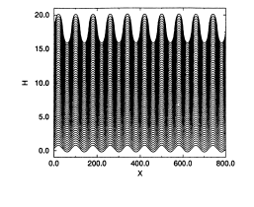
Indefinite increase of the amplitude

Slide 10
3) No conservation with anisotropy
Benney equation (KS+KDV)

Slide 11
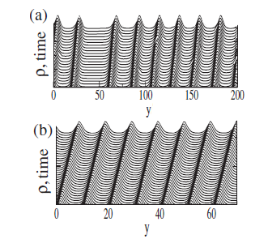
Benney eq. derived for step bunching by C.M. and O. Pierre-Louis (PRE, 1998); see also
C.M. et al. Review of Modern Physics 2010.
And for sand ripples under erosion using a modified model of Bouchaud et el. 1994.
Valanace and C.M., (PRE 2003)

Slide 12
4) Mass conservation with anisotropy (case of sand ripples, dunes)
Modified BCRE model (Csahok, C.M., Rioual, Valance, EPJE 2000)

Slide 13
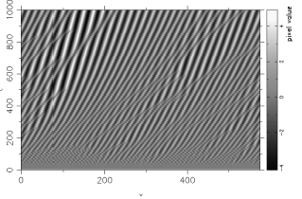
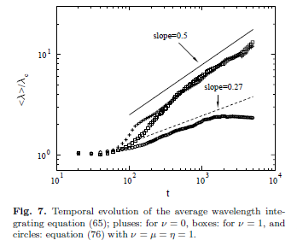
Spatio-temporal portait

Slide 14
No consevation
C=0
anisotropy
consevation
anisotropy

Slide 15
Conclusion
Classes of equations derived from symmetries and conservations
Eqs can be weakly or highly nonlinear; identification by scaling
This provides a powerfull basis to guide the analysis
Eqs. are consistent with those derived from « microscopic » models
Application to dunes would be interesting
Next lecture: when is coarsening expected?

