Slide 1
Partitioned Shadow Volumes
Julien Gerhards, Frédéric Mora,
Lilian Aveneau, Djamchid Ghazanfarpour
XLIM UMR CNRS 7252
University of Limoges , University of Poitiers
France
Notes:
Good afternoon, my name is Julien Gerhards, I am PHD student since last october and I’m going to present our new shading method: Partitioned Shadow Volumes

Slide 2

What we want
Preview!
Notes:
This is what we want to compute: accurate real-time hard shadows

Slide 3
Introduction > Real time hard shadows
Two usual solutions
Shadow Maps [Williams 78]
  Screen space
  Fast
  Aliasing, tweaking
Shadow Volumes [Crow 77] [Heidman 91]
  Object space
  Pixel accurate
  Connectivity, fillrate
Still a research issue
Many works in 40 years!
[Wyman 2015]
  Irregular z-buffers / shadow rays
[Sintorn 2011]
  No mesh connectivity
  Hierarchical SV software rasterization
[Sintorn 2014]
  Improved version
1977
2015
Notes:
Most of real time techniques are based on two well-known methods proposed in the seventies.
A fast screen space method : the shadow map, which is very popular despite suffering from aliasing and artifact issues.
An accurate object space method: the shadow volumes which is real-time but may generate a lot of geometry that can saturate the fillrate. In addition it needs the mesh connectivity
In forty years, many works were published but real time hard shadows are still challenging.
For example, Wyman has proposed this year a technique that combines irregular z-buffers and shadow rays to avoid aliasing related to shadow map.
Here, we focus on shadow volumes. The most efficient work on this topic has been proposed by Sintorn. It performs a hierarchical shadow volume rasterization to remove fillrate issue. And there is no need for mesh connectivity.

Slide 4
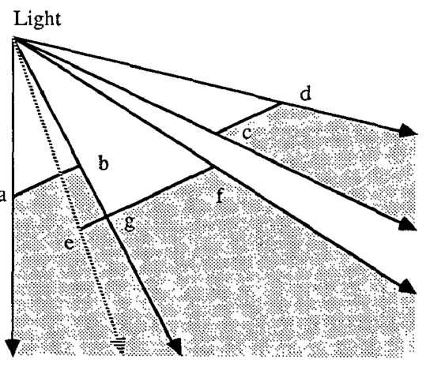
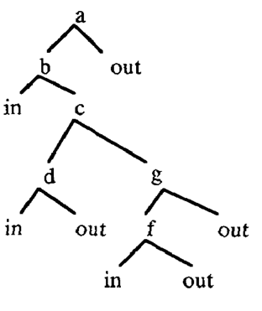
Introduction > Main idea
Revisiting the old SVBSP algorithm [Chin89]
  A different but left aside approach
  Visibility from the light
  BSP tree made with SV
  Clipping: Degeneracies, memory footprint ?
Our solution
Analyze SVBSP drawbacks
Different partitioning strategy
No clipping
    Robust
    Predictable memory footprint
Captures from the SVBSP paper, Siggraph’89
Notes:
In this work we focus on an old technique: the shadow volume binary space partitioning algorithm by Chin.
From Crow to Sintorn, shadow volume techniques share a common point. They render shadow volumes from the camera to solve light visibility.
In comparison, the SVBSP algorithm is an exception. Visibility is not solved from the camera. It is solved from the light using a Binary Space Partitioning tree build over shadow volumes.
Unfortunately, it relies on clipping operations proned to numerical degeneracies. Since it creates new geometry, the memory footprint is not predictable.
This is why this technique has been left aside, despite its originality.
So, our main idea is to revisit the SVBSP algorithm.
We remove its drawback thanks to a new partitoning strategy that does not require any clipping operations. It makes our method robust and with a predictable memory footprint.

Slide 5
Outlines >
Introducing TOP Tree
Partitioned Shadow Volumes
Results
Conclusion and perspectives
Notes:
This is the outlines of my presentation.
At first I will introduce Ternary Object Partitioning tree, the data structure we use.
Next, I will explain the core of our method and presents some results.

Slide 6
Outlines >
Introducing TOP Tree
Partitioned Shadow Volumes
Results
Conclusion and perspectives
Notes:
In this section, we look at the BSP tree drawbacks to define a new partition strategy.

Slide 7
Introducing TOP Tree
Binary Space Partitioning tree
+
-
+
-
Notes:
Let’s consider a simple example: an oriented plane and its related BSP node

Slide 8
Introducing TOP Tree
Binary Space Partitioning tree
+
-
+
-
Notes:
It is easy to locate points using a BSP tree. Points are always ether in the positive or negative halfspace.

Slide 9
Introducing TOP Tree
Binary Space Partitioning tree
+
-
+
-
Notes:
But with triangles, intersection can occure

Slide 10
Introducing TOP Tree
Binary Space Partitioning tree
Clipping
  Robustness ?
  Memory ?
+
-
+
-
Notes:
In such a case, triangles have to be clipped to fit the BSP tree.
Clipping operations is prone to numerical issues and geometric degeneracies.
It creates new geometry that makes memory consumption unpredictable.
This is the main drawback of the SVBSP algorithm and that’s why it was left aside.

Slide 11
Introducing TOP Tree
Binary Space Partitioning tree
Ternary Object Partitioning tree
Clipping
  Robustness ?
  Memory ?
+
-
+
-
+
-
∩
Notes:
We observe that we need a data structure that handles the intersection case.
Thus, we define the Ternary Object Partitioning tree. It is similar to a BSP tree except that we add a third child, namely, the intersection child. It contains all the intersected geometry.
Notice that doing so, we change the partition nature.

Slide 12
Introducing TOP Tree
Binary Space Partitioning tree
Ternary Object Partitioning tree
Clipping
  Robustness?
  Memory?
+
No clipping
  Robust
  No new geometry
-
+
-
+
-
∩
Notes:
As a consequence, clipping becomes useless; we can expect to be more robust and to avoid the creation of new geometry

Slide 13
Outlines >
Introducing TOP tree
Partitioned Shadow Volumes
  Shadow Volumes representation
  Building a TOP tree
  Shading with a TOP tree
Results
Conclusion and perspectives
Notes:
Now I am going to detail our Partitioned Shadow Volumes method.
I will explain how we build a TOP tree and use it for shading. But at first, let’s see how to represent a shadow volume with a TOP tree.

Slide 14
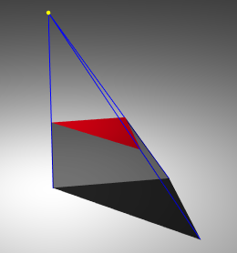
PSV > Shadow Volumes representation
+
∩
+
∩
+
∩
+
-
∩
One triangle one shadow volume 4 TOP tree nodes
Notes:
The shadow volume casted by red triangle is a frustum of 3 shadow planes plus 1 capping plane (the supporting plane of the triangle).
The shadow volume is oriented such as its inside is negative.
Thus to represent this convex with a TOP tree, we need 4 nodes connected to each other by the negative child.

Slide 15
PSV > Shadow Volumes representation
+
∩
+
∩
+
∩
+
-
∩
Positive children Fully outside the SV
Notes:
Doing so, all the positive children will contain geometry fully outside shadow volume.

Slide 16
PSV > Shadow Volumes representation
+
∩
+
∩
+
∩
+
-
∩
Positive children Fully outside the SV
Notes:
Doing so, all the positive children will contain geometry fully outside shadow volume.

Slide 17
PSV > Shadow Volumes representation
+
∩
+
∩
+
∩
+
-
∩
Positive children Fully outside the SV
Notes:
Doing so, all the positive children will contain geometry fully outside shadow volume.

Slide 18
PSV > Shadow Volumes representation
+
∩
+
∩
+
∩
+
-
∩
Positive children Fully outside the SV

Slide 19
PSV > Shadow Volumes representation
+
∩
+
∩
+
∩
+
-
∩
Last negative child Fully inside the SV (in shadow)
Notes:
The negative child contains geometry fully inside the shadow volume

Slide 20
PSV > Shadow Volumes representation
+
∩
+
∩
+
∩
+
-
∩
Intersection children Intersected by the plane (outside or partially outside the SV)
Notes:
The intersection children have a different meaning.

Slide 21
PSV > Shadow Volumes representation
+
∩
+
∩
+
∩
+
-
∩
Intersection children Intersected by the plane (outside or partially outside the SV)
Notes:
Since they contain intersected geometry, their visibility is undefined

Slide 22
PSV > Shadow Volumes representation
+
∩
+
∩
+
∩
+
-
∩
Intersection children Intersected by the plane (outside or partially outside the SV)
Notes:
Intersected geometry may be outside or partially outside the shadow volume

Slide 23
PSV > Shadow Volumes representation
+
∩
+
∩
+
∩
+
-
∩
Intersection children Intersected by the plane (outside or partially outside the SV)

Slide 24
PSV > Per frame overview
Triangle soup
TOP Tree
Data
Building a TOP Tree
Shading with TOP Tree
Algorithms
Notes:
Now this a brief overview of the partitioned shadow volumes method.
We start from a triangle soup that is used to build a TOP tree for a given light source.
Next the TOP tree is used to shade image points.

Slide 25
PSV > Per frame overview
Triangle soup
TOP Tree
Data
Building a TOP Tree
Shading with TOP Tree
Algorithms
Notes:
We now focus on building a TOP tree over shadow volumes

Slide 26
PSV > Building a TOP Tree
Red triangle location (empty tree)
Notes:
We start from en empty TOP tree and a red triangle seen from the light.

Slide 27
PSV > Building a TOP Tree
Merging SV cast by red triangle
Notes:
And we merge its shadow volume representation to initialize the TOP tree

Slide 28
PSV > Building a TOP Tree
Green triangle location
Notes:
For other triangles, we need to locate them into the TOP tree from the root.
For example, the green triangle is located in a positive leaf.

Slide 29
PSV > Building a TOP Tree
Merging SV cast by green triangle
Notes:
And this leaf is replaced with the four nodes of its shadow volume representation.

Slide 30
PSV > Building a TOP Tree
Blue triangle location
Notes:
Here is another example. The blue triangle is intersected by a shadow plane. It is located in the related intersection child.

Slide 31
PSV > Building a TOP Tree
Merging SV cast by blue triangle
Notes:
And this child is replaced by the shadow volume

Slide 32
PSV > Building a TOP Tree
Orange triangle location
Notes:
Now, the orange triangle is in front of the red one

Slide 33
PSV > Building a TOP Tree
Merging SV cast by orange triangle
Notes:
But merging its shadow volume is as easy as the others

Slide 34
PSV > Building a TOP Tree
Purple triangle is located in red SV
Notes:
And at last, the purple triangle is fully hidden from the light by the red one.
Thus it falls in the negative child of red shadow volume…

Slide 35
PSV > Building a TOP Tree
Purple triangle is discarded
Notes:
… at last it is discarded since it is fully in shadow.
The TOP tree is built when all the triangles are inserted.

Slide 36
PSV > Does insertion order matter? (yes)
3n depth
2
n
1
n-1
Insertion order == strip order 3n depth, O(n²) building
Notes:
We can wonder if the triangle insertion order matters ? And yes, it matters.
Let’s study this example: a triangle strip seen from the light.
If triangles are inserted from 1 to n or n to 1, it leads to a bad looking TOP tree of depth 3n.
In addition the building algorithm would run in O(n^2) time

Slide 37
PSV > Randomized insertion order
Problem:
How to avoid bad luck?
Constraint:
Speed matters!
Solution:
Random insertion order of triangles (quicksort!)
Maybe not the best tree, but fast and good tree on average
Notes:
So how to avoid bad luck ? And of course speed is a concern, we do not have time for a complicated strategy.
Think about the quicksort algorithm: theoritically it can run in O(n^2) but thanks to randomisation it runs in O(n log n) in practice.
So our solution is similar : we use a random insertion order of triangles. This may not lead to the most efficient tree, but we can expect a good tree on average. And it remains fast.

Slide 38
PSV > Expected complexity
n triangles
TOP Tree
Data
Building a TOP Tree
Shading with TOP Tree
Algorithms
Notes:
So, we know how to build a TOP tree without doing any complicated operation.

Slide 39
PSV > Expected complexity
n triangles
TOP Tree
O(n)
Data
Building a TOP Tree
Shading with TOP Tree
Algorithms
Notes:
Since each triangle makes the tree grows by at most 4 nodes, its memory footprint is easily predictable.

Slide 40
PSV > Expected complexity
n triangles
TOP Tree
O(n)
Data
Building a TOP Tree
O(n log(n))
Shading with TOP Tree
Algorithms
Notes:
And thanks to randomisation, we can expect a O(n log n) time for building a TOP tree

Slide 41
PSV > Shading with a TOP tree
Shading:
Locate image points in the TOP tree
  Positive leaves: outside shadow volumes
  Negative leaves: inside shadow volumes
Advantage:
TOP tree is used as an acceleration data structure
Notes:
Now let’s see how we use a TOP tree to shade image points.
This comes down to locate points in the data structure.
If the query ends in a negative leaf, it is in shadow
If it ends in a positive leaf, it is lighted.
The idea is to use TOP tree as an acceleration structure for the shading step.

Slide 42
PSV > Shading with a TOP tree
1
2
3
4
1
2
1
3
2
4
1
3
2
4
3
4
Example: Point is hidden by green triangle
Notes:
We will use this example, with a black point hidden from the light by the green triangle.

Slide 43
PSV > Shading with a TOP tree
1
2
3
4
1
2
1
3
2
4
1
3
2
4
3
4
What happens if the point is located like using a BSP tree?
Notes:
At first, imagine we locate the point as in a BSP tree, ignoring the intersection children

Slide 44
PSV > Shading with a TOP tree
1
2
3
4
1
2
1
3
2
4
1
3
2
4
3
4
What happens if the point is localized like using a BSP tree?
Notes:
We start from the root node

Slide 45
PSV > Shading with a TOP tree
1
2
3
4
1
2
1
3
2
4
1
3
2
4
3
4
What happens if the point is localized like using a BSP tree?
Notes:
The point is found in the negative side

Slide 46
PSV > Shading with a TOP tree
1
2
3
4
1
2
1
3
2
4
1
3
2
4
3
4
What happens if the point is localized like using a BSP tree?
Notes:
… in the negative side again

Slide 47
PSV > Shading with a TOP tree
1
2
3
4
1
2
1
3
2
4
1
3
2
4
3
4
False visibility, green triangle is missed!
Notes:
And finally the point falls in a positive leaf. The query ends without having tested the green triangle.

Slide 48
PSV > Shading with a TOP tree
1
2
3
4
1
2
1
3
2
4
1
3
2
4
3
4
Intersection nodes must always be checked
Notes:
Intersection children contain geometry in both the positive and negative half-space of a plane. Thus we have to visit the intersection nodes whatever the side containing the point.

Slide 49
PSV > Shading with a TOP tree
1
2
3
4
1
∩ stack
2
1
3
2
4
1
3
2
4
3
4
Let’s start again, but using a stack to push the intersection nodes
Notes:
We start again our example but we using a stack of intersection nodes.

Slide 50
PSV > Shading with a TOP tree
1
2
3
4
1
1
∩ stack
2
1
3
2
4
1
3
2
4
3
4
Push and continue to
1
2
Notes:
Starting from the root node, we push the intersection node and continue in the negative tree

Slide 51
PSV > Shading with a TOP tree
1
2
3
1
4
1
1
∩ stack
2
1
3
2
4
1
3
2
4
3
4
Push and continue to
1
3
Notes:
Once again we push the intersection node and continue in the negative tree

Slide 52
PSV > Shading with a TOP tree
1
2
3
1
4
1
1
∩ stack
2
1
3
2
4
1
3
2
4
3
4
Notes:
The point is found in the negative side

Slide 53
PSV > Shading with a TOP tree
1
2
3
1
4
1
1
∩ stack
2
1
3
2
4
1
3
2
4
3
4
Positive node: we check the stack
Notes:
And the point is located in a positive leaf. But the stack is not empty !

Slide 54
PSV > Shading with a TOP tree
1
2
3
4
1
1
∩ stack
2
1
3
2
4
1
3
2
4
3
4
Pop
1
Notes:
We need to pop the stack and continue the search

Slide 55
PSV > Shading with a TOP tree
1
2
3
4
1
1
∩ stack
2
1
3
2
4
1
3
2
4
3
4
Continue to
2
Notes:
We know that this point is in green shadow volume.

Slide 56
PSV > Shading with a TOP tree
1
2
3
4
1
1
∩ stack
2
1
3
2
4
1
3
2
4
3
4
Continue to
3
Notes:
We know that this point is in green shadow volume.

Slide 57
PSV > Shading with a TOP tree
1
2
3
4
1
1
∩ stack
2
1
3
2
4
1
3
2
4
3
4
Continue to
4
Notes:
We know that this point is in green shadow volume.

Slide 58
PSV > Shading with a TOP tree
1
2
3
4
1
1
∩ stack
2
1
3
2
4
1
3
2
4
3
4
The point is shadowed, whatever remains on the stack
Notes:
So the query ends in the negative leaf of green shadow volume.
Notice that a point is lighted if it is located in a positive leaf and if the stack is empty

Slide 59
PSV > Shading with a TOP tree
Find location:
Hybrid algorithm between a space partition and an object partition
Drawback:
2 of 3 children always need to be checked, this is not very efficient
Question:
Is it really necessary to visit all intersection nodes ? (no)
Notes:
Finally, this is a hybrid algorithm between a space partition and an object partition.
However, visiting 2 of 3 children at each step is not efficient.
In fact, it is not always necessary to visit an intersection node.

Slide 60
PSV > Shading with a TOP tree
Light
Shadow plane
+
-
+
-
∩
+
∩
-
Example: Let’s consider a shadow plane that intersects 3 triangles
Notes:
In the case of a shadow plane, we can sometimes skip intersection tree

Slide 61
PSV > Shading with a TOP tree
Light
+
-
+
-
∩
+
∩
-
Thus the 3 triangles belongs to the intersection tree
Notes:
On this example, the shadow plane intersects 3 triangles and thus, they all belong to the intersection tree

Slide 62
PSV > Shading with a TOP tree
Light
+
-
+
-
∩
+
∩
-
We can defined a wedge enclosing all the intersected triangles
Notes:
We can noticed that the intersected geometry is enclosed inside a wedge

Slide 63
PSV > Shading with a TOP tree
Light
+
-
+
-
∩
+
∩
-
Points inside the wedge need to visit the intersection tree
Notes:
When a point is inside the wedge, we neeed to visit the intersection tree because the contained triangles can affect the point visivility

Slide 64
PSV > Shading with a TOP tree
Light
+
-
+
-
∩
+
∩
-
Points outside the wedge can skip the intersection tree
Notes:
But points outside the wedge can not be affected by the intersected geometry. Thus the intersection tree can be skipped

Slide 65
PSV > Shading with a TOP tree
Light
+
-
+
-
∩
+
∩
-
α₁
α₂
Conservative wedge: α = max(α₁, α₂)
Notes:
Such a wedge can be defined by two angles

Slide 66
PSV > Shading with a TOP tree
Light
+
-
+
-
∩
+
∩
-
α
α
Conservative wedge: α = max(α₁, α₂)
Notes:
But we use a conservative representation to spare memory and because our tests show that the difference is not significant.

Slide 67
PSV > Shading with a TOP tree
Light
+
-
+
-
∩
+
∩
-
β
α
α
Decision made by angles comparison
Notes:
Each time a point is tested against a shadow plane, an angle comparison is sufficient to know if the intersection tree needs to be visited or not.

Slide 68
PSV > Shading with a TOP tree
Light
+
-
+
-
∩
+
∩
-
θ
α
α
Decision made by angles comparison

Slide 69
PSV > Expected complexity
n triangles
TOP Tree
O(n)
Data
Building a TOP Tree
O(n log(n))
Shading with TOP Tree
Algorithms
Notes:
Ok let us discuss about shading complexities

Slide 70
PSV > Expected complexity
n triangles
TOP Tree
O(n)
Data
Building a TOP Tree
O(n log(n))
Shading with TOP Tree
O(log(n))
Algorithms
Notes:
Intersection trees are generally much smaller than positive or negative trees since a triangle has a greater probability of falling in an half-space than being intersected by a plane. In addition to our optimization to avoid useless trees, shading is expected in O(log(n)) time.

Slide 71
Outlines >
Introducing TOP Tree
Partitioned Shadow Volumes
Results
  OpenGL Implementation
  Tests and comparison
Conclusion and perspectives
Notes:
Let’s see how this works in practice.
At first I will give a brief overview of our OpenGL implementation
Next I will present some tests and comparisons.

Slide 72
PSV > OpenGL implementation
n triangles
TOP Tree
Data
Building a TOP Tree
Shading with TOP Tree
Algorithms
Notes:
Obviously The TOP tree is stored on the GPU.

Slide 73
PSV > OpenGL implementation
n triangles
TOP Tree
GPU MEM
Building a TOP Tree
Shading with TOP Tree
SHADERS
Notes:
Building the TOP tree and shading are implemented using two shaders.

Slide 74
PSV > OpenGL implementation
n triangles
SSBO: TOP Tree
Array of 4n nodes
32 Bytes per node
GPU MEM
Building a TOP Tree
Shading with TOP Tree
SHADERS
Notes:
Thanks to the TOP tree predictable size, a shader storage buffer of 4n nodes is allocated. We use 32 bytes per node.

Slide 75
PSV > OpenGL implementation
n triangles
SSBO: TOP Tree
Array of 4n nodes
32 Bytes per node
GPU MEM
Compute shader
One triangle per thread
Concurrent accesses: atomics
Shading with TOP Tree
SHADERS
Notes:
Building the TOP tree is implemented with a Compute Shader. Each thread inserts one triangle in the TOP tree and merges its shadow volume.
Using a parallel construction raises concurrent accesses which are all handled with atomic operations

Slide 76
PSV > OpenGL implementation
n triangles
SSBO: TOP Tree
Array of 4n nodes
32 Bytes per node
GPU MEM
Compute shader
One triangle per instance
Concurrent accesses: atomics
Fragment shader
Deferred shading
Stack of 32 integers
SHADERS
Notes:
At last, shading with TOP tree is implemented in a fragment shader. It is run once per pixel tanks to deferred shading.
Unless otherwise stated, we always use a stack of thirty two integers to push the intersection nodes.

Slide 77
Results > Tests and comparison
More tests and details in the paper! Including results on a GTX 780.
Hard shadows
OS: Linux
Hardware: NVIDIA GTX 980, 1024 1024
Models: From 20k to 1000k triangles
Front face culling: ON
+
Notes:
Hard shadow tests are run on a GTX 980 at the same resolution.
We use different models from twenty thousand triangles to one million triangles and front face culling is enable.
This is an overview of our results but more tests and details can be found in the paper.

Slide 78
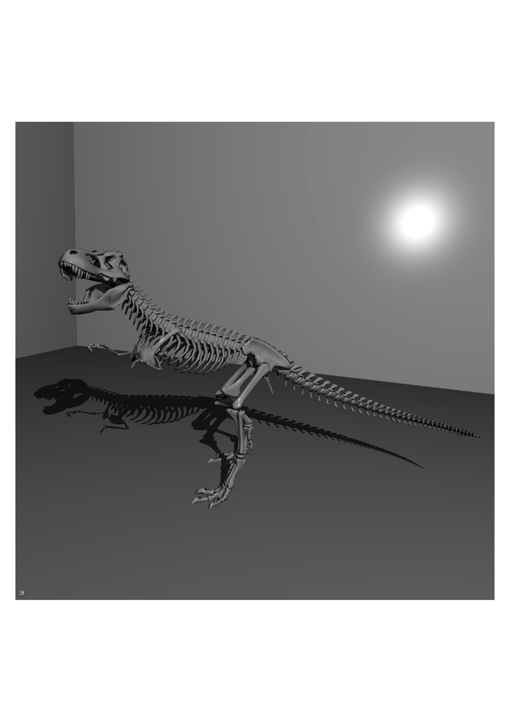
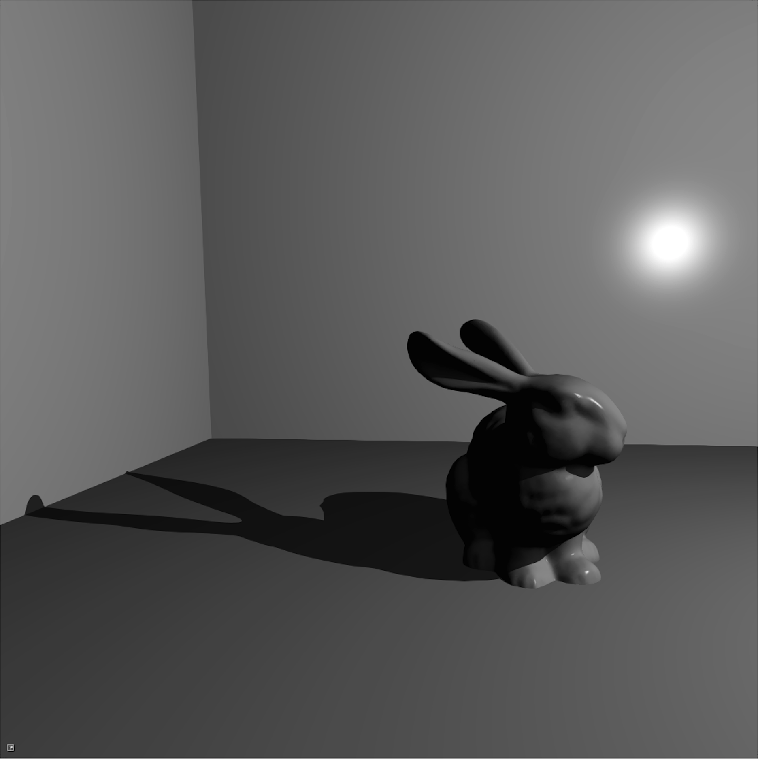
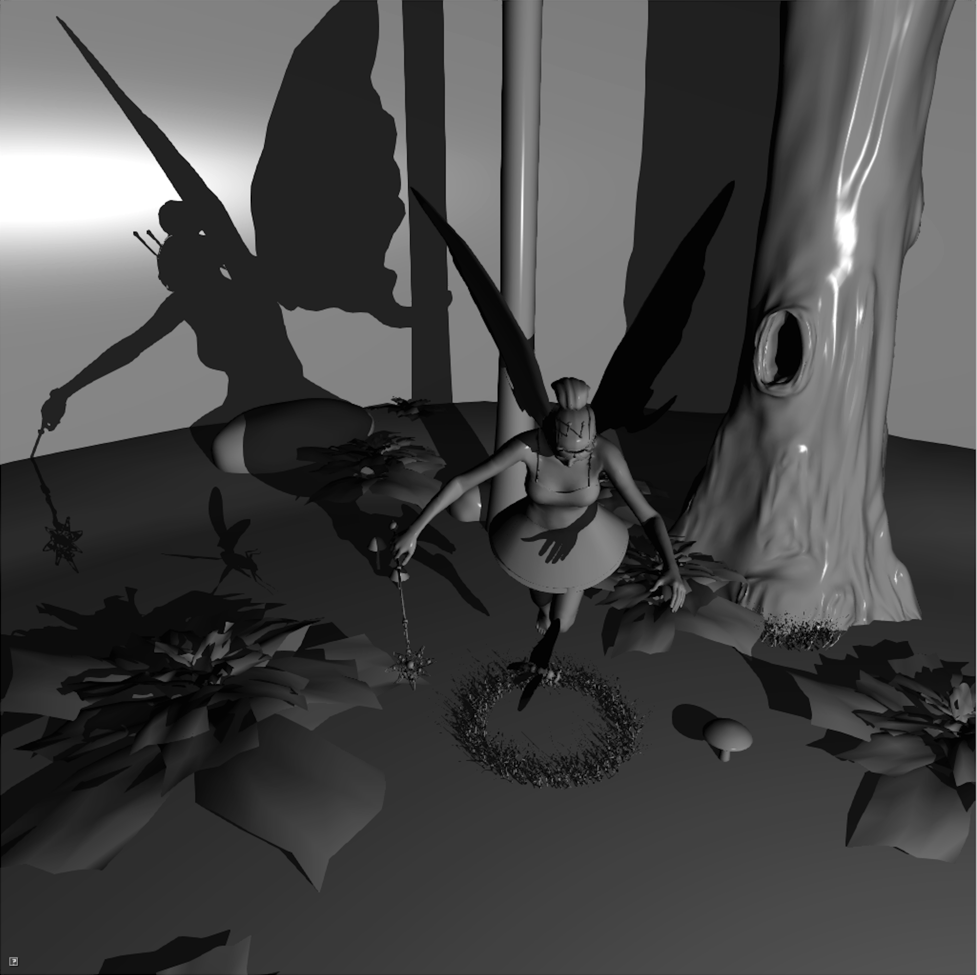
Results > Tests and comparison
Building (ms) Shading (ms) PSV time (ms) | 20 K 0.18 1.85 2.03 | 69 K 0.4 1.85 2.05 | 174 k 1.24 2.09 4.14
Notes:
This slide presents the 3 first models. The PVS time is the average time per frame.
And the building and shading times give the timings for building a TOP tree and shading fragments.
Building the TOP tree is very fast and always faster than the shading step.

Slide 79
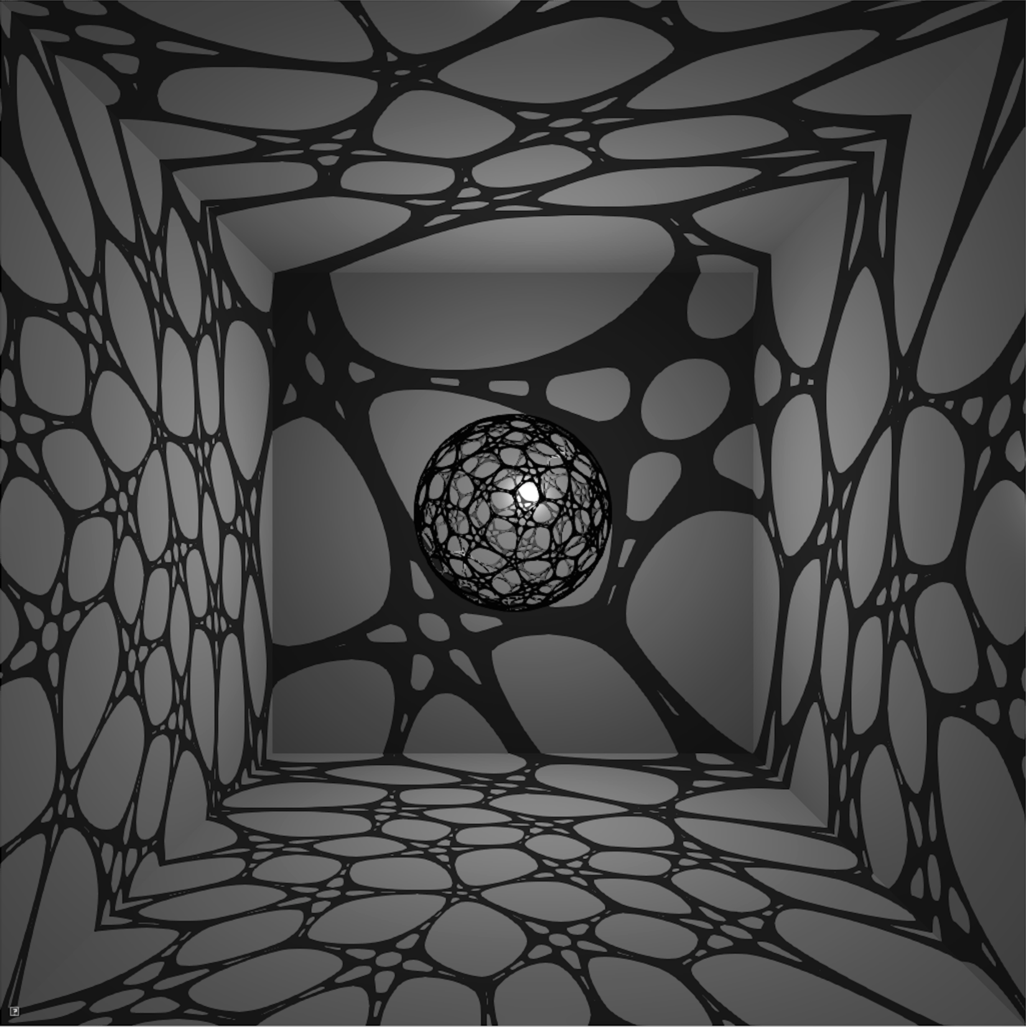
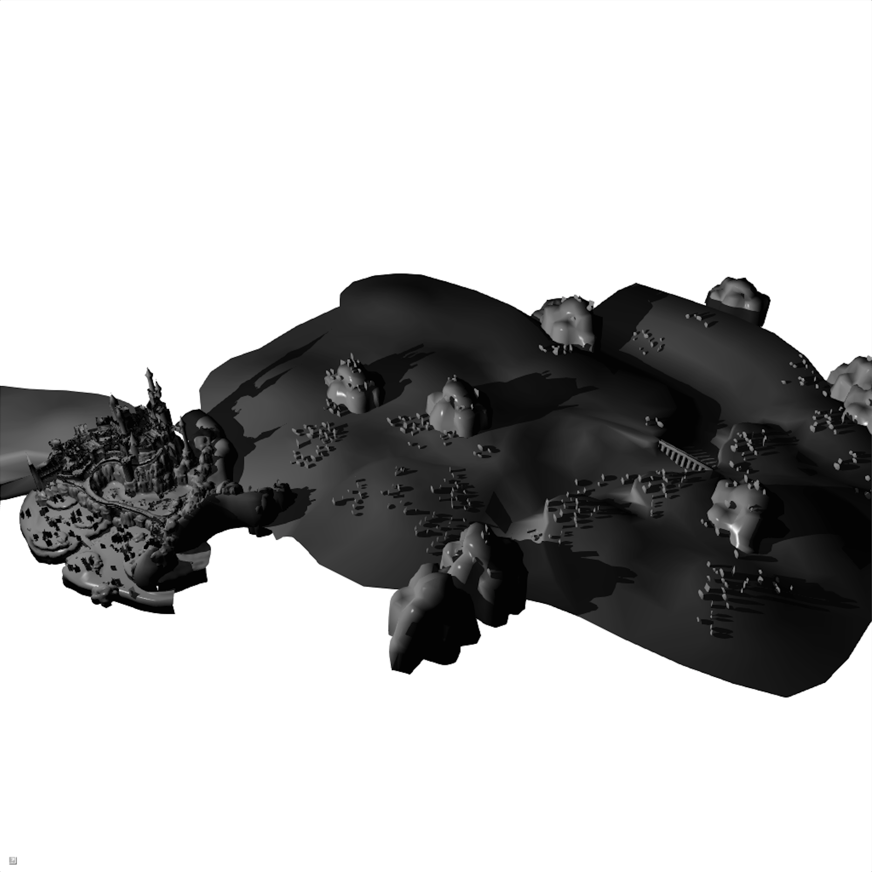
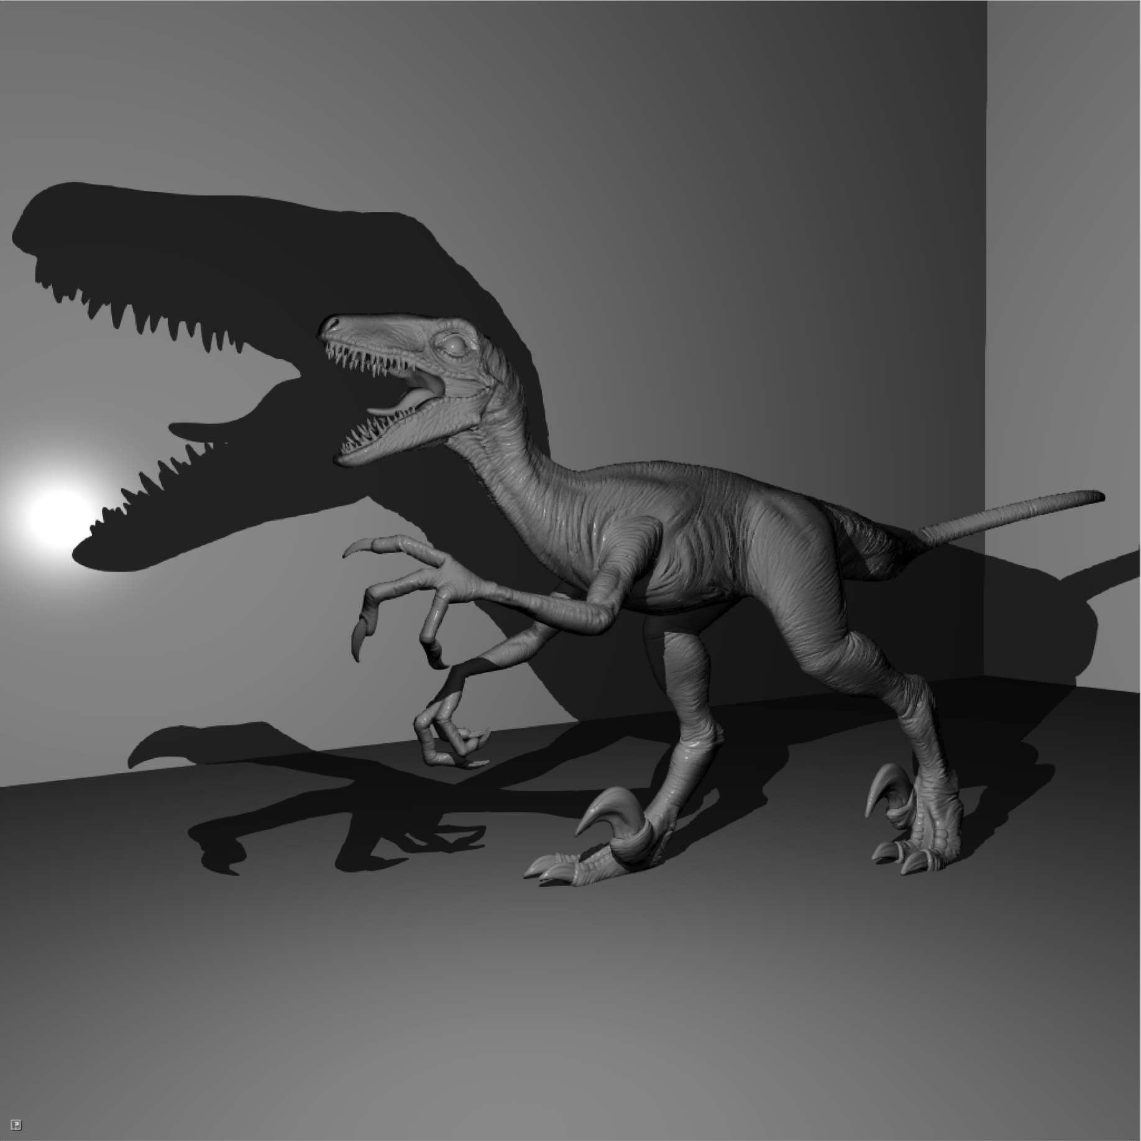
Results > Tests and comparison
Building (ms) Shading (ms) PSV time (ms) | 200 K 1.04 1.23 2.27 | 360k 3.0 6.4 9.4 | 1000K 5.81 3.15 8.96
Notes:
This is still the case on bigger model such as Citadel in the middle.
The building step becomes more expensive only with Raptor on the right, which is a highly tesselated model made of one million of triangles.
Obviously, our method behaviour also depends on the shadow complexity in the scene.

Slide 80
Results > Tests and comparison
Complexity in practice
Test:
6 decimated Raptors
Fixed shadow complexity
Increasing geometric complexity
Building: O(n log(n))
Shading: O(log(n))
Notes:
Thus, to properly analyse the practical complexity, we created six decimated Raptors from one hundred thousand triangles to one million triangles.
The dashed line on the graph corresponds to the building time, and the solid line corresponds to the shading time.
This test confirms the expected complexities discussed before.

Slide 81
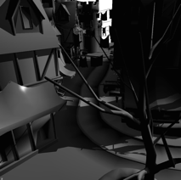
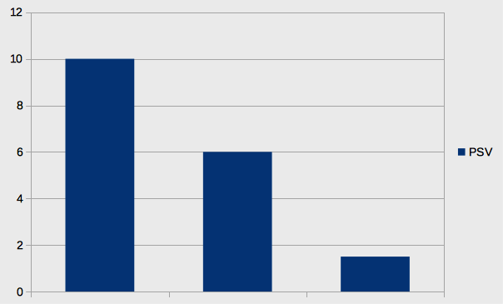
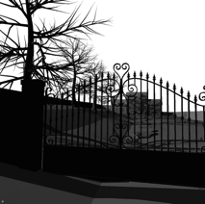
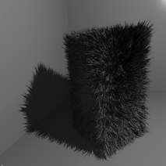
Results > Tests and comparison
Indirect comparison with [Sintorn2014]
Test:
Same hardware: GTX 780
Same models and data (shared by Erik Sintorn)
Speed:
We are slower!
Difference decreases as #triangles increases
[Sintorn2014] scales linearly
PSV scales logarithmically
Memory:
[Sintorn2014]: 33 to 58 MB
PSV: 7.3 to 48.8 MB
Slow down factor
60K 88K 400K Triangles
Notes:
We also made an indirect comparison with the technique presented last year by Erik Sintorn: Per Triangle Shadow Volumes.
To date, It can be considered as the fastest shadow volumes method and it is also faster than our Partitioned Shadow Volumes approach.
However the difference in efficiency decreases as the number of triangles increases.
This is because our approach scales logarithmically while the others scales linearly.
If we have a look at the memory, PSV has a little advantage.

Slide 82
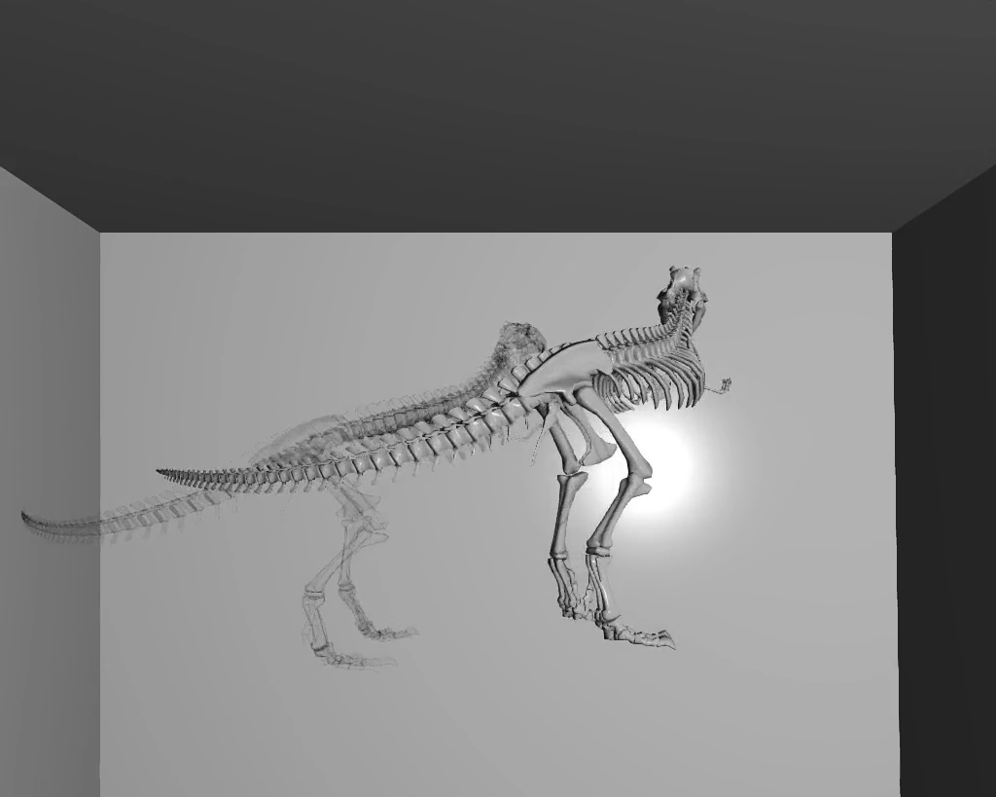
Results > Tests and comparison
X-ray shadows (Order Ind. Transparency)
Algorithms: Slight changes
Support for material properties
all details in the paper
OS: Linux
Hardware: NVIDIA GTX 980, 1024 1024
Front face culling: OFF
+
Notes:
With minor modifications, PSV supports transparency.
To demonstrate this we render x-ray shadows, as if all the models were transparent
Of course front face culling is turned off in this case, and all the triangles are merged in the TOP tree.

Slide 83
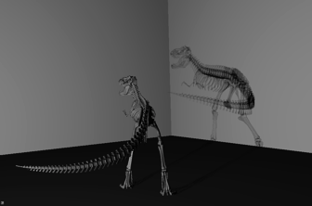
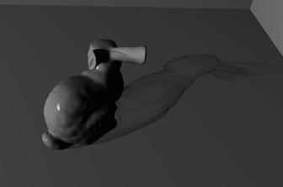
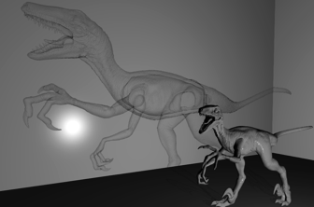
Results > Tests and comparison
Building (ms) Shading (ms) PSV time (ms) | 20 K 0.30 3.09 3.39 | 69k 0.72 2.95 3.67 | 1000K 15.78 18.12 33.90
Notes:
This increases the building step by a factor two.
Shading is also more expensive. Not only more nodes are visited, but this needs to use a bigger stack of sixty four integers instead of thirty two. This has a cost. However PSV remains real time and fast on models of moderate size.

Slide 84
Outlines >
Introducing TOP Tree
Partitioned Shadow Volumes
Results
Conclusion and perspectives
Notes:
To conclude…

Slide 85
Conclusion and perspectives
Starting point:
The old SVBSP algorithm [Chin89]
Previously left aside because of its drawbacks
Key point:
Ternary Object Partitioning tree
Fixed memory footprint, building O(n log(n)), shading O(log(n))
End point:
Partitioned Shadow Volumes
Robust, inherits from TOP tree properties
Notes:
I will recall the starting point of this work: the old SVBSP algorithm.
This kind of approach was left aside because of its drawbacks.
But thanks to our new partitioning strategy, we have shown that it is worth exploring.

Slide 86
Conclusion and perspectives
Not the fastest ever but:
Fast, clearly real-time, with interesting algorithmic complexities
Quite straightforward implementation
Perspectives:
Combination with any shadow casters culling technique
TOP tree may be useful for other partitioning problems
Want to test ?
Compute and fragment shaders available for download:
https://github.com/PSVcode/EG2015
Notes:
PSV is not the fastest shadow volume technique, but it is fast and it has interesting complexities.
In addition it is quite easy to implement
And it can probably be improved again.
For example it could benefit from any shadow casters culling technique.
PSV aside, we also think that TOP tree may be usefull for other partitoning problems.
This is the end of my talk, but if you want to play with PSV, our shaders are available for downloads.

Slide 87
Thank you !
Questions?
https://github.com/PSVcode/EG2015
Notes:
Thank you for your attention

Slide 88
Very bad (but rare) case
Specific geometric configuration
And specific light position
https://github.com/PSVcode/EG2015
Notes:
Thank you for your attention

