Slide 1



EGSR 2016
27th Symposium on Rendering
Deep Partitioned Shadow Volumes
Using Stackless and Hybrid Traversals
Frédéric Mora, Julien Gerhards, Lilian Aveneau, Djamchid Ghazanfarpour
University of Limoges, University of Poitiers - France
Xlim UMR CNRS 7252

Slide 2
Motivations
Real-time shadows
  Shadow mapping
    Fast, simple
    Accuracy (resolution, grazing, self-shadows), directional light
  Shadow volume
    Accurate, isotropic light
    Complex, problems (silhouette, geometric dependent)
  Partitioned Shadow Volume
    Accurate, isotropic light
    Stack, new method (EG 2015)
Analyse PSV, propose a new stackless method

Slide 3
PSV > overview
Triangles soup
+
Light position
TOP Tree
Image points
(Z-buffer)
GPU MEM
Building step
Top tree construction in a Compute Shader
Shading step
Point location in the TOP tree using a Fragment Shader
(output: lighted / in shadow)
SHADERS

Slide 4
PSV > TOP Tree
Ternary Object Partitioning: nodes have 3 children
One shadow volume 4 TOP tree nodes

Slide 5
PSV > TOP Tree
Ternary Object Partitioning: nodes have 3 children
One shadow volume 4 TOP tree nodes
+
-
∩

Slide 6
PSV > TOP Tree
Ternary Object Partitioning: nodes have 3 children
One shadow volume 4 TOP tree nodes
+
∩
+
-
∩

Slide 7
PSV > TOP Tree
Ternary Object Partitioning: nodes have 3 children
One shadow volume 4 TOP tree nodes
+
∩
+
∩
+
∩
-
+
∩

Slide 8
PSV > overview
Triangles soup
+
Light position
TOP Tree
Image points
(Z-buffer)
GPU MEM
Building step
Top tree construction in a Compute Shader
Shading step
Point location in the TOP tree using a Fragment Shader
(output: lighted / in shadow)
SHADERS

Slide 9
PSV > TOP tree building
Insert a first triangle
1
2
3
3
1
2

Slide 10
PSV > TOP tree building
Insert a second triangle
1
2
3
1
2
3

Slide 11
PSV > TOP tree building
Insert a third triangle
1
2
3
1
2
3
1
2
3

Slide 12
PSV > TOP tree building
Insert a fourth triangle
1
2
3
1
2
3
1
2
1
3
2
3

Slide 13
PSV > TOP tree building
No triangle splitting!
No numerical errors
  Accurate method
Number of nodes: 4 times triangles’ number
  Can be allocated once
Allow parallel building with only few locks
  Fast building on GPU

Slide 14
PSV > overview
Triangles soup
+
Light position
TOP Tree
Image points
(Z-buffer)
GPU MEM
Building step
Top tree construction in a Compute Shader
Shading step
Point location in the TOP tree using a Fragment Shader
(output: lighted / in shadow)
SHADERS

Slide 15
PSV query > point in shadow
1
2
3
1
2
3
1
2
1
3
2
3

Slide 16
PSV query > point in shadow
1
PUSH
1
PUSH
1
2
3
1
SHADOW
2
3
1
2
1
3
2
3

Slide 17
PSV query > lighted point
1
PUSH
1
PUSH
1
2
3
1
2
3
1
1
POP
2
1
3
2
3

Slide 18
PSV query > lighted point
1
PUSH
1
PUSH
1
2
3
1
2
3
1
1
POP
2
1
3
1
POP
2
3

Slide 19
PSV query > lighted point
1
PUSH
1
PUSH
1
2
3
1
2
3
1
1
POP
2
1
3
1
POP
2
3
LIGHTED

Slide 20
PSV query > in short
Similar to point in a BSP
But need a stack to push the intersection nodes
Conclude as soon a point is located into a shadow volume
Clear the stack to decide it is lighted

Slide 21
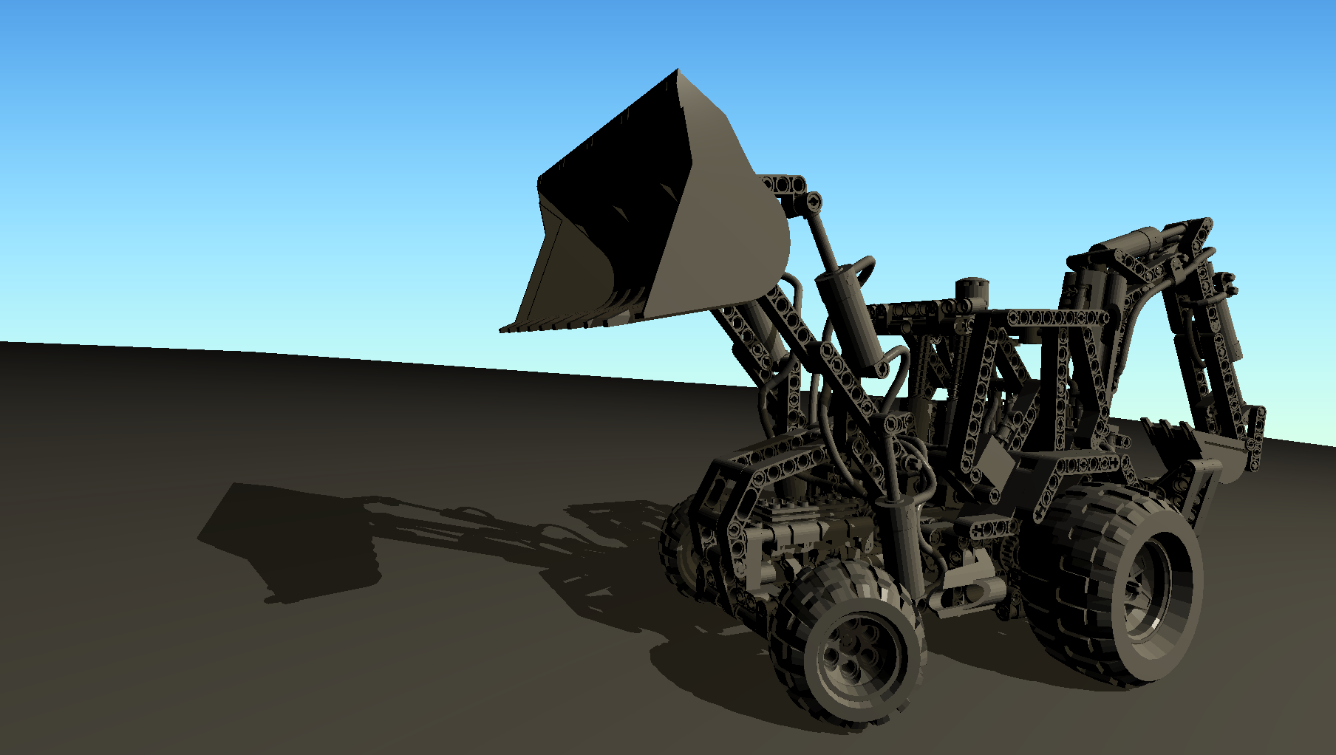
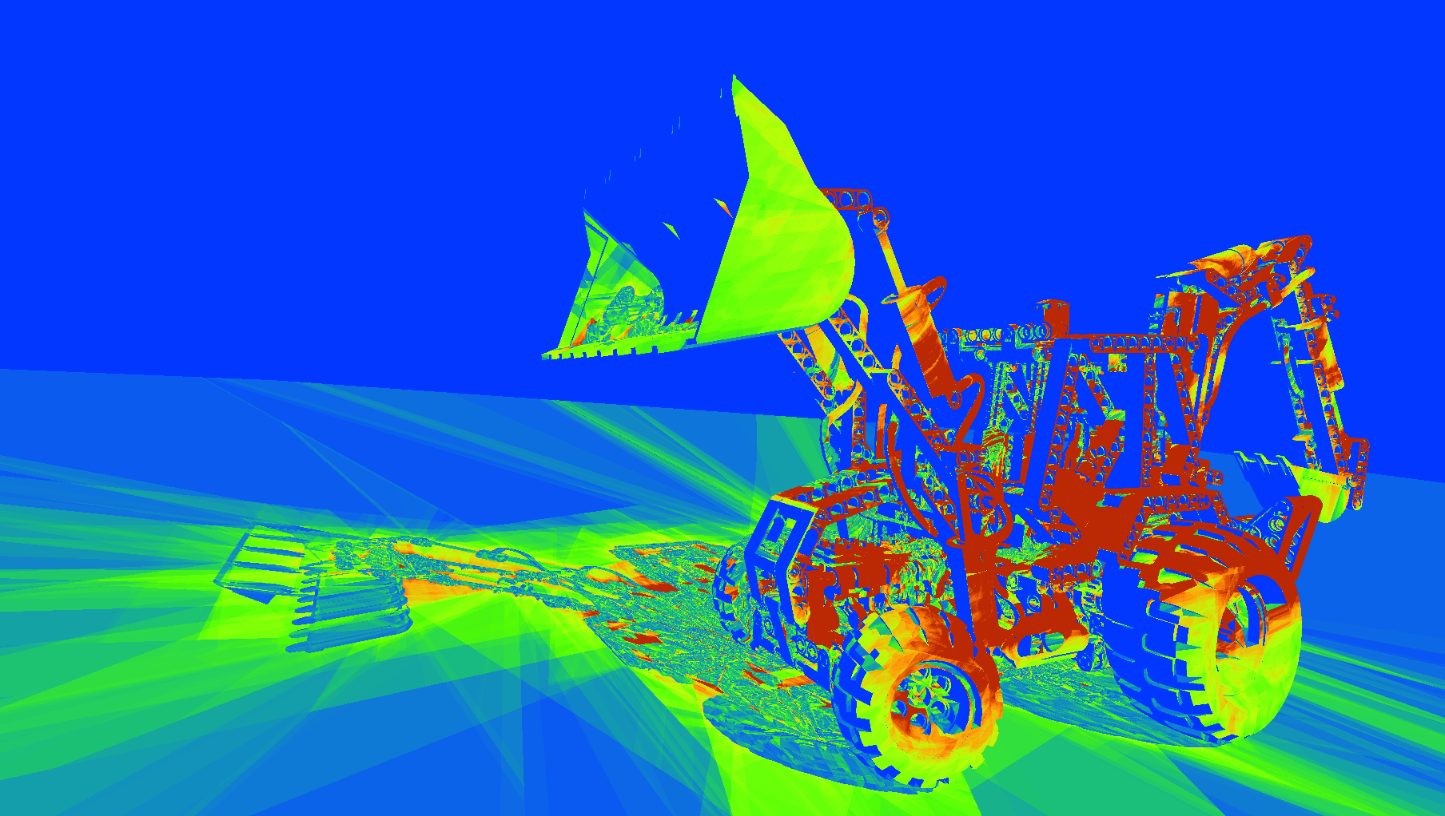
PSV > stack-based query analysis

Slide 22
PSV > stack-based query analysis

Slide 23
PSV > stack-based query analysis

Slide 24
PSV > Deep query
Behaviour
  Shadow: early exit, quite fast
  Lighted: need to clear out the stack, can be slow
Similar to computation logic
  Theorem: check all the negation
  Accelerate: add constraints
We add a depth constraint:
  Push intersection nodes only if they contain at least one triangle nearest from the light than the query point

Slide 25
PSV > Stack problem
TOP tree can have a large depth …
  We need a sufficiently large stack
How to predict the stack size?
  Too large: computation overhead
  Too small: errors, or lock
We propose a stackless query
  Each node contains a link to its nearest intersection ancestor ...

Slide 26
TOP tree > enable stackless query
New building algorithm
1
2
3
3
1
2

Slide 27
TOP tree > enable stackless query
ø
New building algorithm
1
2
3
3
1
2

Slide 28
TOP tree > enable stackless query
New building algorithm
1
ø
2
ø
3
ø
3
1
2

Slide 29
TOP tree > enable stackless query
1
ø
2
ø
3
ø
3
4
1
2
5
6

Slide 30
TOP tree > enable stackless query
1
ø
2
ø
3
ø
3
4
1
2
5
6

Slide 31
TOP tree > enable stackless query
1
ø
2
ø
3
ø
3
4
1
2
2
5
2
6
2

Slide 32
TOP tree > enable stackless query
1
ø
2
ø
3
ø
3
4
1
2
2
5
2
6
2
7
8
9

Slide 33
TOP tree > enable stackless query
1
ø
2
ø
3
ø
3
4
1
2
2
5
2
6
2
7
8
9

Slide 34
TOP tree > enable stackless query
1
ø
2
ø
3
ø
3
4
1
2
2
5
2
6
2
7
5
8
5
9
5

Slide 35
Stackless query >
New query algorithm: starts with intersection node
1
ø
2
ø
3
ø
3
4
1
2
2
5
2
6
2
7
5
8
5
9
5

Slide 36
Stackless query >
New query algorithm: starts with intersection node
1
ø
2
ø
3
ø
3
4
1
2
2
5
2
6
2
7
5
8
5
9
5

Slide 37
Stackless query >
New query algorithm: starts with intersection node
1
ø
2
ø
3
ø
3
4
1
2
2
5
2
6
2
5
7
JUMP TO
5
8
5
9
5

Slide 38
Stackless query >
New query algorithm: starts with intersection node
1
ø
2
ø
3
ø
3
4
1
2
2
5
2
6
2
5
7
JUMP TO
5
8
5
9
5

Slide 39
Stackless query >
New query algorithm: starts with intersection node
1
ø
2
ø
3
ø
3
2
4
JUMP TO
1
2
2
5
2
6
2
5
7
JUMP TO
5
8
5
9
5

Slide 40
Stackless query >
New query algorithm: starts with intersection node
1
ø
2
LIGHTED
ø
3
ø
3
2
4
JUMP TO
1
2
2
5
2
6
2
5
7
JUMP TO
5
8
5
9
5

Slide 41
PSV > Stackless solution
Stackless algorithm:
  Little modification of the building algorithm
  No extra memory needed
    Use wasted memory in previous method
  Compatible with depth constraint
Hybrid method:
  A small stack
  Swap to stackless query when stack is full

Slide 42
Results >
NVIDIA GTX 980 @ 1920 x 1080
Algorithms analysis
  Number of visited nodes per query
Performance analysis
  Time per frame using 2500 animation frames
More results in the paper !

Slide 43
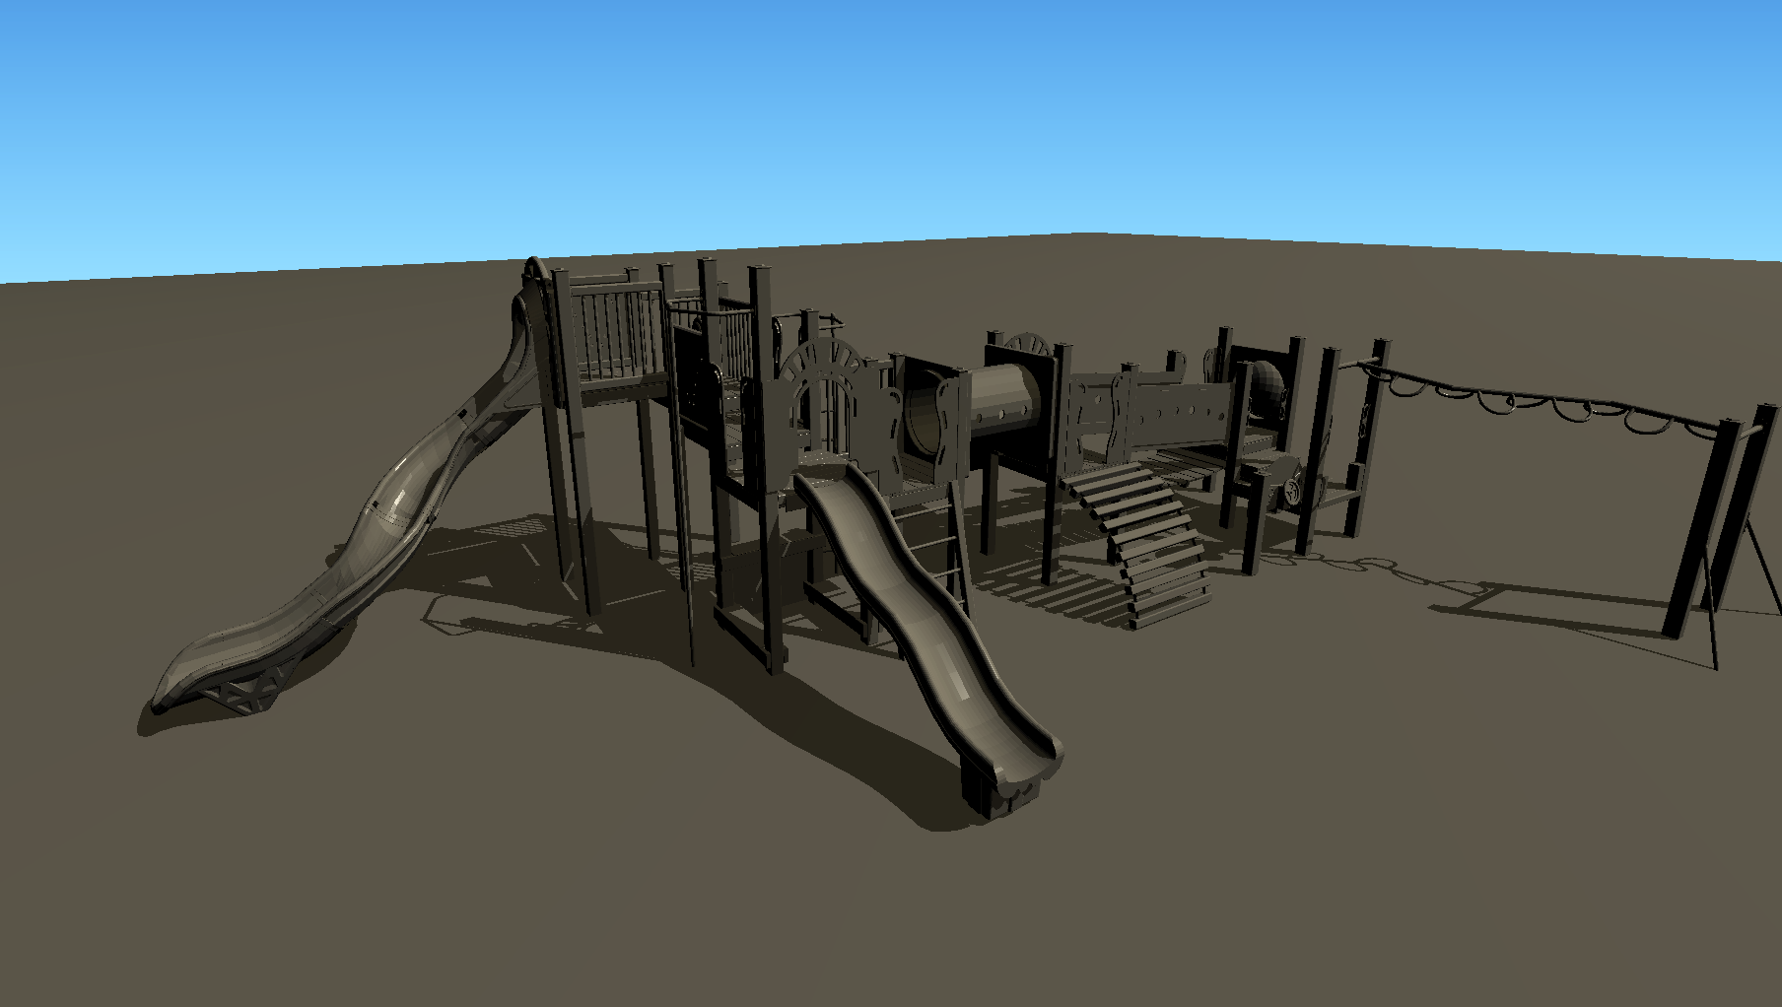
Results > Models
Playground > 131K triangles

Slide 44
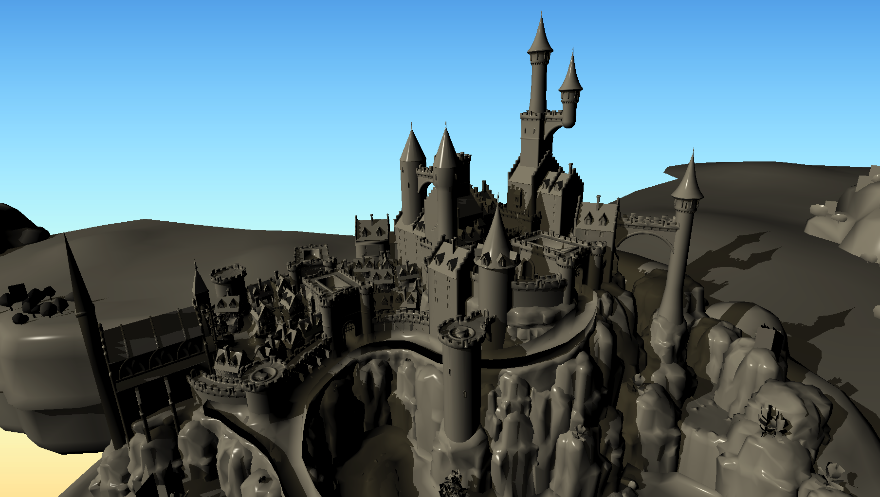
Results > Models
Epic Citadel > 393K triangles

Slide 45
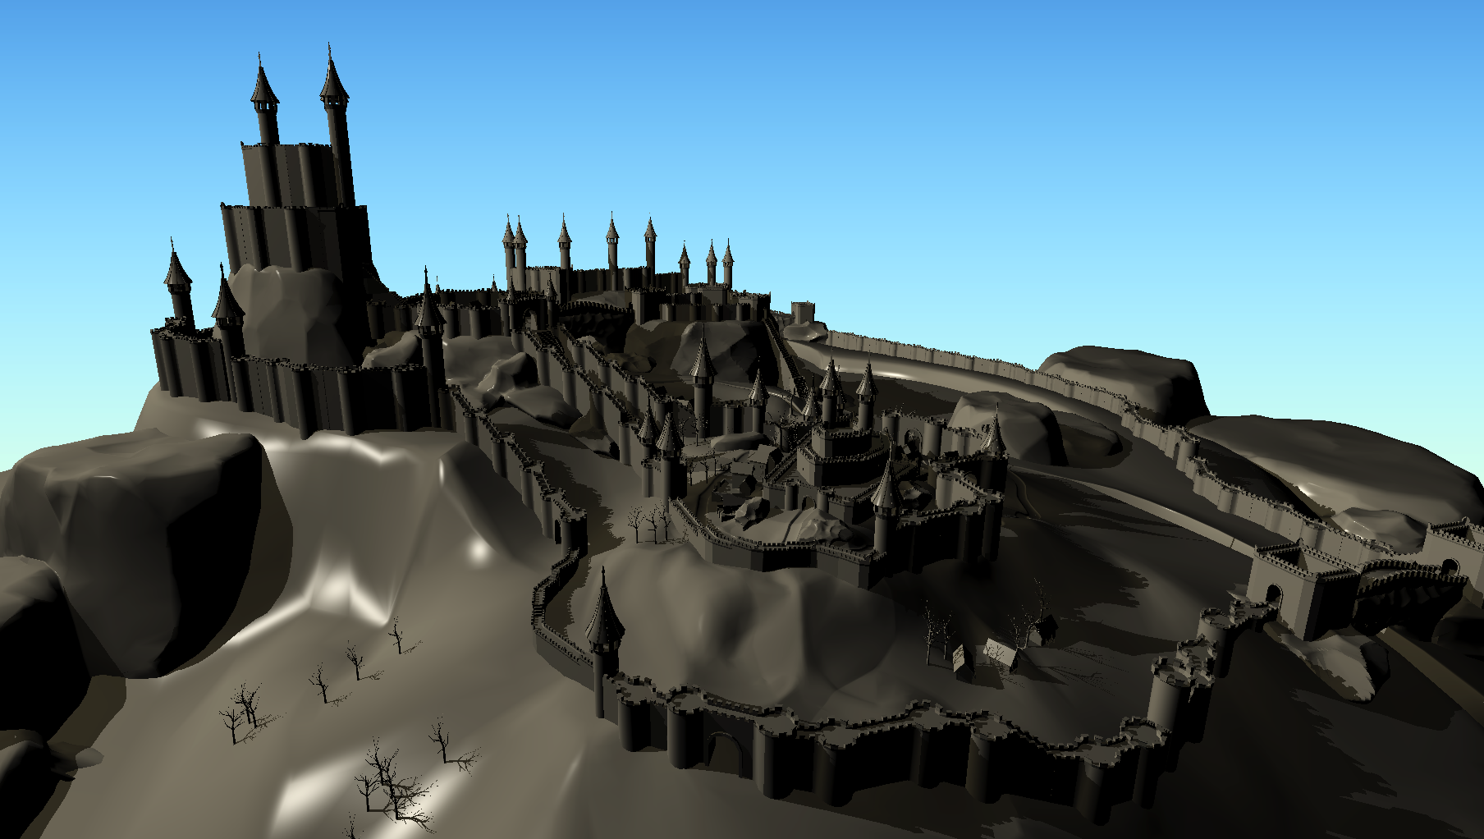
Results > Models
Closed City > 623K triangles

Slide 46
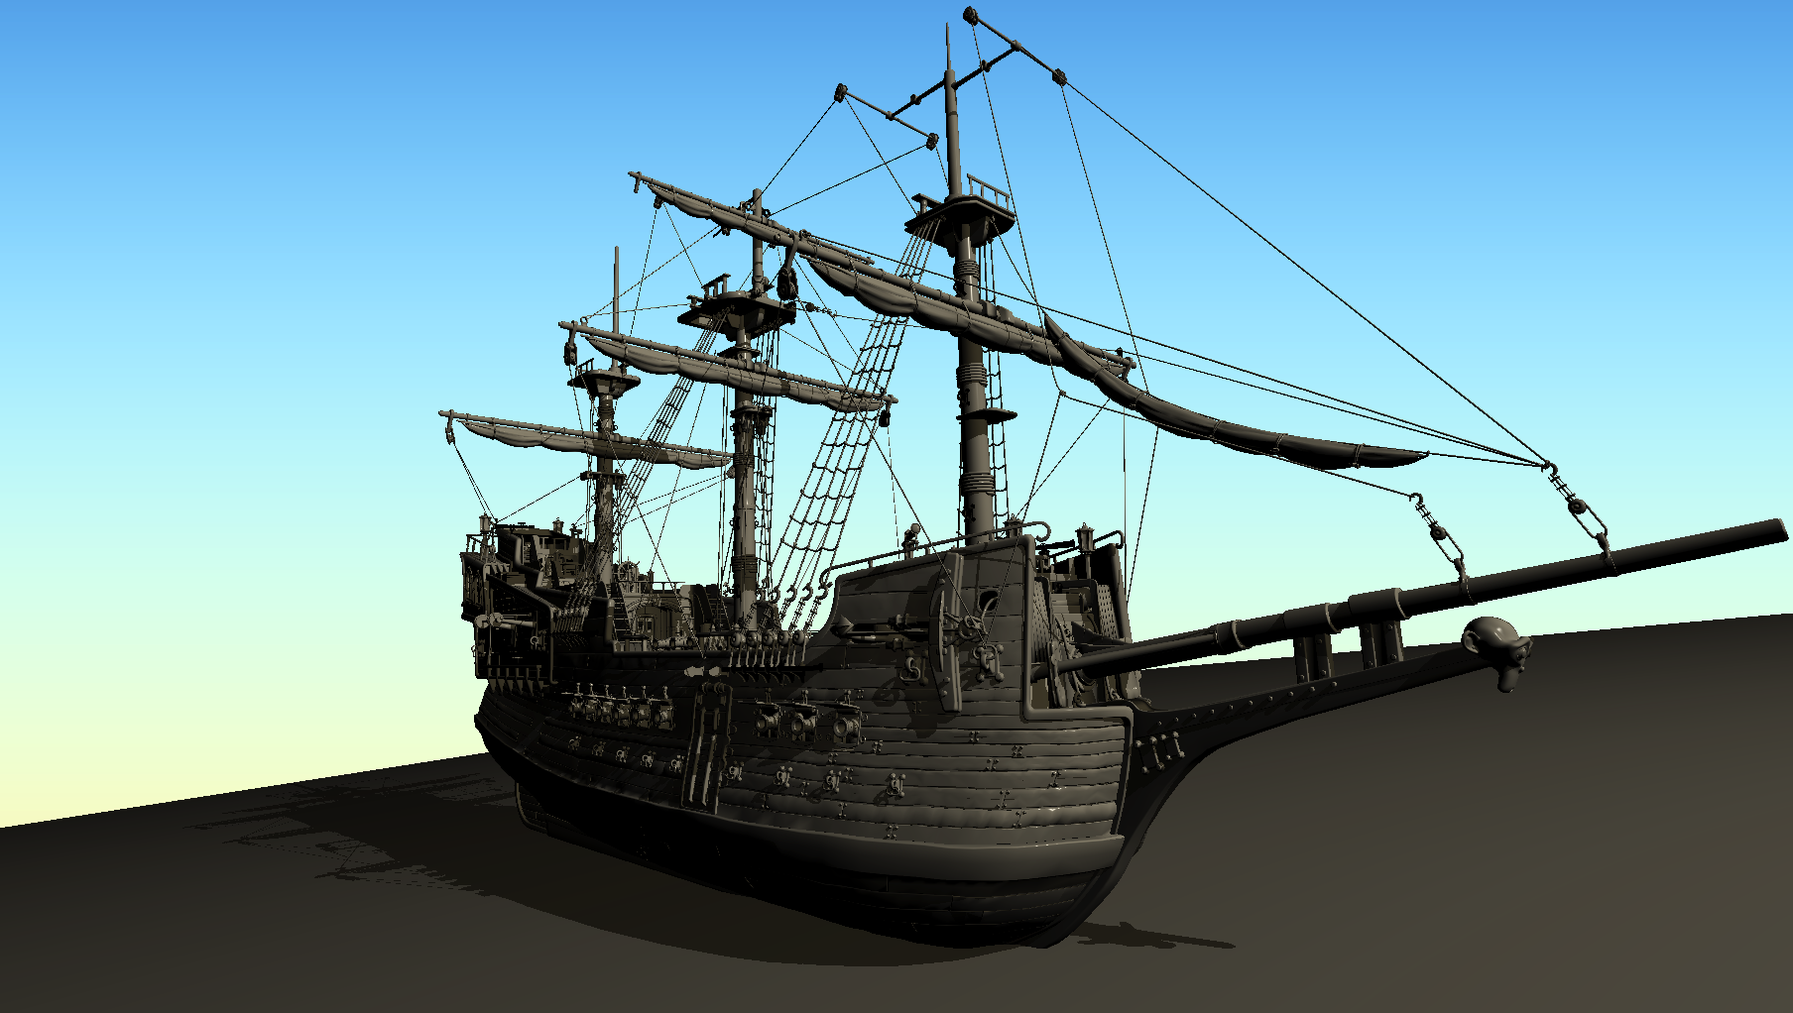
Results > Models
Ship > 956K triangles

Slide 47
Results > Models
Excavator> 1 130K triangles

Slide 48
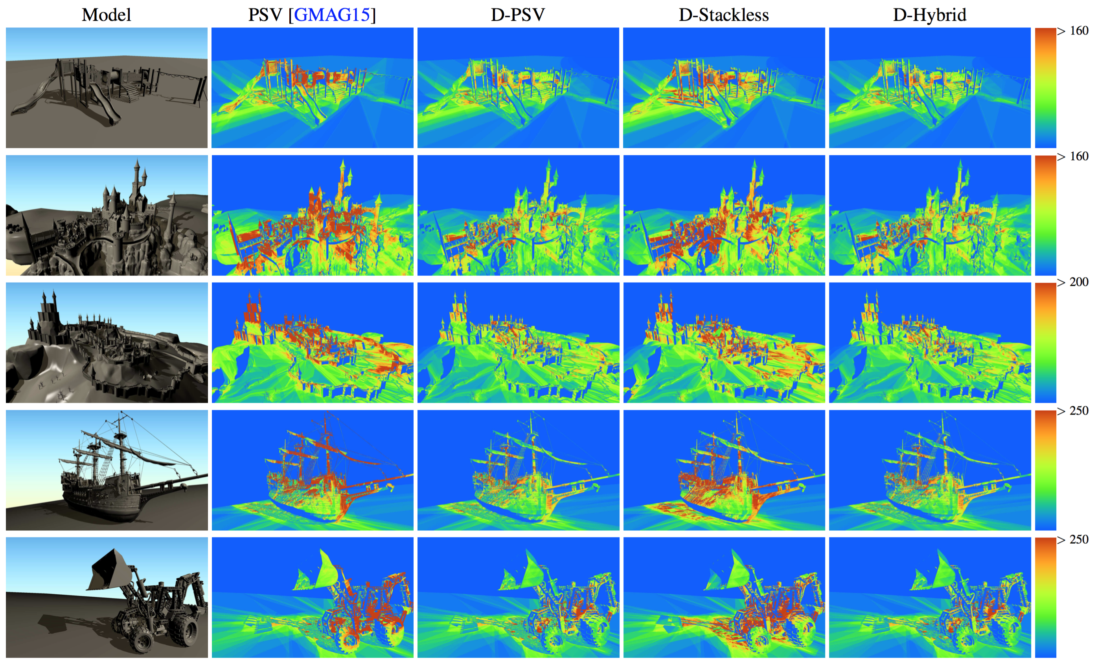
Results > Number of visited nodes
No depth test + Stack

Slide 49
Results > Number of visited nodes
Depth test + Stack

Slide 50
Results > Number of visited nodes
Depth test + Stackless

Slide 51
Results > Number of visited nodes
Depth test + Hybrid

Slide 52
Results > Number of visited nodes
Visited nodes
Stack/Stackless

Slide 53
Results > Number of visited nodes
Visited nodes
Stack/Stackless

Slide 54
Results > Number of visited nodes
Visited nodes
Stack/Stackless

Slide 55
Results > Number of visited nodes
Visited nodes
Stack/Stackless

Slide 56
Results > Timings (Excavator 1130k triangles)
Depth test allows to improve over PSV
D-PSV, D-Stackless, D-Hybrid have close performances
D-Hybrid is slightly more efficient
Z-PASS
PSV
D-PSV
D-Stackless
D-Hybrid

Slide 57
Results > Timings (Excavator 1130k triangles)
Stability: Query algorithms using depth test are also more stable
Z-PASS
PSV
D-PSV
D-Stackless
D-Hybrid

Slide 58
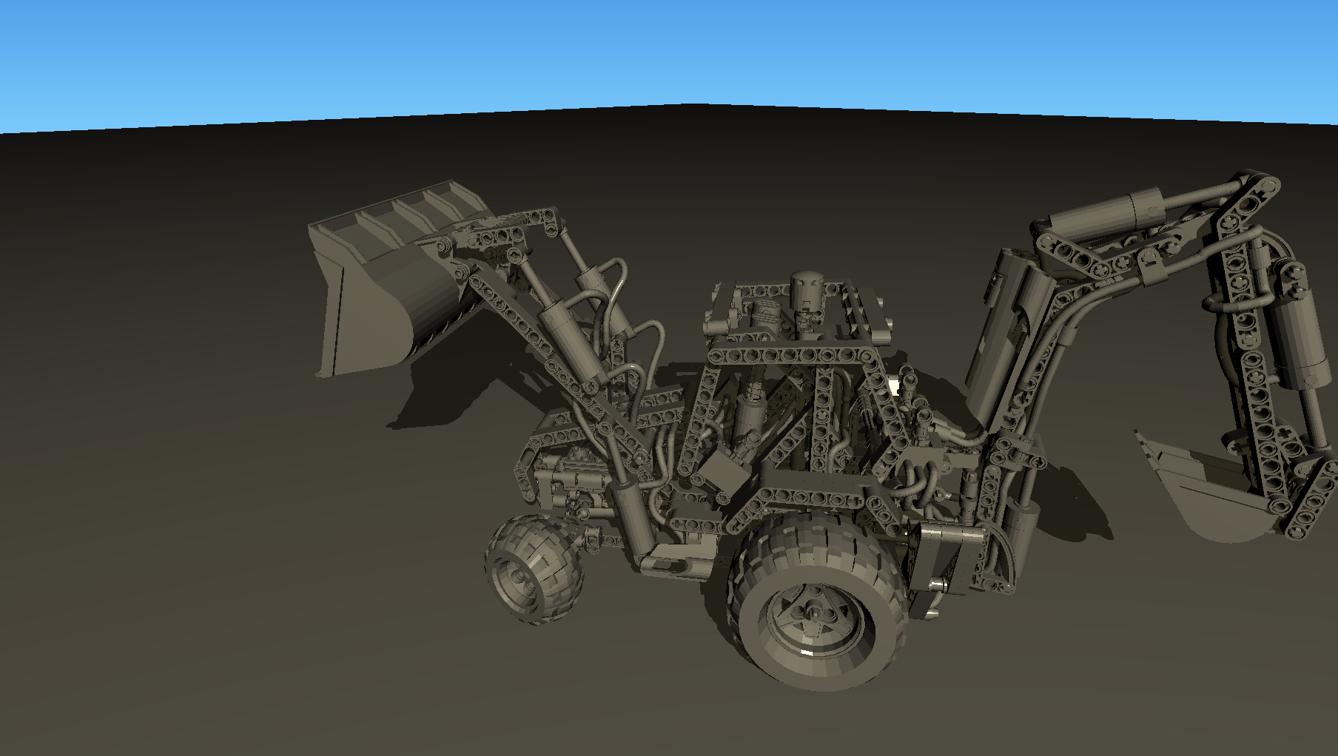
Results > Timings (Excavator 1130k triangles)
Focus: Z-PASS faster
Z-PASS
PSV
D-PSV
D-Stackless
D-Hybrid

Slide 59
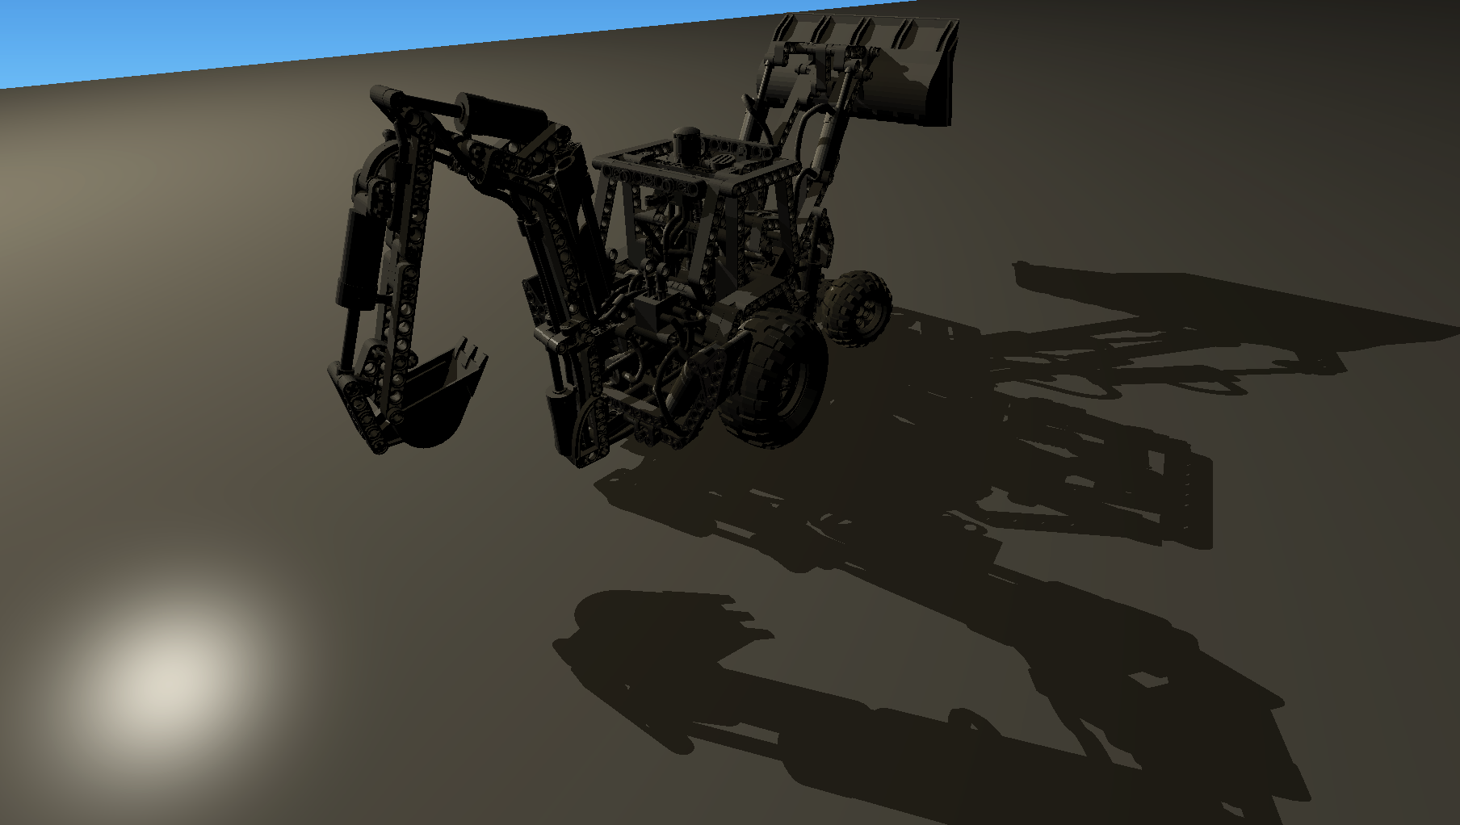
Results > Timings (Excavator 1130k triangles)
Focus: Z-PASS (much) slower
Z-PASS
PSV
D-PSV
D-Stackless
D-Hybrid

Slide 60
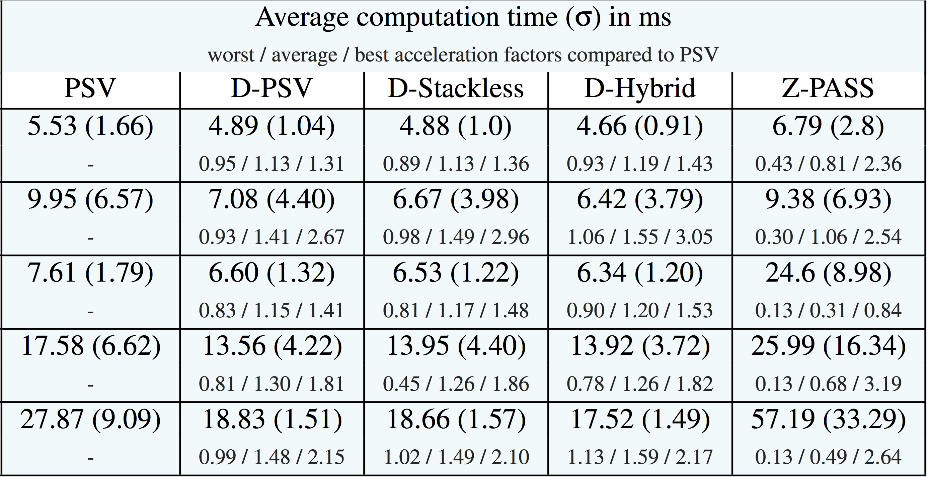
Results > Average computation times

Slide 61
Results > Average computation times
Z-PASS is slow, forget about it…

Slide 62
Results > Average computation times
Z-PASS is slow, forget about it…

Slide 63
Results > Average computation times
D-Hybrid is the best most of the times

Slide 64
Results > Average computation times
D-Hybrid is more stable

Slide 65
Conclusions
PSV analysis
  Slow for some lighted query points
  Stack size difficult to predict
Two enhancements
  Depth constraint
  Stackless query
Results show Hybrid request is a good solution
  Small timings variation
Introduce constraints into the building step?
https://github.com/PSVcode/EGSR2016

